Slide 1

"Once? No. Twenty times? Sure!" Uncertainty and precommitment in repeated choice
David J. Hardisty, Amir Sepehri, Poonam Arora
UBC Sauder , Western Ivey, Manhattan College
Funding support from NSF and SSHRC
Society for Consumer Psychology
March, 2020
Notes:
Images from unsplash.com

Slide 2



Slide 3
Major revision
Paper has split in two and now has a different theory (sorry Stephen!)
Main finding is robust but process is unclear
Criticisms and suggestions welcome

Slide 4
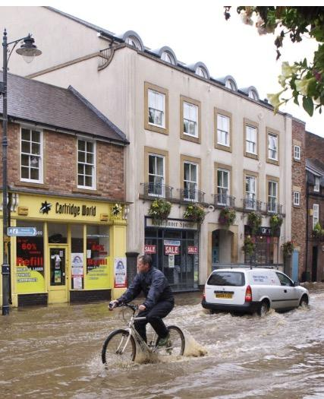

Decision Making with Rare Events
Poor decision making with low probability events:
Data backup
Extreme weather events (e.g., earthquake, flood)
Nighttime visibility
Notes:
Image from unsplash.com
Flood image from: https://upload.wikimedia.org/wikipedia/commons/3/36/Urban_flood_cropped.jpg CC BY-SA 2.0

Slide 5
Research Motivation
Normally, greater delay is associated with increased uncertainty
example: $10 promised today or in a year
However, with repeated low probability events, increasing time horizon may increase subjective probability
Example (choice bracketing):
Wear your seatbelt? Chance of injury this time vs lifetime (Slovic, Fischhoff, & Lichtenstein, 1978)
Notes:
when the likelihood of being killed or injured during a single trip (~.00000025 probability of being killed, and .00001 of being injured) was communicated to individuals, it did not worry them too much. However, when the lifetime risk of death (~.01) or injury (.33) was presented to individuals, they were more likely to use seatbelts (Slovic, Fischhoff, & Lichtenstein, 1978).

Slide 6
How to nudge people to think long-term?
People sometimes precommit to invest in protection for several time periods in advance
examples:
Binding commitments: long-term insurance contracts
Non-binding commitments: safety decisions (seat-belt, helmet, etc)
Social dilemmas: CO² reductions

Slide 7
Why Precommitment?
Choice Bracketing
Slovic et al. 1978
Read et al. 1999
Scale Design as a Choice Architecture Tool
Camilleri & Larrick, 2014
Description vs. Experience of Risk
Precommitment
Hertwig, Barron, Weber, & Erev, 2004
Integrating losses
Kahneman & Tversky, 1979
Intertemporal Uncertainty Avoidance
Hardisty & Pfeffer, 2017

Slide 8
Theory 1: Subjective Probability
Time horizon
+
Subjective probability
(of large loss)
+
+
Precommitment
+
Preference for safer option
Intuitively plausible
Not supported by any self-report measures
Not supported by some behavioral measures

Slide 9
Theory 2: Multiple Goals
One choice at a time → goal is to do well on that choice → disregard low probability events
Precommiting to multiple choices → goals to do well on each choice and to do well overall → upweight low probability events
Notes:
Another way to think about this is: mode goal (be correct frequently) vs mode goal + mean goal (be correct frequently and correct in aggregate)

Slide 10
Theory 2: Multiple Goals
Time horizon
+
Long-term goal
+
Upweight low probability events
+
+
Precommitment
+
Preference for safer option
Consistent with behavioral results
Too fuzzy
Currently collecting process data

Slide 11
Study 1
Question: Do individuals choose the safe option more often when they precommit their choices?

Slide 12
Design Overview
Participants (N=60 students) played 4 blocks of 20 rounds (“years”)
Between subjects: repeated vs precommited choice
DV: Choice to “invest” in protection (small, certain loss) or take a risk of a large loss
Full instructions & comprehension test
1 block paid out for real money

Slide 13
Instructions (pg 1)
Imagine you are an investor in Indonesia and you have a risky venture that earns 8,500 Rp per year. However, there is a small chance that you will suffer a loss of 40,000 Rp in a given year. You have the option to pay 1,400 Rp for a safety measure each year to protect against the possible loss. You will be fully protected if you invest in protection. The loss has an equal chance of happening each year, regardless of whether it occurred in the previous year.

Slide 14
Choice
INVEST | - You definitely lose 1,400 Rp, and have a 0% chance of the large loss occurring.
NOT INVEST | - You have a 4% chance of losing 40,000 Rp and a 96% chance of losing 0 Rp.
Notes:
Here’s the payoff matrix participants saw.

Slide 15
Choices: Repeated Condition
Will you invest in protection this year?
INVEST | NOT INVEST

Slide 16
Choices: Precommited Condition
Will you invest in protection in year 1?
INVEST | NOT INVEST
~~~~~~~~~~~~~~~~~~~~~~~~~~~~~~~~~~~~~~~~~~~~~~~~~~~~~~~~~~~~~~~~~~~~~~ Will you invest in protection in year 2?
INVEST | NOT INVEST
~~~~~~~~~~~~~~~~~~~~~~~~~~~~~~~~~~~~~~~~~~~~~~~~~~~~~~~~~~~~~~~~~~~~~~
Will you invest in protection in year 3?
INVEST | NOT INVEST
~~~~~~~~~~~~~~~~~~~~~~~~~~~~~~~~~~~~~~~~~~~~~~~~~~~~~~~~~~~~~~~~~~~~~~
Will you invest in protection in year 4?
INVEST | NOT INVEST
~~~~~~~~~~~~~~~~~~~~~~~~~~~~~~~~~~~~~~~~~~~~~~~~~~~~~~~~~~~~~~~~~~~~~~
Will you invest in protection in year 5?
INVEST | NOT INVEST
~~~~~~~~~~~~~~~~~~~~~~~~~~~~~~~~~~~~~~~~~~~~~~~~~~~~~~~~~~~~~~~~~~~~~~ [...]
Will you invest in protection in year 20?
INVEST | NOT INVEST

Slide 17
Feedback
Year 1 Results
Your choice: INVEST
The random number was: 88
This Means
The large loss: did not occur
Result: You lost 1,400 Rp.

Slide 18
Feedback
Year 2 Results
Your choice: NOT INVEST
The random number was: 3
This Means
The large loss: occurred
Result: You lost 40,000 Rp.

Slide 19
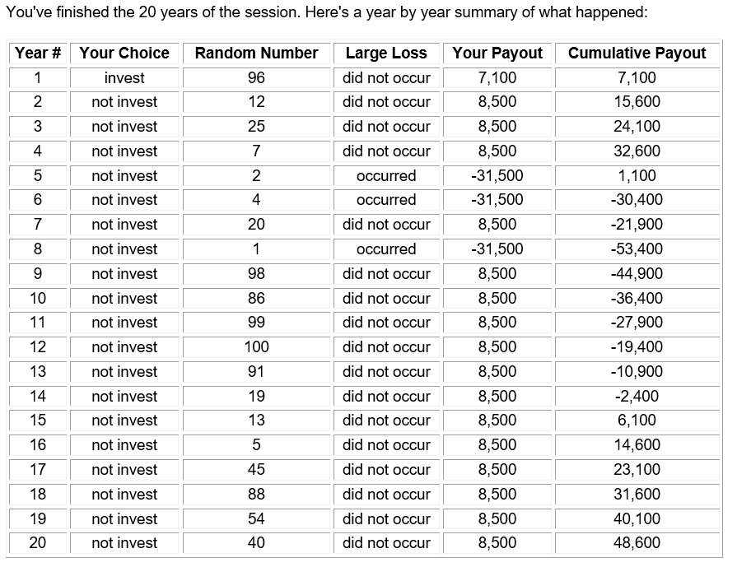

Slide 20
Study 1 Results
1
0.9
0.8
0.7
0.6
Investment Proportion
0.5
Repeated
0.4
Precommitted
0.3
0.2
0.1
0
Block 1
Block 2
Block 3
Block 4

Slide 21
Self-report Data
Across studies, self-report:
“the likelihood that a loss would occur at least once in 20 rounds” (___%)
How likely is the big loss? (1-7 scale)
How worried are you about the big loss? (1-7 scale)
Always null results!

Slide 22
Study 2
Question: How does a change in the Decision-Maker time horizon affect preferences in repeated and precommited choice?
Notes:
In this study, we experimentally manipulate the decision-making time horizon focus. This will provide further process evidence.

Slide 23
Study 2: Theory
If precommitment increases time horizon, then…
…experimentally increasing the time horizon should have the same effect
…and should wipe out the effect of precommitment

Slide 24
Study 2
N=567 Mturkers, hypothetical
Repeated vs Precommitted
Time horizon manipulation (vs no-instruction control):
“Think about all the 20 rounds of the game. What is the best strategy?”
“How many rounds out of 20 you think you should invest?”
Notes:
We also manipulated EV of the risky option, but I’m going to cut that here for time. The short version is that it has no effect if the risky option is superior on EV.

Slide 25
Study 2: Results

Slide 26
Study 2: Summary
Urging participants to think about “all” 20 rounds of the game:
Increased the choice of safe option in the repeated condition.
Did not have any effect in the precommitment condition.
Further supports the “increase in time-horizon” account.
Notes:
The aggregate focus manipulation did not have any effect on the precommitment condition, because precommitment had already increased the time-horizon in participants in that condition.

Slide 27
Study 3
Question: What if pre-commitment isn’t binding?
Notes:
Pre-commitment is not always feasible in real-world. People may precommit their choices but would want the liberty to change their choices later. Therefore, a non-binding precommitment condition may be an interesting situation to explore.

Slide 28
Study 3: Theory
If precommitment increases time horizon, then…
…non-binding precommitment should have the same effect

Slide 29
Study 3
N=210 MTurkers
Repeated vs Precommitted vs. non-binding precommitted
Key difference: Ability to change precommitted choices after each round
Notes:
We used the same solo game with three conditions. The repeated and precommited conditions were similar to previous studies. In the non-binding precommitment condition, participants precommitmed their choices for 20 rounds, but after each round was played, they were redirected to the choice page and could change their choices for the remaining rounds.

Slide 30
Study 3: Results
Notes:
The non-binding precommitment condition is as effective as the original precommitment. Even though this condition was essentially similar to the repeated condition in that participants could change their choices after each round, the mere fact that they precommit their choices at the beginning made them to invest more. This can provide us with some new insights on self-set defaults.

Slide 31
Study 3: Summary
Non-binding precommitment is roughly as effective as the binding precommitment.
Supports the time horizon story
Rules out “differences in feedback timing” as an explanation
Notes:
We show that having participants precommit their choices is enough to increase their DM time horizon and in turn the choice of the safe option, EVEN IF they can change their choices afterwards, pretty much similar to the repeated condition.
This finding, together with those of the previous study, show that having participants either precommit their choices or consider all the 20 rounds of the game, increases the choice of safe option, EVEN IF they are making their choices round-by-round or have the freedom to change them round-by-round.

Slide 32
Study 4: Methods
IV: Number of rounds in each block: 20 vs 10 vs 5
“Subjective Probability” Prediction: pre-commitment should be less effective with shorter blocks
“Multiple Goals” Prediction: block length doesn’t matter

Slide 33
Study 4: Results

Slide 34
Study 4: Summary
The effect of precommitment is equally strong for shorter vs longer block lengths
This contradicts the “subjective probability” theory
This is consistent with the “multiple goals” theory
Notes:
We argued that precommitment works through increasing the subjective probability of the big loss happening. In the gain frame, because people are risk-averse and are already not considering the risky option, precommitment does not have any effect. This further supports our subjective probability account.

Slide 35
Study 5: Methods & Theories
Probability education intervention: 4% chance of losing 40,000 (this means that there is a 56% chance of the 40,000 payment happening at least once during 20 months)
“Subjective Probability” Prediction: education should increase investment rates, and decrease the effect of precommitment
“Multiple Goals” Prediction: No effect

Slide 36
Study 5: Results
Notes:
A 2 (choice structure) by 2 (probability education) by 4 repeated (blocks) ANOVA with investment proportion in each block as the DV found a main effect of precommitment (M_{rep} = .35 vs M_{pre} = .54, F(1,276) = 29.62, p < .001), and a marginally significant effect of probability education (M_{control} = .41 vs M_{education} = .48, F(1,276) = 3.58, p =.06). The interaction of probability education and choice structure was not significant (F(1,276) = .11 , p = .74).

Slide 37
Study 5: Summary
Education slightly increases investment rates (replication of Slovic, Fischhoff, & Lichtenstein, 1978)
Precommitment has a larger effect, and is not changed by education
This suggests procommitment changes goals, rather than probability perceptions

Slide 38
Extension to Social Dilemmas?

Slide 39
Study 6: IDS
Interdependent Security (IDS) is a social dilemma with stochastic losses (Kunreuther & Heal, 2003)
disease control (COVID-19, anyone???)
border security
risky investments
People typically cooperate less in IDS than in a deterministic Prisoner’s Dilemma

Slide 40
IDS payoff matrix
 |  | Your Counterpart
 |  | INVEST | NOT INVEST
You | INVEST | - You definitely lose 1,400 Rp, and have a 0% chance of the large loss occurring. - Your counterpart definitely loses 1,400 Rp, and has a 0% chance of the large loss occurring. | - You definitely lose 1,400 Rp and have a 1% chance of losing an additional 40,000 Rp. - Your counterpart has a 3% chance of losing 40,000 Rp and a 97% chance of losing 0 Rp.
 | NOT INVEST | - You have a 3% chance of losing 40,000 Rp and a 97% chance of losing 0 Rp. - Your counterpart definitely loses 1,400 Rp and has a 1% chance of losing an additional 40,000 Rp. | - You have a 4% chance of losing 40,000 Rp and a 96% chance of losing 0 Rp. - Your counterpart has a 4% chance of losing 40,000 Rp and a 96% chance of losing 0 Rp.

Slide 41
PD payoff matrix
 |  | Your Counterpart
 |  | INVEST | NOT INVEST
You | INVEST | - You lose 1,400 Rp. - Your counterpart loses 1,400 Rp. | - You lose 1,800 Rp. - Your counterpart loses 1,200 Rp.
 | NOT INVEST | - You lose 1,200 Rp. - Your counterpart loses 1,800 Rp. | - You lose 1,600 Rp. - Your counterpart loses 1,600 Rp.

Slide 42
Study 6: Additional Design Details
N=120 students
Incentive compatible
4 blocks of 20 rounds each
Anonymous pairs
Randomly paired before each block

Slide 43
Study 6: Deterministic vs Stochastic Prisoners Dilemma

Slide 44
Study 7
Question: How does non-binding precommitment operate in Social dilemmas?

Slide 45
Study 7
Stochastic Prisoners’ dilemma (IDS)
N=160 paid pool participants (students)
IV: Repeated vs Precommitted vs. non-binding precommitted
1 block paid for real money

Slide 46
Study 7 payoff matrix
 |  | Your Counterpart
 |  | INVEST | NOT INVEST
You | INVEST | - You definitely lose 1,400 Rp, and have a 0% chance of the large loss occurring. - Your counterpart definitely loses 1,400 Rp, and has a 0% chance of the large loss occurring. | - You definitely lose 1,400 Rp and have a 1% chance of losing an additional 40,000 Rp. - Your counterpart has a 3% chance of losing 40,000 Rp and a 97% chance of losing 0 Rp.
 | NOT INVEST | - You have a 3% chance of losing 40,000 Rp and a 97% chance of losing 0 Rp. - Your counterpart definitely loses 1,400 Rp and has a 1% chance of losing an additional 40,000 Rp. | - You have a 4% chance of losing 40,000 Rp and a 96% chance of losing 0 Rp. - Your counterpart has a 4% chance of losing 40,000 Rp and a 96% chance of losing 0 Rp.

Slide 47
Study 7: Results

Slide 48
Study 7: Summary
Replication of precommitment effect in a stochastic social dilemma.
Non-binding precommitment is not as effective when there is a counterpart involved.

Slide 49
Conclusions
In repeated choice with large, low-probability losses, precommitment increases investment in protection
…because precommitment activates a long-term goal (?)
In interdependent security, precommitment increases cooperation
In regular prisoners dilemma, precommitment reduces cooperation

Slide 50
Thank You!

Slide 51
Extra Studies

Slide 52
Study S2
Question: How does a change in the actual probabilities of the large loss affect precommitment?

Slide 53
Study 2: Theory
If precommitment works by increasing subjective probability, then…
…explicit increases in probability (with EV constant) should have the same effect (and should wipe out the effect of precommitment)

Slide 54
Study 2
Modified Solo game, N=421 MTurkers
Slightly modified version with mining in the Known region (certain loss of 1,400 Rp) or the Unknown region (4% chance of a 40,000 Rp. loss)
Repeated vs Precommitted
Probability of the big loss (4% vs. 20% vs. 50%)
Expected value held constant

Slide 55
Study 2: Choice
KNOWN | - You definitely lose 1,400 Rp, and have a 0% chance of the large loss occurring.
UNKNOWN | - You have a 4% chance of losing 40,000 Rp and a 96% chance of losing 0 Rp.
Notes:
Here’s the payoff matrix participants saw.

Slide 56
Study 2: Choice
KNOWN | - You definitely lose 1,400 Rp, and have a 0% chance of the large loss occurring.
UNKNOWN | - You have a 20% chance of losing 8,000 Rp and a 80% chance of losing 0 Rp.
Notes:
Here’s the payoff matrix participants saw.

Slide 57
Study 2: Choice
KNOWN | - You definitely lose 1,400 Rp, and have a 0% chance of the large loss occurring.
UNKNOWN | - You have a 50% chance of losing 3,200 Rp and a 50% chance of losing 0 Rp.
Notes:
Here’s the payoff matrix participants saw.

Slide 58
Study 2: Results
Notes:
We replicate the effect of precommitment in our original solo game which was the 4% conditions. The pattern of results in the 20% and 50% conditions supports our subjective probability account. As the probability of the big loss increases, the effect of precommitment becomes weaker in the 20% condition, and becomes non-significant in the 50% condition.

Slide 59
Conclusion
Precommitment effect becomes weaker and eventually non-significant as the probability of big loss increases.
Why? Because when the probability is already high, there is little room for precommitment to increase the subjective likelihood of the big loss.

Slide 60
Study S5
Question: How does precommitment affect investment rates in a gain frame?
Notes:
Up to now, all the studies have investigated the effect of precommitment in a loss frame. It would be interesting to examine this effect in a gain frame.

Slide 61
Study 5: Theory
If precommitment increases time horizon and subjective probability, then…
…gains should show the opposite effect

Slide 62
Study 5
N=355 students (at UBC and Ivey!)
Incentive compatible
Repeated vs Precommitted
Loss vs Gain
(Also varied choice presentation format to be aggregated vs separated; this is null.)

Slide 63
Study 5: Loss Choice
KNOWN | - You definitely pay 1,400 Rp, and have a 0% chance of the large loss occurring.
UNKNOWN | - You have a 4% chance of paying 40,000 Rp and a 96% chance of paying 0 Rp.
Notes:
Here’s the payoff matrix participants saw.

Slide 64
Study 5: Gain Choice
KNOWN | - You definitely receive 1,400 Rp, and have a 0% chance of the gain loss occurring.
UNKNOWN | - You have a 4% chance of receiving 40,000 Rp and a 96% chance of receiving 0 Rp.
Notes:
Here’s the payoff matrix participants saw.

Slide 65
Study 5: Results

Slide 66
Study 5: Conclusion
The effect of precommitment on the attractiveness of a big “gain” is eliminated
For gains, most people are already risk averse, so precommitment has no effect
Notes:
We argued that precommitment works through increasing the subjective probability of the big loss happening. In the gain frame, because people are risk-averse and are already not considering the risky option, precommitment does not have any effect. This further supports our subjective probability account.

