Slide 1
The Value of Nothing:
Asymmetric Attention to Opportunity Costs Drives Intertemporal Decision Making
David J. Hardisty
University of British Columbia
Society for Consumer Psychology
February 2016
Notes:
Images from unsplash.com

Slide 2
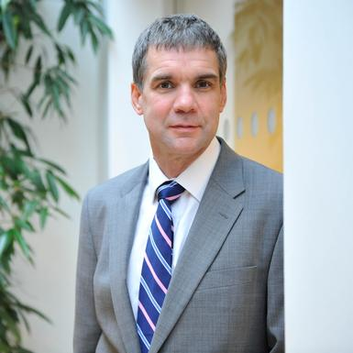

Co-Authors
Daniel Read
WBS
Christopher Olivola
CMU
Read, D., Olivola, C. Y., & Hardisty, D. J. (2016). The Value of Nothing: Asymmetric Attention to Opportunity Costs Drives Intertemporal Decision Making. Working paper.

Slide 3
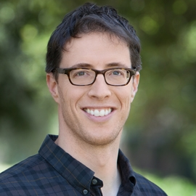


Consumer choices and opportunity costs
J Lev
But forego the bigger pension.
Jet Lev
But forego the JetLev.
SOME YEARS HENCE
NOW
Notes:
Image from unsplash.com
Consumer decision making concerns opportunity costs. People seek to attain the best possible distribution of their scarce resources.
Patience is the willingness to forego earlier opportunities to attain larger but later ones.
Choosing between JetLev now, and Pension plan some years hence.
All choices have this nature, because by definition taking something means giving up something else.
When making the choice of the JetLev you might not give sufficient weight to the future pension plan, and when making the pension plan choice you might not give sufficient weight to the JetLev.
Suppose that I nudge you by reminding you what you give up if you take the future pension plan.
And by reminding you what you give up by taking the JetLev.
The pension plan nudge should make the pension seem worse (or equivalently make the JetLev seem better). The JetLev nudge has a corresponding effect on the JetLev.
The ultimate result is indeterminate. So what will happen?

Slide 4
The “Hidden Zero” Effect
(Magen, Dweck & Gross; 2008)
Standard choices between smaller-sooner (SS) and larger-later (LL) rewards.
$100 now and $0 in one year
OR
$0 now and $150 in one year
Patience increased
Similar results by others (Loewenstein and Prelec 1991, 1993; Radu et al. 2011, Wu and He 2012, Read and Scholten 2012, and Magen et al. 2014)

Slide 5
Why does this happen?
$100 now and $0 in one year
OR
$0 now and $150 in one year
Opportunity cost?
Sequence effect?
Contrast or averaging effect?

Slide 6
Study 1: Conditions
Hidden zero:
$5.50 now
OR
$7.50 in 61 days
LL zero:
$5.50 now
OR
$0 in now and $7.50 in 61 days
SS zero:
$5.50 now and $0 in 61 days
OR
$7.50 in 61 days
Explicit zero (both LL and SS):
$5.50 now and $0 in 61 days
OR
$0 in now and $7.50 in 61 days

Slide 7
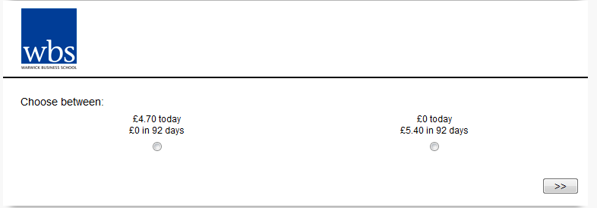
Study 1: Methods
610 participants recruited through Maximiles
15 hypothetical intertemporal choices
DV: proportion of LL choices (patience)

Slide 8
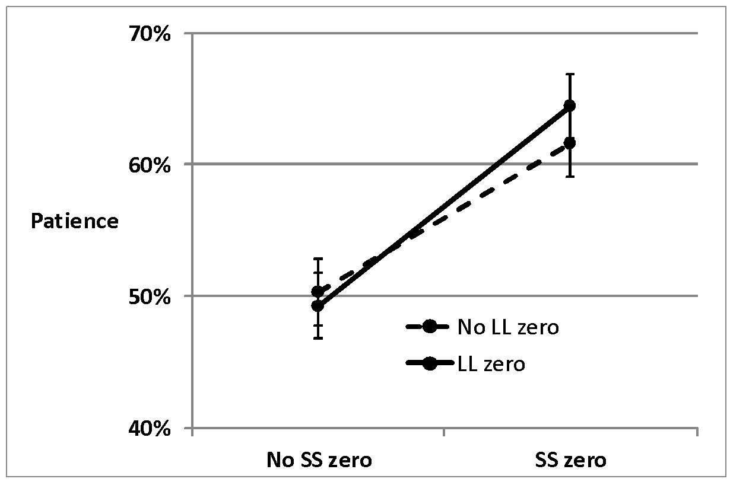
Study 1 Results
Notes:
Discount rates reduced from around 400% to around 250%

Slide 9
Study 1: Results
Hidden zero:
$5.50 now
OR
$7.50 in 61 days
LL zero:
$5.50 now
OR
$0 in now and $7.50 in 61 days
SS zero:
$5.50 now and $0 in 61 days
OR
$7.50 in 61 days
Explicit zero (both LL and SS):
$5.50 now and $0 in 61 days
OR
$0 in now and $7.50 in 61 days
SS zero does all the work
LL zero does NOTHING
Asymmetric opportunity cost? Sequences? Contrast?

Slide 10
Study 1: Conditions
Middle zero:
$5.50 now and $0 in 30 days
OR
$0 in 30 days and $7.50 in 61 days

Slide 11
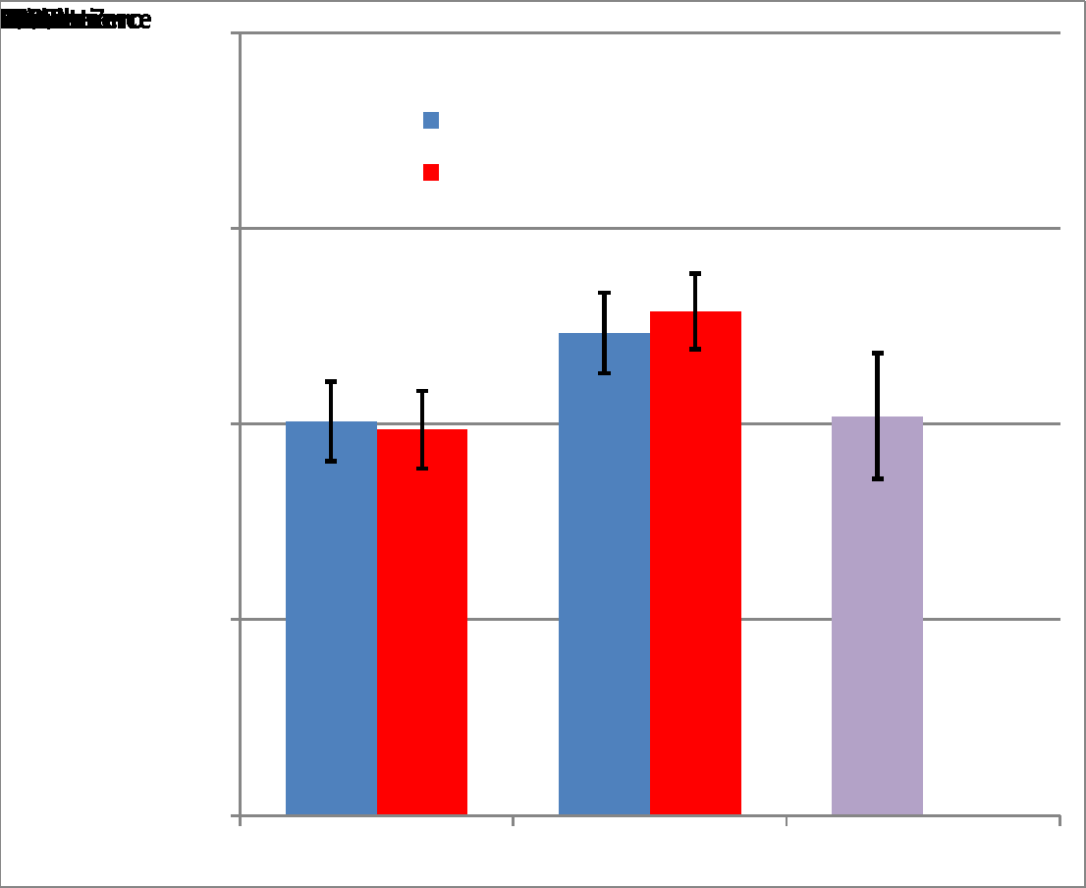
Study 1 Results
NO effect of
LL zero
SS zero does all the work.
NO effect of Middle zero
SS zero
Hid-
den
Ex-plicit
Middle
LL zero

Slide 12

Asymmetric Subjective
Opportunity Cost (ASOC)
Reminding people that they won’t get something now has no effect – they already know this.
But reminding them that if they won’t get something later – that is not so obvious.
Notes:
Image from unsplash.com

Slide 13
Moderating & Generalizing ASOC
Study 2: Magnitude
Study 3: “Now” effect
Study 4: Losses
Study 5: “Nothing”
Study 6: Real outcomes, RTs
Study 7: Separate reminder
Study 8: Other domains

Slide 14
Study 2: Magnitude
Items from Kirby, Petry, & Bickle (1999) :
Small: £25 today OR £30 in 80 days
Medium: £49 today OR £60 in 89 days
Large: £69 today OR £85 in 91 days
Prediction: Maybe our effect will get smaller at larger magnitudes

Slide 15
Study 2 Results
 | Magnitude
Zero Condition | Small | Medium | Large | N
Explicit | .53 | .58 | .61 | 58
SS zero | .54 | .60 | .61 | 55
LL zero | .42 | .48 | .49 | 50
Hidden | .40 | .43 | .48 | 47
ASOC effect | .13 | .14 | .13

Slide 16
Moderating & Generalizing ASOC
Study 2: Magnitude – robust!
Study 3: “Now” effect
Study 4: Losses
Study 5: “Nothing”
Study 6: Real outcomes, RTs
Study 7: Separate reminder
Study 8: Other domains

Slide 17
Study 3: “Now”
Perhaps there’s something special about “now”, driving the asymmetry
Today-SS:
£5.50 today and £0 in 61 days
OR
£0 today and £7.50 in 61 days
Delayed-SS:
£5.50 in 61 days and £0 in 122 days
OR
£0 in 61 days and £7.50 in 122 days
Prediction: maybe effect will disappear in delayed-SS condition (alternative is ASAP effect, Kable & Glimcher 2010)

Slide 18
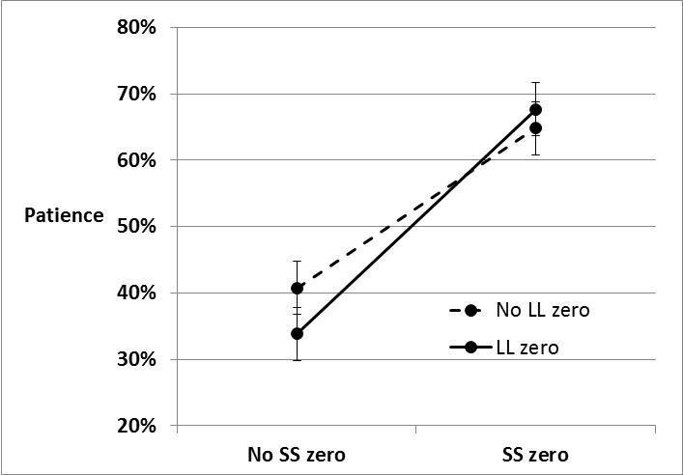
Study 3 Results: Today-SS

Slide 19
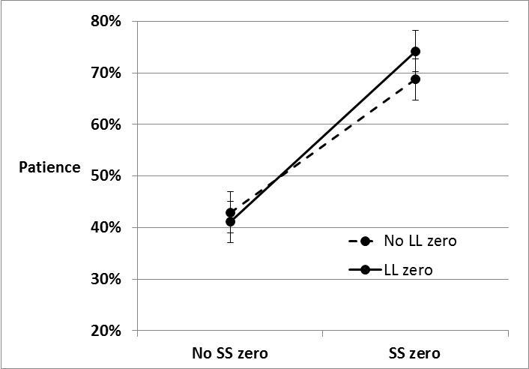
Study 3 Results: Delayed-SS

Slide 20
Moderating & Generalizing ASOC
Study 2: Magnitude – robust!
Study 3: “Now” effect – robust!
Study 4: Losses
Study 5: “Nothing”
Study 6: Real outcomes, RTs
Study 7: Separate reminder
Study 8: Other domains

Slide 21
Study 4: Losses
Losses eliminate or flip several intertemporal choice phenomena (Appelt, Hardisty, & Weber 2011; Hardisty, Appelt, & Weber 2013; Thaler 1981)
Receive:
£5.50 today and £0 in 61 days
OR
£0 today and £7.50 in 61 days
Pay:
£5.50 today and £0 in 61 days
OR
£0 today and £7.50 in 61 days

Slide 22
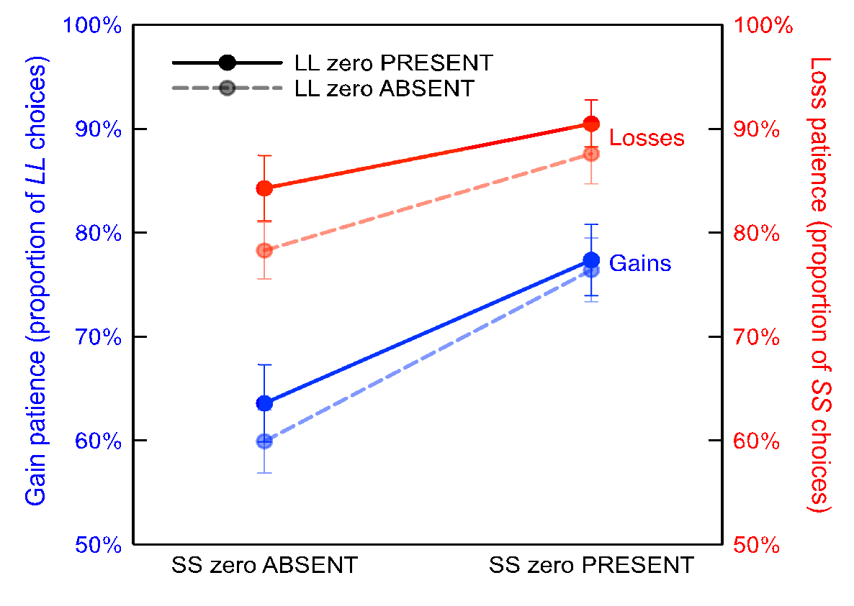
Study 4: Gains and Losses

Slide 23
Moderating & Generalizing ASOC
Study 2: Magnitude – robust!
Study 3: “Now” effect – robust!
Study 4: Losses – robust!
Study 5: “Nothing”
Study 6: Real outcomes, RTs
Study 7: Separate reminder
Study 8: Other domains

Slide 24
Study 5: “Nothing”
Literally a “£0” effect?
Receive £25 today and nothing in 29 days
OR
Receive nothing today and £35 in 29 days

Slide 25
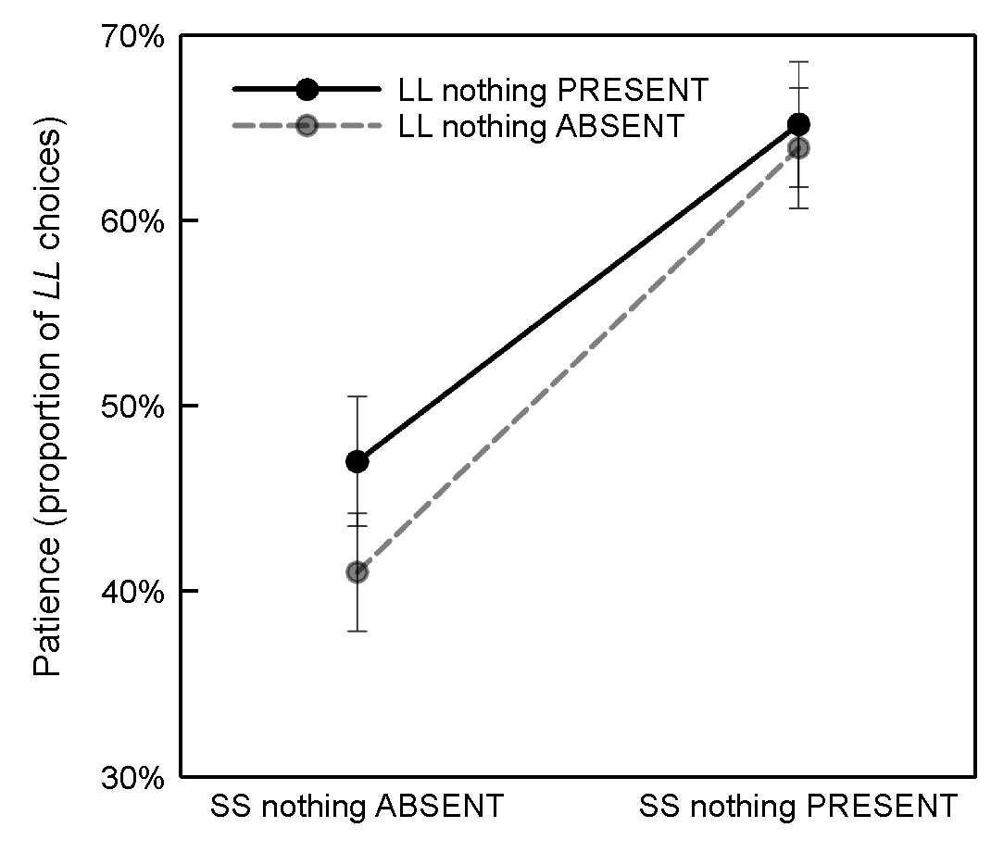
Study 5: “Nothing”

Slide 26
Moderating & Generalizing ASOC
Study 2: Magnitude – robust!
Study 3: “Now” effect – robust!
Study 4: Losses – robust!
Study 5: “Nothing” – robust!
Study 6: Real outcomes, RTs
Study 7: Separate reminder
Study 8: Other domains

Slide 27
Study 6: Real Choices, RTs
Stanford Students (N=301)
Paid out one trial randomly using an Amazon gift certificate
(including immediate payments)
Also recorded response times

Slide 28
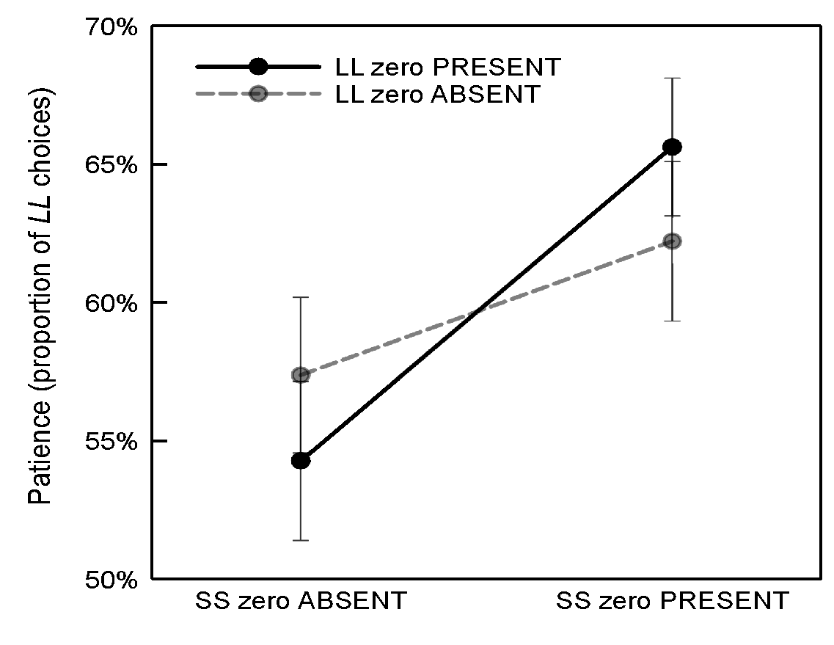
Study 6: Real Choices

Slide 29
Real vs Hypothetical Outcomes
 | Hypothetical (Study 1) | Real (Study 8)
Explicit | .64 | .66
Later | .61 | .63
Sooner | .47 | .55
Hidden | .50 | .56
Hidden zero effect (Explicit minus Hidden) | .14 | .10

Slide 30
Study 6: RTs
5.0 sec
4.8 sec
4.2 sec
3.8 sec

Slide 31
Moderating & Generalizing ASOC
Study 2: Magnitude – robust!
Study 3: “Now” effect – robust!
Study 4: Losses – robust!
Study 5: “Nothing” – robust!
Study 6: Real outcomes, RTs – robust!
Study 7: Separate reminder
Study 8: Other domains

Slide 32
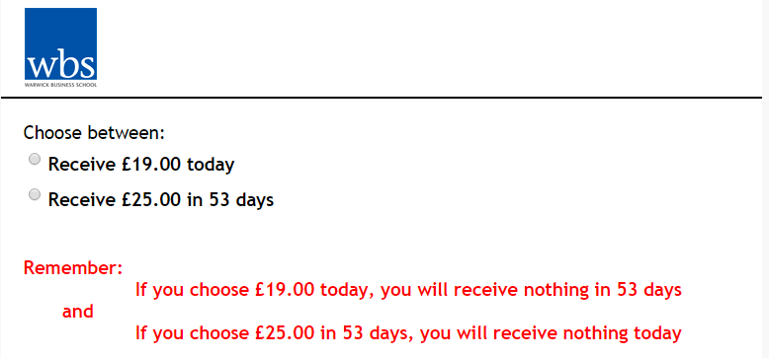
Study 7: Separate reminder
Literally a “£0” effect?
Or really about opportunity cost?

Slide 33
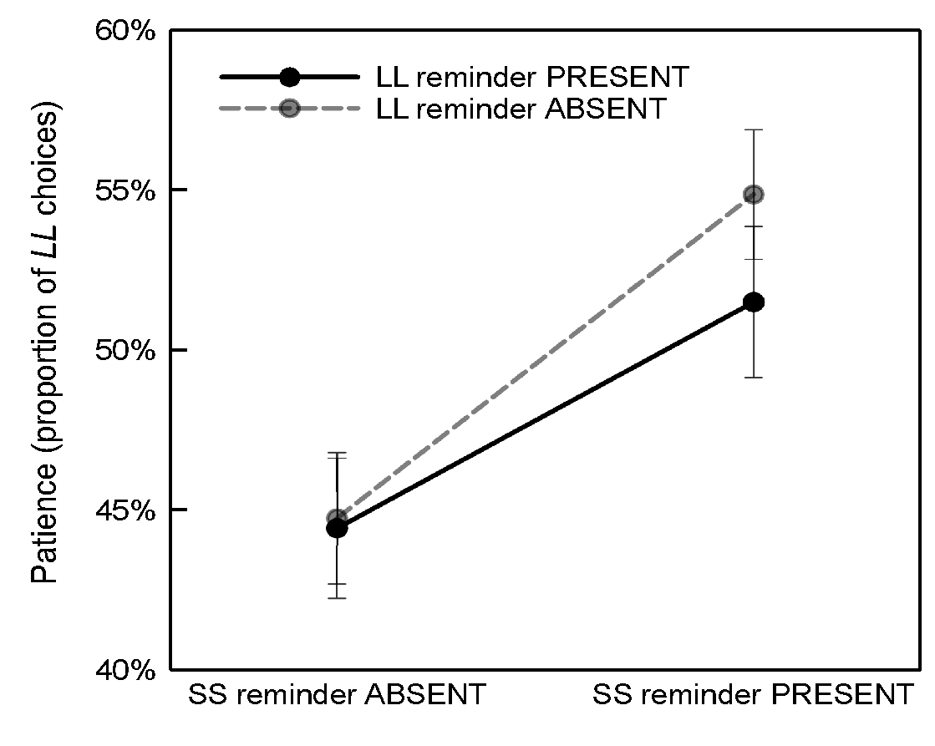
Study 7: Separate reminder

Slide 34
Moderating & Generalizing ASOC
Study 2: Magnitude – robust!
Study 3: “Now” effect – robust!
Study 4: Losses – robust!
Study 5: “Nothing” – robust!
Study 6: Real outcomes, RTs – robust!
Study 7: Separate reminder – robust!
Study 8: Other domains

Slide 35
Study 8: Other domains
Could zeroes save lives?
Suppose the government was choosing between two public health programs to save lives. Which would you prefer?
Save 11 lives in 2016, but save 0 lives in 2017
Save 13 lives in 2017, but save 0 lives in 2016

Slide 36
Study 8: Other domains
Public health
Pollution & air quality
Mass Transit
Chocolates
Phone discount
Music & movie downloads

Slide 37
Study 8: Other domains

Slide 38
Moderating & Generalizing ASOC
Study 2: Magnitude – robust!
Study 3: “Now” effect – robust!
Study 4: Losses – robust!
Study 5: “Nothing” – robust!
Study 6: Real outcomes, RTs – robust!
Study 7: Separate reminder – robust!
Study 8: Other domains – robust!

Slide 39
Other Studies
People do not predict it
No effect on thought listings
May NOT work for a single item now vs later (?)
Zero effect is smaller on MTurk
Overall N = 5447, d = .32
Run with 6 different populations (from 4 different countries)

Slide 40
Summary
People are naturally aware of sooner (but not future) opportunity costs
Partly explains high discount rates
“SS zero” nudge reminds people of future opportunity cost, increasing “patient” choices

Slide 41
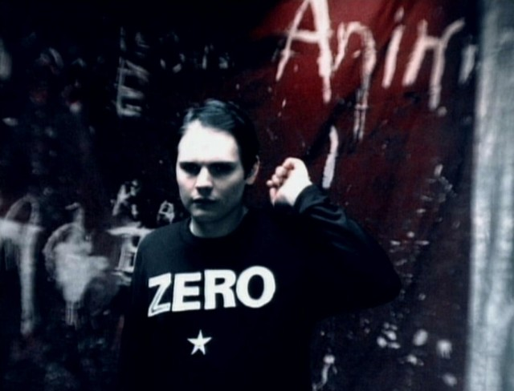
Thank You!

