Slide 1

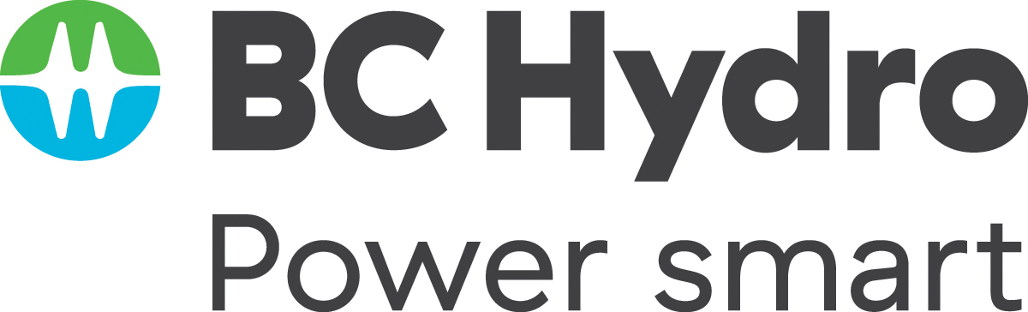
Twice as nice?
A Longitudinal Field Study of Separate vs. Combined Nudges for Household Laundry Behaviours

Slide 2



Notes:
What brings us together?

Slide 3
Today’s Research
“Behavioral Insights” research
“True story ” of the project
We’ll do a couple prediction contests – be ready!
“Working paper” in progress – please interrupt with questions/comments (Lab/b-school style)

Slide 4
Co-Authors & Partners
UBC
David Hardisty
Kirstin Appelt
Sid Mookerjee
Yanwen Wang
Jiaying Zhao
BC Hydro
Arien Korteland
Valerie Rodrigues
Netu Sidhu

Slide 5
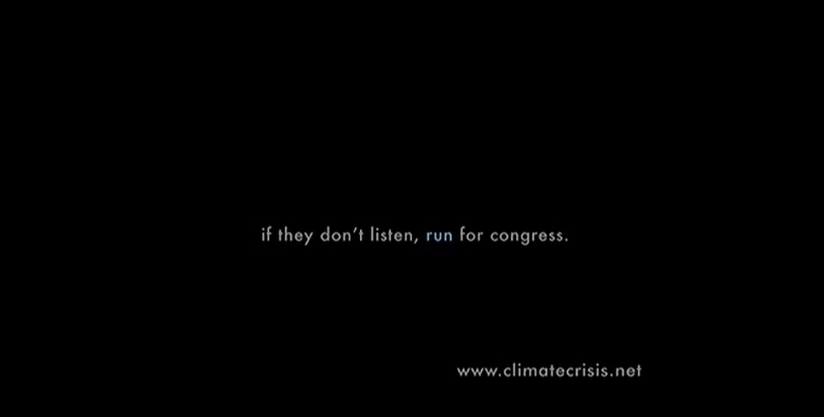
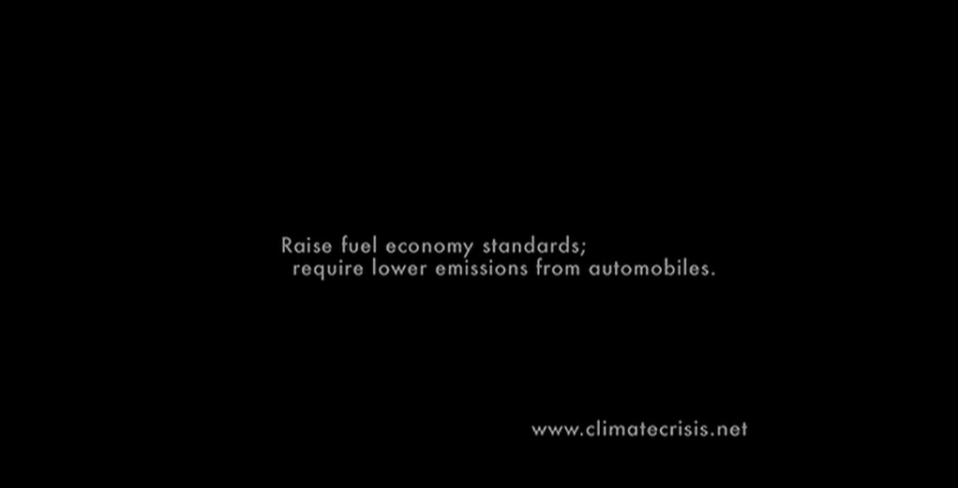
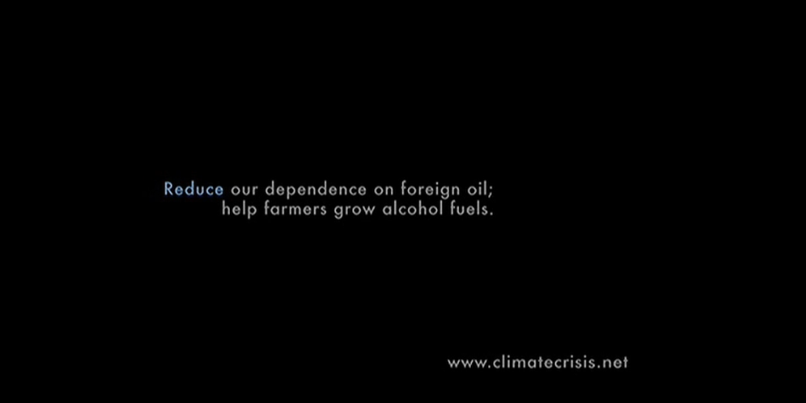
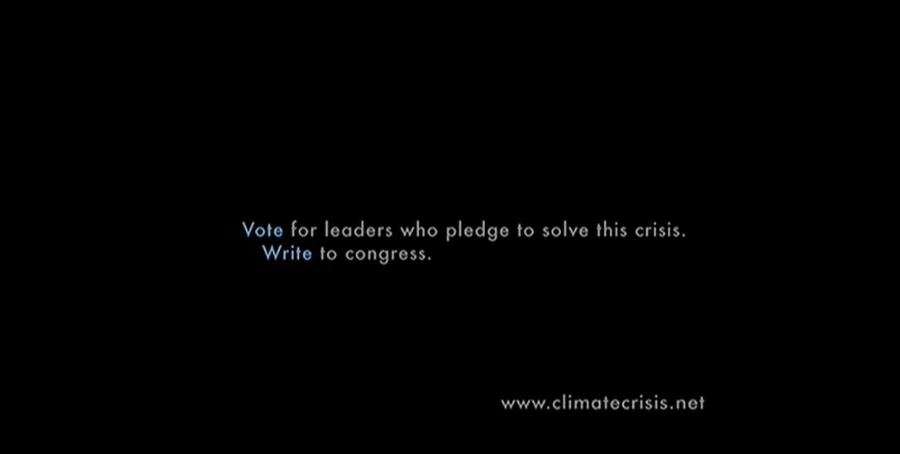
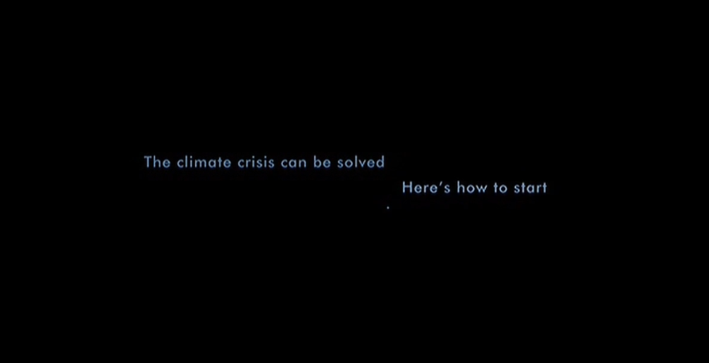
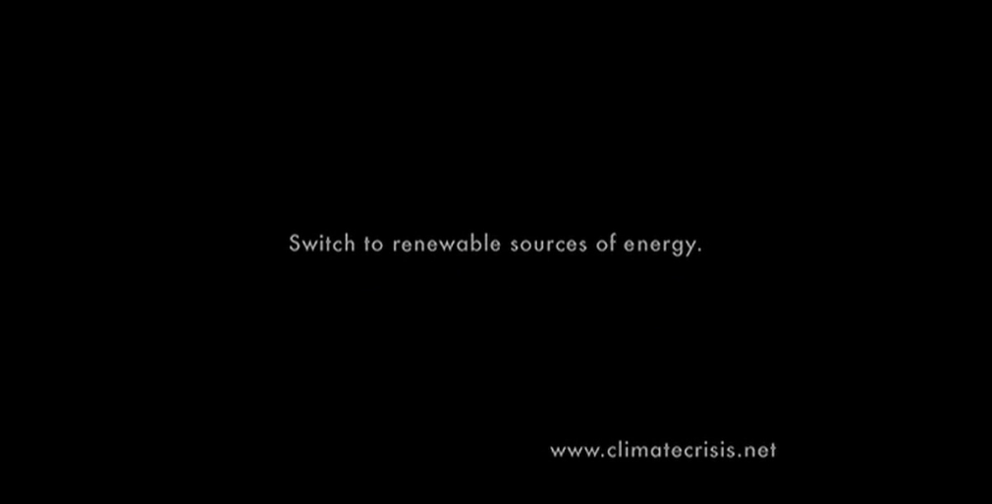
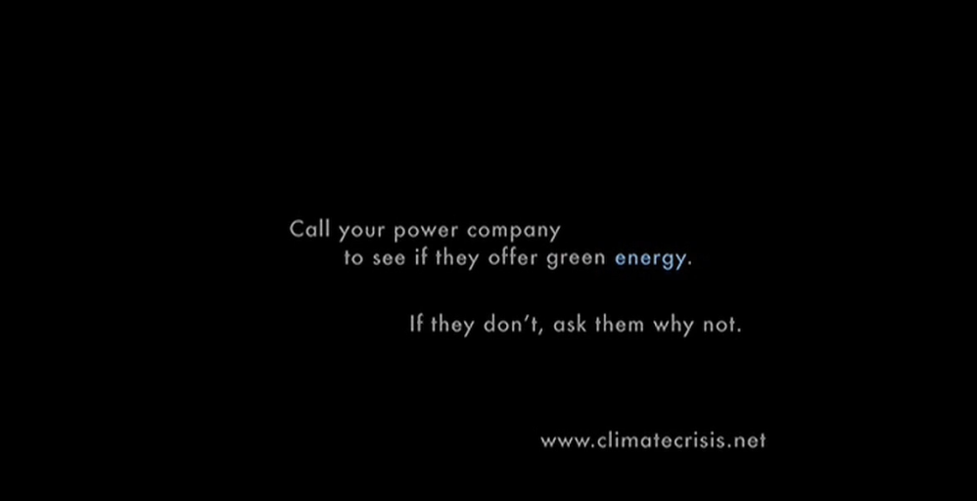
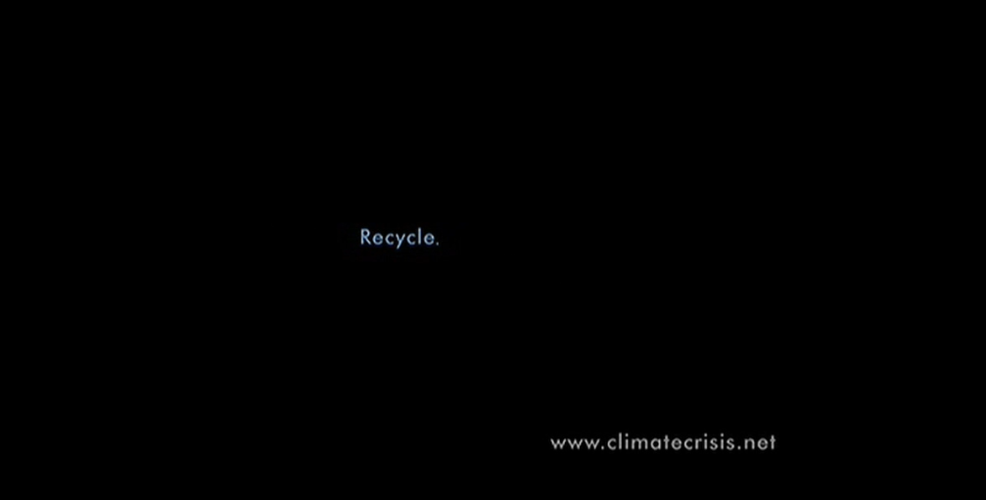
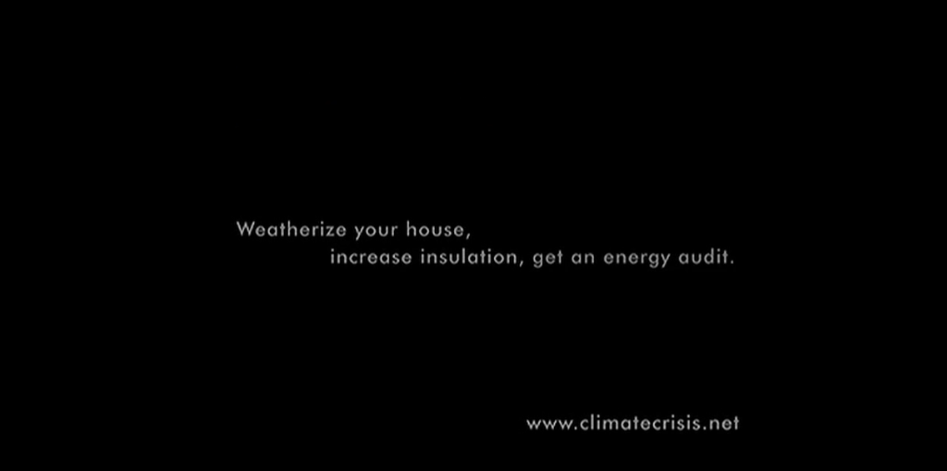
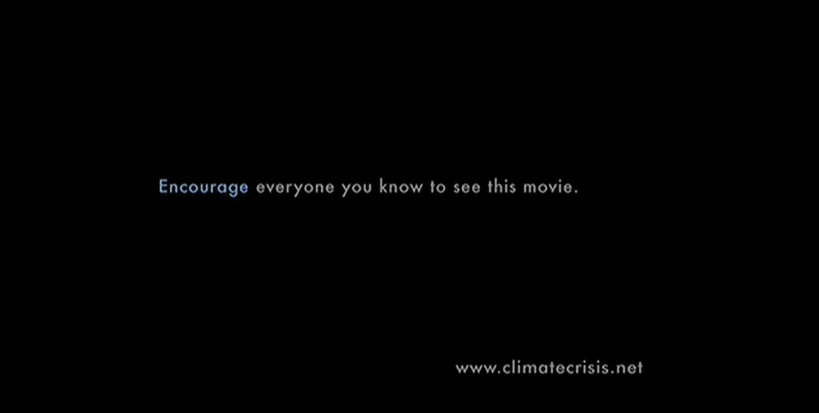
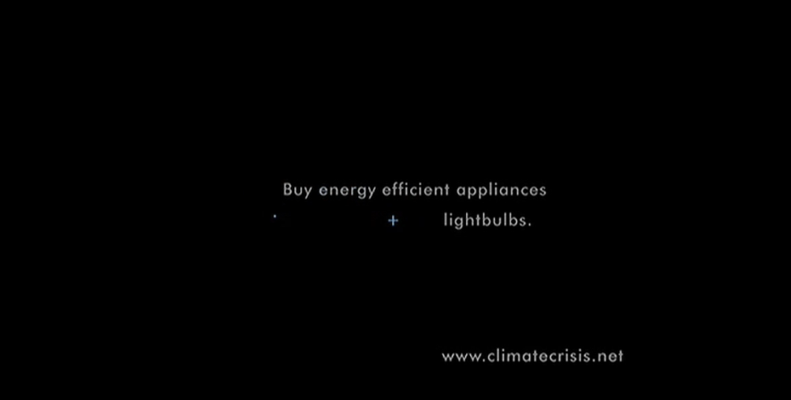
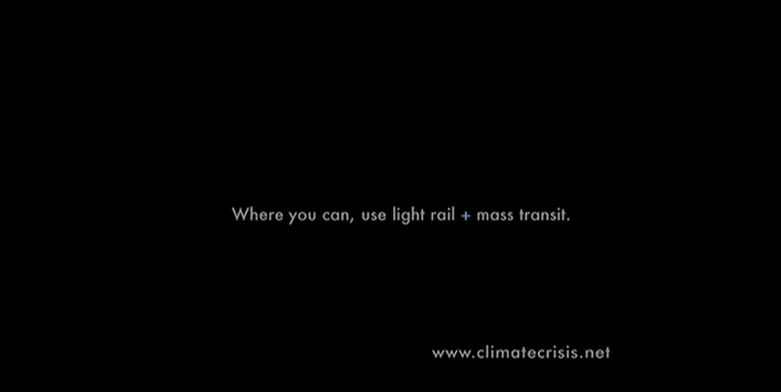
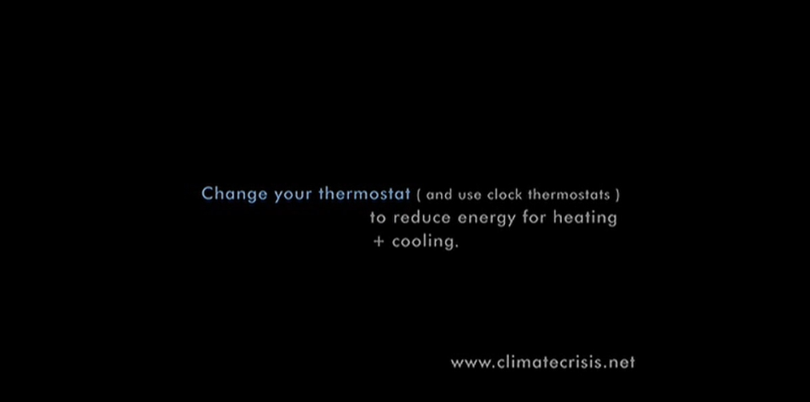
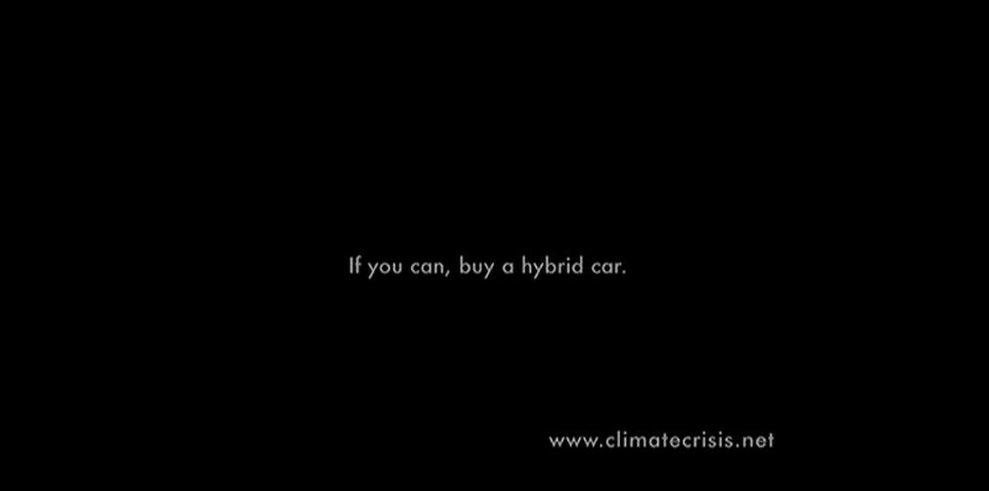
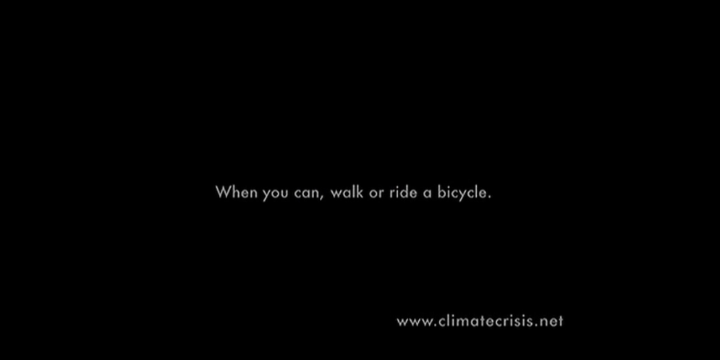
Motivation
Who’s seen An Inconvenient Truth?

Slide 6
Key Questions
How to nudge sustainable behaviour change?
Better to use “prosocial” motivation, “pro-self” motivation, or both together?
Better to make many questions for behaviour change, or focus on one?

Slide 7
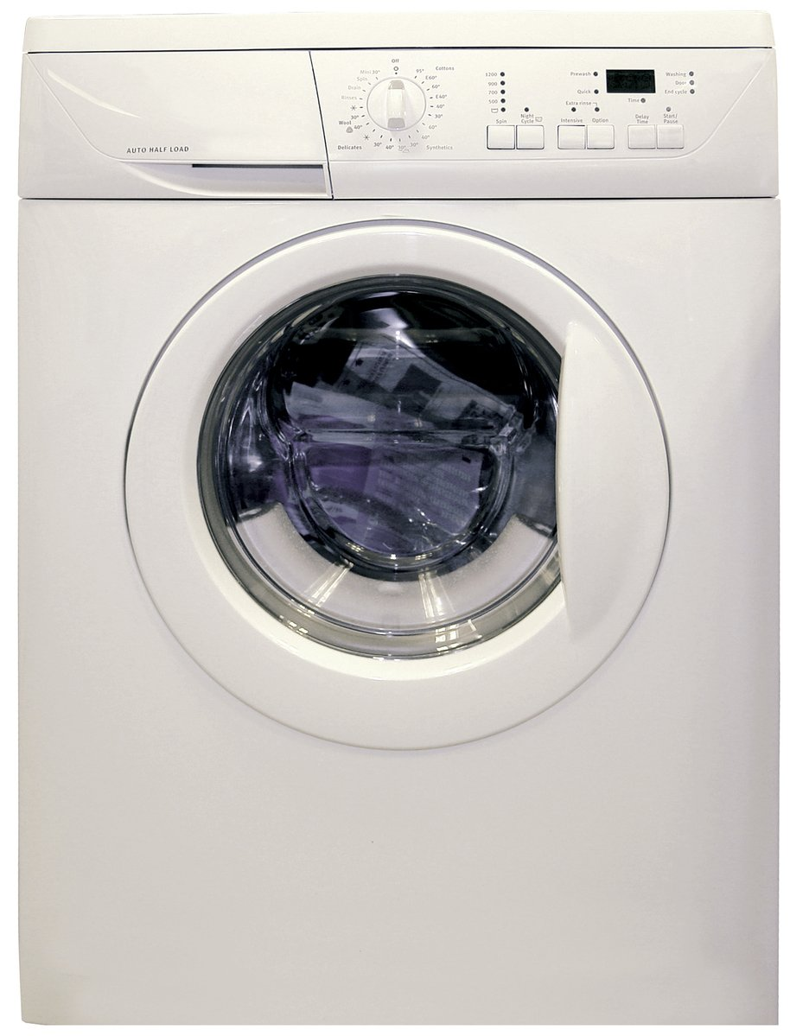
Practical Impact
Laundry represents about 19% - 28% of home energy use in houses using electric water heating, or 10-12% of household electricity in homes using natural gas water heating
(BC Hydro calculations based on data from https://www.energystar.gov/ )
Little research on changing laundry behaviour
Identifiable via spikes in metered data (in theory)
Image credit: https://en.wikipedia.org/wiki/Clothes_dryer#/media/File:Clothes_Dryer.jpg
Notes:
Image source: https://www.freeimages.com/photo/washing-machine-1418432

Slide 8

Agenda
Literature review
Pilot surveys (Feb 2021 – Apr 2021)
Main study design (June 2021 – May 2022)
Hypotheses
Behavioural intention results
Self-report results
Behaviour logging results
Energy meter results
Summary & Conclusions

Slide 9
Literature Review

Slide 10
Literature Review
Short-term vs. long-term effects
  Most “nudging” studies only examine a single choice
  Dynamic energy competitions can be effective long-term (Schultz et al 2007; Wemyss et al., 2019), but only while the feedback is maintained
  Defaults and auto-escalation are effective long-term (e.g., Benartzi & Thaler 2013)
Spillover effects
  Meta-analysis shows positive spillover effects on intentions, but small negative effects on actual behaviour and policy support (Maki et al., 2019)
  Single request vs multiple simultaneous requests??
Monetary vs. environmental motivation
  Financial and environmental framing both improve energy efficient purchases, especially when scaled up (Camilleri & Larrick 2014; Hardisty et al. 2020; Ungemach et al 2018)
  Financial and environmental messaging both improve energy saving intentions (Steinhorst, Klöckner, & Matthies, 2015; Steinhorst & Klöckner, 2018), but not actual behaviour (Steinhorst & Klöckner, 2018)

Slide 11
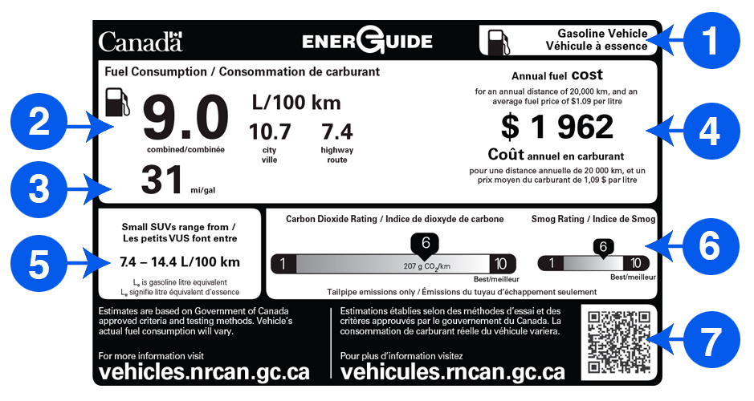
Literature Review
Image credit: https://www.nrcan.gc.ca/energy-efficiency/energuide-canada/energuide-vehicles/21010

Slide 12
Pilot Surveys

Slide 13
Pilot Surveys
Perhaps a decal on the laundry machine could provide a lasting nudge?
  Constant reminder
  Attractive
  Low-cost
  What‘s the right message?
Pilot surveys (Feb 2021 – Apr 2021) pre-tested ideas via hypothetical scenarios with online samples from Prolific.co

Slide 14
Pilot Survey 2
600 Canadian participants on Prolific assigned to one of 13 conditions
Between-participants design:
2 (gain vs. loss framing)
x 2 (time horizon: per load vs 10-year)
x 3 (motivators: money vs. energy vs. both)
+ control
DVs: Willingness to engage in conservation behaviour (1=Not at all likely, 5=Very likely):
- Rewear clothes until dirty
- Combine small loads into large loads
- Wash laundry in cold water
- Hang dry laundry inside or outside

Slide 15
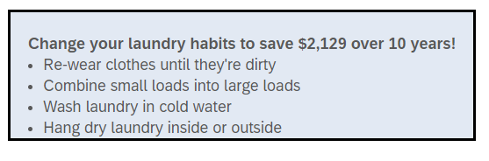
Pilot Surveys – Survey 2
Money-gain 10-year condition

Slide 16
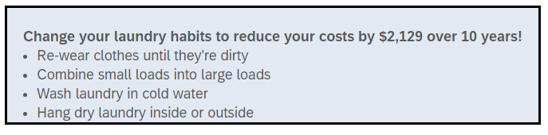
Pilot Surveys – Survey 2
Money-loss 10-year condition

Slide 17
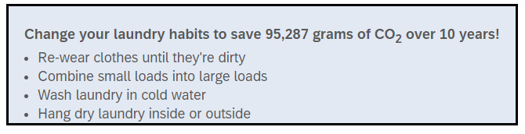
Pilot Surveys – Survey 2
CO2-gain 10-year condition

Slide 18
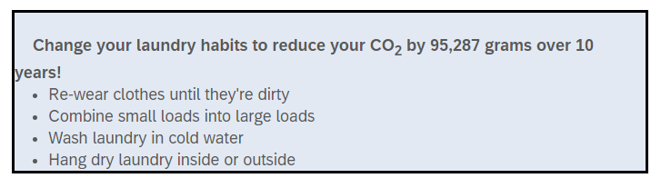
Pilot Surveys – Survey 2
CO2-loss 10-year condition

Slide 19
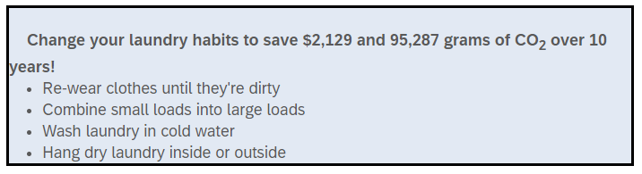
Pilot Surveys – Survey 2
Combined Money-Gain + CO2-Gain Condition

Slide 20
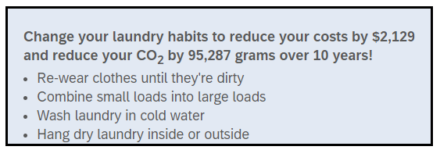
Pilot Surveys – Survey 2
Combined Money-Loss + CO2-Loss Condition

Slide 21
Pilot Surveys – Survey 2 Design Summary
Money-gain condition
CO2-gain condition
Money+ CO2-gain condition
Money-loss condition
CO2-loss condition
Money+ CO2-loss condition
Willingness to place decal (1= Definitely not, 5=Definitely yes): “Would you be willing to place a removable decal or sticker with this message on your washer or dryer?”
Willingness to engage in conservation behaviour (1=Not at all likely, 5=Very likely): “Rewear clothes until dirty, Combine small loads into large loads, Wash laundry in cold water, Hang dry laundry inside or outside”

Slide 22
Pilot Survey 2
Which condition do you predict was most effective in Pilot Survey 2?
Control
Money Gain
Money Loss
CO2 Gain
CO2 Loss
Money + CO2 Gain
Money + CO2 Loss
Null results

Slide 23
Pilot Survey 2
None of the interventions were significantly more effective than control
Fishing: The combined motivation condition (money + environment incentives) was marginally more effective than money or environment incentive alone in driving cold water washing intentions (p = .067).
Takeaway: Providing financial & climate information is not a strong motivator to change laundry behaviours

Slide 24
Pilot 4
In qualitative pilot, most people said they care about their clothing, but not microplastics
Perhaps a combination of energy, money, and clothing together would be effective?
Perhaps a novel motivation (microplastics) would be effective?
Vivid imagery might help?
400 Canadian participants on Prolific assigned to one of 8 conditions
Between-participants design:
2 (messages: microplastic vs. energy+money+CO2)
x 3 (animal: turtle vs. orca vs. polar bear)
+ microplastics sweater and turtle
+ control

Slide 25
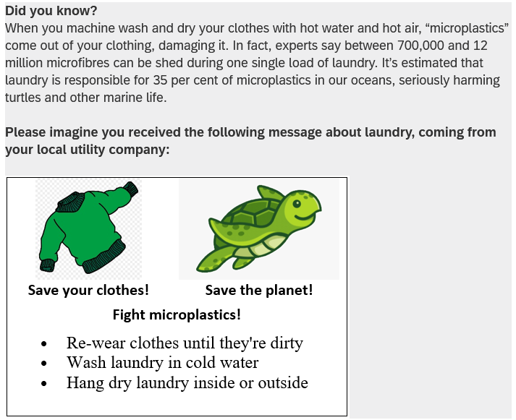
Microplastics sweater and turtle condition
Willingness to engage in conservation behaviour (1=Not at all likely, 5=Very likely):
Rewear clothes until dirty
Combine small loads into large loads
Wash laundry in cold water
Hang dry laundry inside or outside
Image credit: https://www.pngkey.com/maxpic/u2w7w7u2o0q8o0r5/

Slide 26
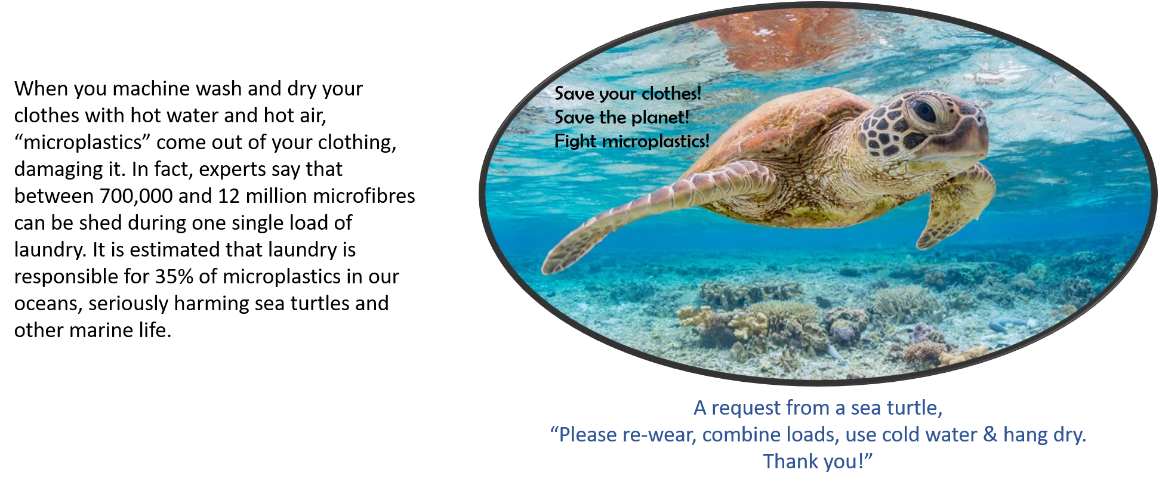
Pilot Surveys – Survey 4
Microplastics turtle condition
Willingness to engage in conservation behaviour (1=Not at all likely, 5=Very likely): “Rewear clothes until dirty, Combine small loads into large loads, Wash laundry in cold water, Hang dry laundry inside or outside

Slide 27
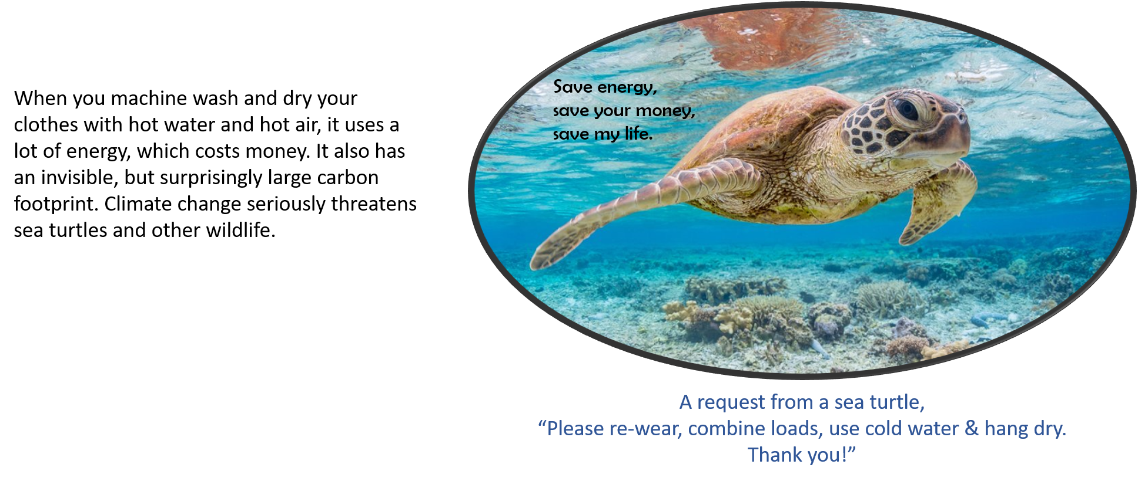
Pilot Surveys – Survey 4
Energy turtle condition

Slide 28
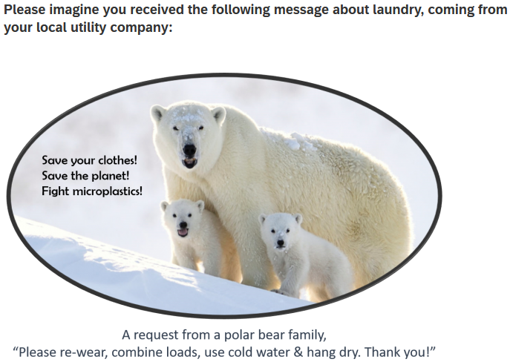
Pilot Surveys – Survey 4
Microplastics bear condition

Slide 29
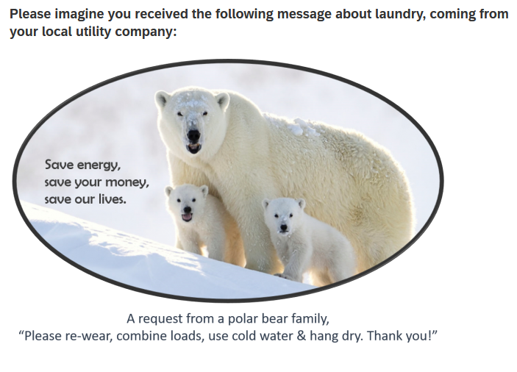
Pilot Surveys – Survey 4
Energy bear condition

Slide 30
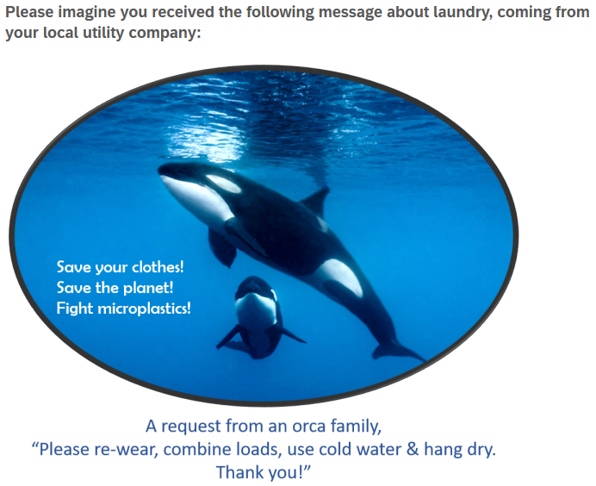
Pilot Surveys – Survey 4
Microplastics orcas condition

Slide 31
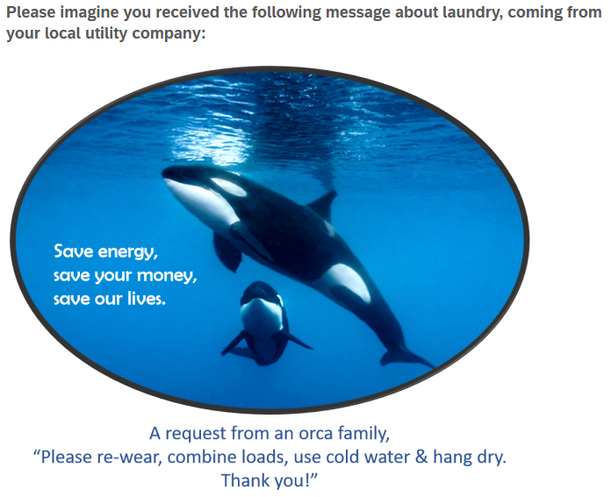
Pilot Surveys – Survey 4
Energy orcas condition

Slide 32
Pilot Survey 4
Which condition do you predict was most effective in Pilot Survey 4?
Control
Micro sweater + turtle
Micro turtles
Energy turtles
Micro bears
Energy bears
Micro orcas
Energy orcas
Null results

Slide 33
Pilot Surveys – Survey 4
Label | Place decal | Cold Water | Rewear | Combine Load | Hang Dry | Average
Control (n=48) |  | 3.6 | 3.4 | 4.2 | 3.0 | 3.5
Microplastics Sweater (n=42) | 3.5 | 4.1* | 4.0* | 4.4 | 3.2 | 3.9
Microplastics Turtle (n=48) | 3.5 | 4.2* | 3.9* | 4.4 | 3.2 | 4.0
Microplastics Polar (n=45) | 3.6 | 3.9 | 3.6 | 4.3 | 3.2 | 3.7
Microplastics Orca (n=45) | 3.6 | 3.9 | 3.7 | 4.3 | 3.2 | 3.8
Energy turtle (n=40) | 3.1 | 4.1 | 3.7 | 4.2 | 3.1 | 3.7
Energy Polar (n=45) | 3.1 | 3.8 | 3.6 | 4.3 | 3.1 | 3.7
Energy orca (n=40) | 3.5 | 3.9 | 3.6 | 4.1 | 3.1 | 3.7
Note: * = significantly different from control, p < .05
Takeaway: Microplastic messaging with sweater and/or turtle were the most effective

Slide 34
Main Study Design

Slide 35
Study Design: Participants
1,210 BC Hydro customers recruited from BC Hydro’s Team Power Smart program and completed the first survey
Follow-up surveys every 3 months, for 1 year total
Must have Washing Machine & Clothes Dryer and pay BC Hydro bill
64% women, mean age = 57
Notes:
Note: 1,647 agreed to participate in advance, but only 1,158 completed the time 1 survey, mostly due to blocked emails from Microsoft-related email addresses (such as @hotmail, @outlook, @msn, and @live email addresses) blocking our emails.

Slide 36
Target Laundry Behaviours
Re-wear
Combine loads
Use cold water
Hang dry clothes

Slide 37
Study Design: Overview
Independent Variable: Participants randomly assigned to one of six conditions
  Control (no decal)
  Control (QR logging decal)
  Turtle appeal to change 4 behaviours
  Fleece appeal to change 4 behaviours
  Turtle + fleece appeal to change 4 behaviours
  Turtle + fleece appeal to hang dry
Dependent Variables:
  Laundry behaviour change intentions to re-wear, combine loads, cold water, hang-dry
  Retrospective self-report of efficiency behaviours, every 3 months for one year
  Ongoing log of laundry behaviour for one year
  Energy meter data (hourly level) for one year, including 1-year prior history

Slide 38
Control (no decal)

Slide 39
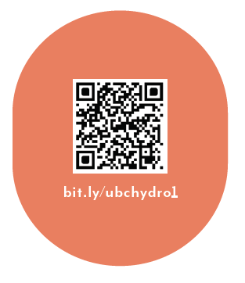
Control (logging decal only)
As part of your participation in this study, we will mail you a decal to put on your washer or dryer, which will look like the following:

Slide 40
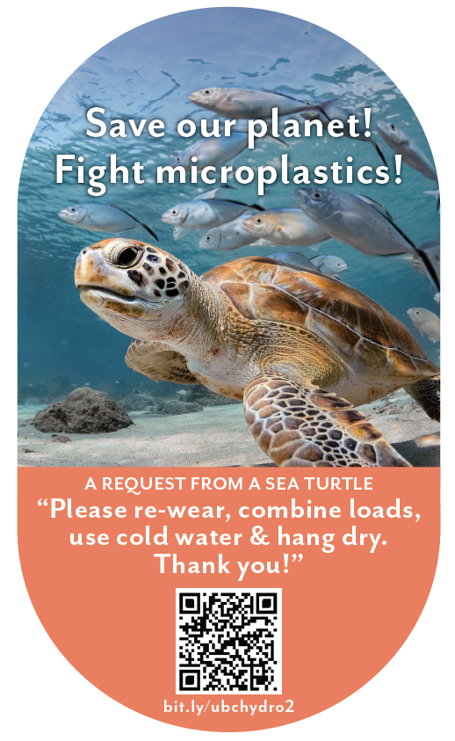
Sea Turtle + Bundled
When you machine wash and dry your clothes with hot water and hot air, “microplastics” come out of your clothes. In fact, experts say that between 700,000 and 12 million microfibres can be shed during one single load of laundry. It is estimated that laundry is responsible for 35% of microplastics in our oceans, seriously harming sea turtles and other marine life.
You can save our planet by:
- Re-wearing clothes more often
- Combining loads to run fewer, larger loads of laundry
- Washing laundry with cold water, rather than hot water or warm water
- Hanging clothes to dry (inside or outside), rather than machine-drying clothes
As part of your participation in this study, we will mail you a decal to put on your washer or dryer, which will look like the following:

Slide 41
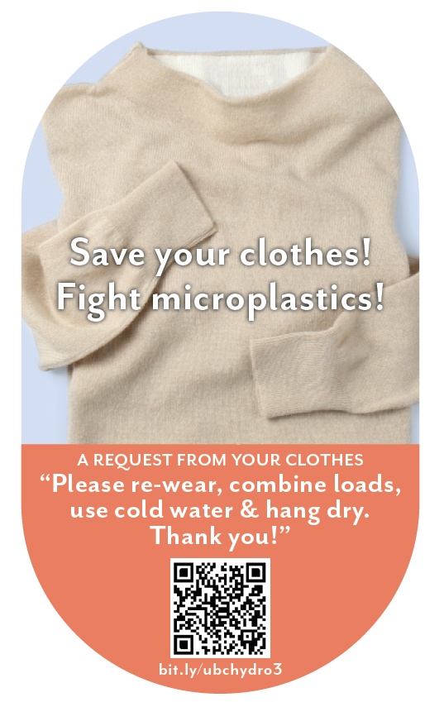
Clothing + Bundled
When you machine wash and dry your clothes with hot water and hot air, “microplastics” come out of your clothes. In fact, experts say that between 700,000 and 12 million microfibres can be shed during one single load of laundry. This breaks down the fabric in your clothes, damaging it and shortening the amount of time you’ll be able to enjoy wearing it.
You can save your clothes by:
- Re-wearing clothes more often
- Combining loads to, run fewer, larger loads of laundry
- Washing laundry with cold water, rather than hot water or warm water
- Hanging clothes to dry (inside or outside), rather than machine-drying clothes
As part of your participation in this study, we will mail you a decal to put on your washer or dryer, which will look like the following:

Slide 42
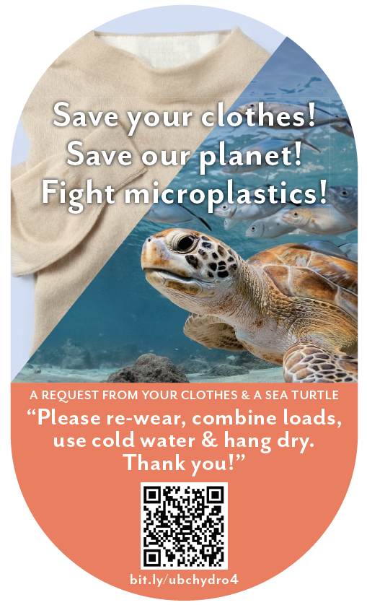
Turtle + Clothing + Bundled
When you machine wash and dry your clothes with hot water and hot air, “microplastics” come out of your clothes. In fact, experts say that between 700,000 and 12 million microfibres can be shed during one single load of laundry. This breaks down the fabric in your clothes, damaging it and shortening the amount of time you’ll be able to enjoy wearing it. It is also estimated that laundry is responsible for 35% of microplastics in our oceans, seriously harming sea turtles and other marine life.
You can save your clothes and save our planet by:
- Re-wearing clothes more often
- Combining loads to, run fewer, larger loads of laundry
- Washing laundry with cold water, rather than hot water or warm water
- Hanging clothes to dry (inside or outside), rather than machine-drying clothes
As part of your participation in this study, we will mail you a decal to put on your washer or dryer, which will look like the following:

Slide 43
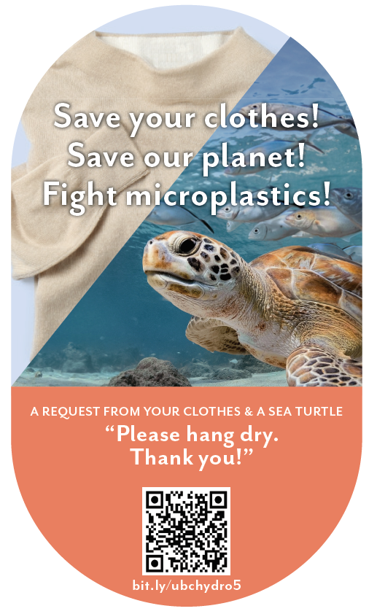
Turtle + Clothing + Hang Dry
When you machine wash and dry your clothes with hot water and hot air, “microplastics” come out of your clothes. In fact, experts say that between 700,000 and 12 million microfibres can be shed during one single load of laundry. This breaks down the fabric in your clothes, damaging it and shortening the amount of time you’ll be able to enjoy wearing it. It is also estimated that laundry is responsible for 35% of microplastics in our oceans, seriously harming sea turtles and other marine life.
You can save your clothes and save our planet by:
- Hanging clothes to dry (inside or outside), rather than machine-drying clothes
As part of your participation in this study, we will mail you a decal to put on your washer or dryer, which will look like the following:

Slide 44
Intentions Results

Slide 45
Intentions to engage in efficient laundry behaviours
Label | Cold Water | Rewear | Combine Load | Hang Dry | Average
Control (n=217) | 3.35 | 3.24 | 3.27 | 3.53 | 3.34
QR Scan Only Control (n=185) | 3.25 | 3.10 | 3.19 | 3.44 | 3.25
Sea turtle + bundled msg (n=189) | 3.61₁ ₂ | 3.47₁ ₂ | 3.46₁ ₂ | 3.60 | 3.53₁ ₂
Fleece + bundled msg (n=200) | 3.58₁ ₂ | 3.52₁ ₂ | 3.48₁ ₂ | 3.61₂ | 3.55₁ ₂
Sea turtle + fleece + bundled msg (n=184) | 3.60₁ ₂ | 3.42₁ ₂ | 3.40₁ ₂ | 3.54 | 3.49₁ ₂
Sea turtle + fleece + hang dry msg (n=189) | 3.56₁ ₂ | 3.42₁ ₂ | 3.38₂ | 3.77₁ ₂ | 3.53₁ ₂
Note: Participants answered on a 1-5 scale from 1=“much less often” to 3=“the same” to 5=“much more often”.
Subscripts indicate significant difference from control (1) or QR scan only control (2).

Slide 46
Intentions to engage in efficient laundry behaviours
Summary:
All decals increased intentions to improve behaviours
Roughly equally effective on intentions

Slide 47
Summary: Decal Effectiveness vs Control
Condition | Intentions | Self-report | Logged Washing | Logged Drying | Metered Washing | Metered Drying
Turtle + Bundle | ✓
Fleece + Bundle | ✓
Turtle + Fleece + Bundle | ✓
Turtle + Fleece + Hang Dry | ✓

Slide 48
Self-report Results

Slide 49
Self-report Results
Takeaway:
From S1 to S4, participants were marginally less likely to report engaging in laundry efficient behaviours for the control conditions (ps <.1). “Sea turtle+fleece+hang dry” message and “Sea turtle+bundled” message were marginally more effective than control conditions at S4 (ps <.1)

Slide 50
Self-report Results
Takeaway:
From S1 to S4, participants were marginally less likely to report engaging in laundry efficient behaviours for the control conditions (ps <.1). “Sea turtle+fleece+hang dry” message and “Sea turtle+bundled” message were marginally more effective than control conditions at S4 (ps <.1)

Slide 51
Self-report of efficient laundry behaviours
Summary:
Two decal messages marginally improved self-reported behaviours over time:
Microplastics turtle + bundled msg
and
Microplastics turtle + fleece+hang-dry msg

Slide 52
Summary: Decal Effectiveness vs Control
Condition | Intentions | Self-report | Logged Washing | Logged Drying | Metered Washing | Metered Drying
Turtle + Bundle | ✓ | †
Fleece + Bundle | ✓
Turtle + Fleece + Bundle | ✓
Turtle + Fleece + Hang Dry | ✓ | †

Slide 53
Behaviour Logging Results

Slide 54
Behaviour Logging Results: QR Code Usage
 | Number | %
Via URL | 12,485 | 32%
Via QR Code | 26,460 | 68%
Total | 38,945 | 100%

Slide 55
Behaviour Logging Results
Condition | n | Total Washed | Total Dried | Ratio (Dried / Washed)
Control (Decal) | 137 | 72.6 | 56.4 | 0.77
Turtle + Bundle | 125 | 50.2*** | 34.9*** | 0.68*
Clothes + Bundle | 113 | 67.5 | 51.8 | 0.75
Turtle + Clothes + Bundle | 109 | 63.4 | 46.1† | 0.73
Turtle + Clothes + Hang Dry | 127 | 64.2 | 39.4** | 0.63***
Symbols indicate significant differences from control. † p < .1, ** p < .01, *** p < .001
Notes:
These are the total numbers reported across the year. However, we only made logging “mandatory” for the first six months. Furthermore, man loads may not have been logged. The average across the year comes out to 1.2 laundry loads logged per week, and 0.9 drier loads logged per week. This is far below BC Hydro’s Residential End Use Study, which indicates the average # of washer loads (across all households and housing types) is 3.7 per week and the average # of dryer loads is 3.5 per week. The difference is likely due to a combination of self-selection and self-report issues. The ratio of machine dried loads to washed loads is probably the most reliable measure, avoiding self-report effects (but not self-selection effects).

Slide 56
Logging of efficient laundry behaviours
Summary:
Two decal messages improved logged behaviours over time:
Microplastics turtle + bundled msg decreased washing and drying
and
Microplastics turtle + fleece+hang-dry msg decreased drying

Slide 57
Summary: Decal Effectiveness vs Control
Condition | Intentions | Self-report | Logged Washing | Logged Drying | Metered Washing | Metered Drying
Turtle + Bundle | ✓ | † | ✓ | ✓
Fleece + Bundle | ✓
Turtle + Fleece + Bundle | ✓
Turtle + Fleece + Hang Dry | ✓ | † |  | ✓

Slide 58
Energy Meter Results

Slide 59
Energy Meter Results: kWh per Day across all participants
Condition | Pre | Post | Change
Control (No survey) | 22.74 | 23.36 | 0.62
Control (No decal) | 21.21 | 21.54 | 0.32
Control (QR decal) | 22.93 | 23.14 | 0.21
Turtle + Bundle Msg | 23.02 | 23.79 | 0.77
Fleece + Bundle Msg | 22.04 | 22.77 | 0.72
Turtle + Fleece + Bundle Msg | 21.26 | 22.16 | 0.9
Turtle + Fleece + Hang Dry Msg | 22.06 | 22.54 | 0.48
NOTE: No significant differences across conditions
Notes:
The average household electricity consumption kWh per day is 28.9 kWh in the USA
The Texas average kilowatt usage per day is 39.2 kWh
https://electricityplans.com/kwh-kilowatt-hour-can-power/

Slide 60
Energy Meter Results: kWh for logging participants
Condition | n | Total Energy | Wash Energy | Dry Energy | Ratio (Dry/Wash)
Control (Decal only) | 94 | 15,168 | 139 | 121 | 0.81
Turtle + Bundle Msg | 91 | 14,704 | 105† | 79* | 0.68**
Fleece + Bundle Msg | 98 | 15,778 | 141 | 121 | 0.8
Turtle + Fleece + Bundle Msg | 72* | 14,240 | 102† | 82* | 0.79
Turtle + Fleece + Hang Dry Msg | 92 | 14,410 | 122 | 86* | 0.69**
Symbols indicate significant differences from control. † p < .1, * p < .05, ** p < .01

Slide 61
Metered efficient laundry behaviours
Summary:
No significant change in total energy usage, but data is noisy
When isolating laundry times, three condition were effective:
Turtle + bundled msg
Turtle + fleece + bundled msg*
Turtle + fleece + hang dry

Slide 62
Summary: Decal Effectiveness vs Control
Condition | Intentions | Self-report | Logged Washing | Logged Drying | Metered Washing | Metered Drying
Turtle + Bundle | ✓ | † | ✓ | ✓ | † | ✓
Fleece + Bundle | ✓
Turtle + Fleece + Bundle | ✓ |  |  |  | † | ✓
Turtle + Fleece + Hang Dry | ✓ | † |  | ✓ |  | ✓

Slide 63
Study Summary & Conclusions

Slide 64
Conclusions
In the context of a motivated sample of BC laundry doers, over a period of one year:
Decals can be an effective nudging tool for sustaining energy efficient behaviour over time; serves as a constant reminder & motivation; attractive image is important; could be extended to other behaviours
Intentions often do not translate into real behaviour change
Changes in laundry behaviours were not detectable in total household energy usage, perhaps due to negative spillover

Slide 65
Conclusions
Most effective: combining a single, novel motivator (microplastics turtle) with multiple behaviour change requests
Not so effective in this context: self-interest (clothing, money), climate impacts
Sometimes energy motivations are not the best way to change energy behaviours!
Not all environmental motivators are the same

Slide 66

An invitation to our UBC DIBS online seminars
https://www.sauder.ubc.ca/thought-leadership/divisions-groups/decision-insights-business-society/events-courses-resources

Slide 67
Thank You!

Slide 68
Questions?

Slide 69
References
Benartzi, S., & Thaler, R. H. (2013). Behavioral economics and the retirement savings crisis. Science, 339(6124), 1152-1153
Camilleri, A. R., & Larrick, R. P. (2014). Metric and scale design as choice architecture tools. Journal of Public Policy & Marketing, 33(1), 108-125.
Hardisty, D. J., Shim, Y., Sun, D., & Griffin, D. W. (2020). Encouraging energy efficiency: Product labels activate temporal tradeoffs. Available at SSRN 3576266.
Maki, A., Carrico, A. R., Raimi, K. T., Truelove, H. B., Araujo, B., & Yeung, K. L. (2019). Meta-analysis of pro-environmental behaviour spillover. Nature Sustainability, 2(4), 307-315
Schultz, P. W., Nolan, J. M., Cialdini, R. B., Goldstein, N. J., & Griskevicius, V. (2007). The constructive, destructive, and reconstructive power of social norms. Psychological science, 18(5), 429-434.
Steinhorst, J., Klöckner, C. A., & Matthies, E. (2015). Saving electricity–For the money or the environment? Risks of limiting pro-environmental spillover when using monetary framing. Journal of Environmental Psychology, 43, 125-135.
Steinhorst, J., & Klöckner, C. A. (2018). Effects of monetary versus environmental information framing: Implications for long-term pro-environmental behavior and intrinsic motivation. Environment and Behavior, 50(9), 997-1031.
Ungemach, C., Camilleri, A. R., Johnson, E. J., Larrick, R. P., & Weber, E. U. (2018). Translated attributes as choice architecture: Aligning objectives and choices through decision signposts. Management Science, 64(5), 2445-2459.
Wemyss, D., Cellina, F., Lobsiger-Kägi, E., De Luca, V., & Castri, R. (2019). Does it last? Long-term impacts of an app-based behavior change intervention on household electricity savings in Switzerland. Energy Research & Social Science, 47, 16-27.

