Slide 1

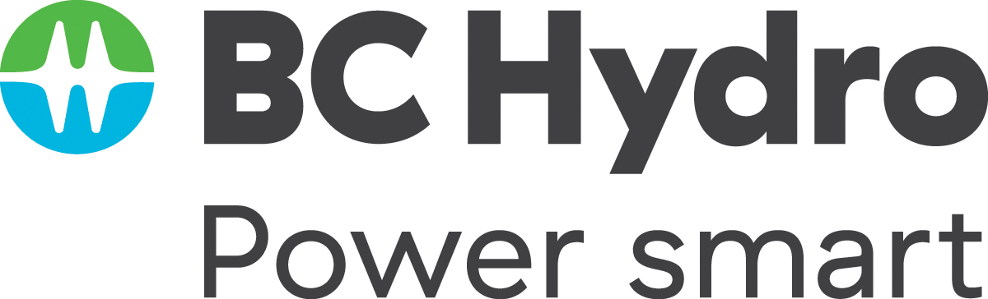
Twice as nice?
A Longitudinal Field Study of Separate vs. Combined Nudges for Household Laundry Behaviours
Notes:
Land acknowledgment
Background: This is a study we conducted in partnership with BC Hydro (as part of their Power smart program) about how to effectively encourage sustainable laundry behaviour, especially hang drying. We took it for granted that hang drying was a desirable behaviour.
When I later found out that some people are not allowed to hang dry, I couldn’t believe it. I’ve previously lived in Japan, France, and Italy, and those are all places where hang drying is the norm.

Slide 2
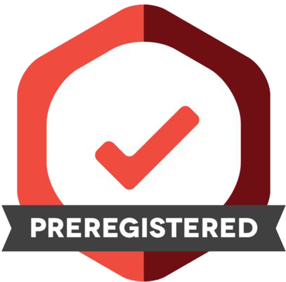
Co-Authors & Partners
UBC
David Hardisty
Kirstin Appelt
Sid Mookerjee
Yanwen Wang
Jiaying Zhao
BC Hydro
Arien Korteland
Valerie Rodrigues
Netu Sidhu
Pre-registration: https://aspredicted.org/WWZ_WQ3

Slide 3
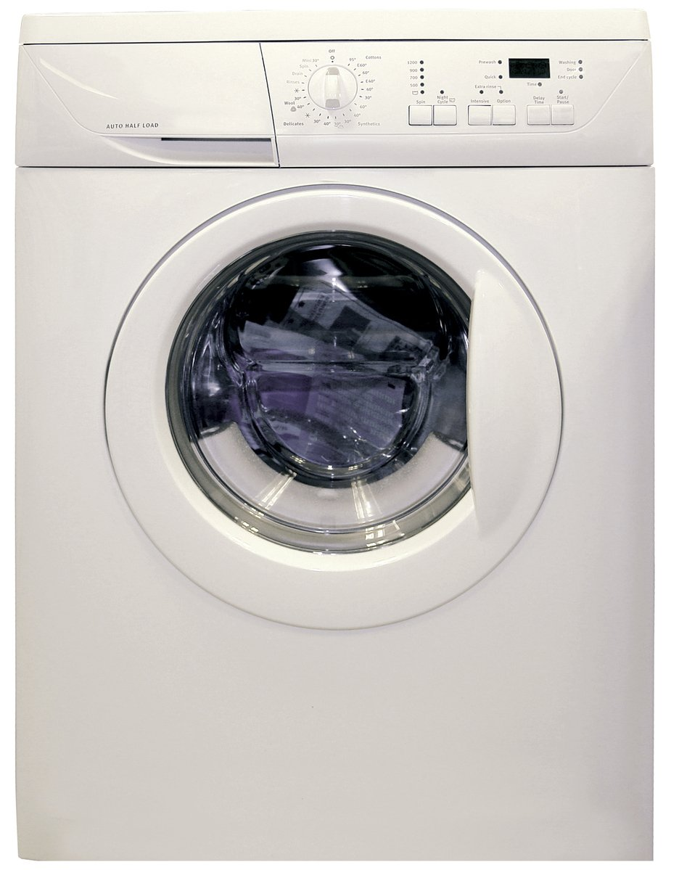
Practical Impact
Laundry represents about 19% - 28% of home energy use in houses using electric water heating (energy calculations based on data from https://www.energystar.gov/ )
Little research on changing laundry behaviour
Target behaviours:
Re-wear
Combine loads
Use cold water
Hang dry clothes
Image credit: https://en.wikipedia.org/wiki/Clothes_dryer#/media/File:Clothes_Dryer.jpg
Notes:
Image source: https://www.freeimages.com/photo/washing-machine-1418432

Slide 4
Pilot Surveys
Perhaps a decal on the laundry machine could provide a lasting nudge?
Constant reminder
Attractive
Low-cost
What‘s the right message?
6 pilot surveys (Feb 2021 – Apr 2021) pre-tested ideas via hypothetical scenarios with online samples from Prolific.co
Financial appeals were not effective (e.g., “Change your laundry habits to reduce your costs by $2,129 over 10 years!”)
Climate appeals were not effective (e.g., “Change your laundry habits to reduce your CO2 by 95,287 grams over 10 years!”)

Slide 5
Main Study Design: Participants
N=1,210 BC Hydro customers recruited from BC Hydro’s Team Power Smart program and completed the first survey
Hourly energy meter data for 1 year study (plus 1 year prior history)
Follow-up surveys every 3 months, for 1 year total
Must have Washing Machine & Clothes Dryer and pay energy bill
64% women, mean age = 57
Research questions:
Long term impact of decal nudge?
Pro-environment message, pro-self, or both?
Request many behavior changes, or just one hard one?
Notes:
Note: 1,647 agreed to participate in advance, but only 1,158 completed the time 1 survey, mostly due to blocked emails from Microsoft-related email addresses (such as @hotmail, @outlook, @msn, and @live email addresses) blocking our emails.

Slide 6
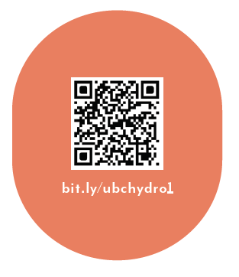
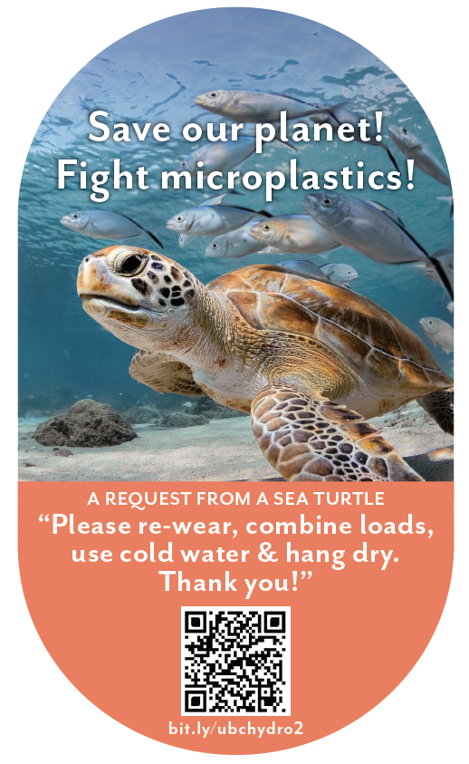
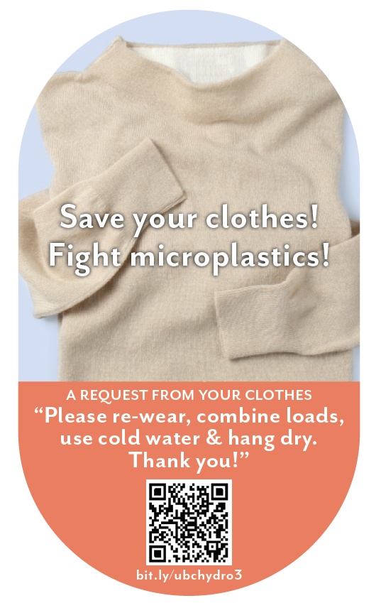
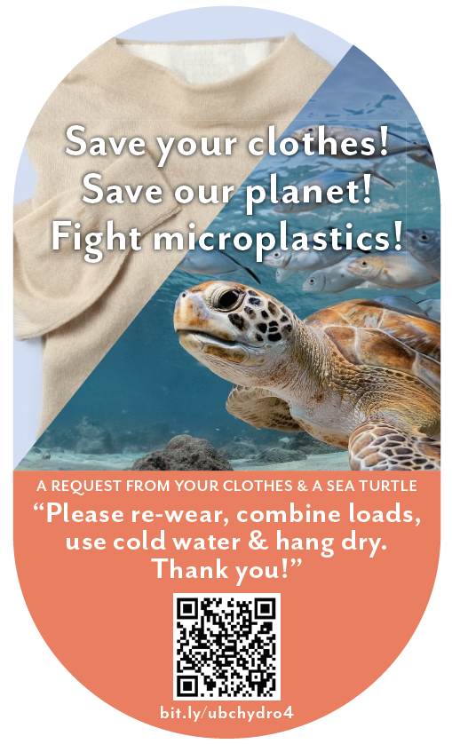
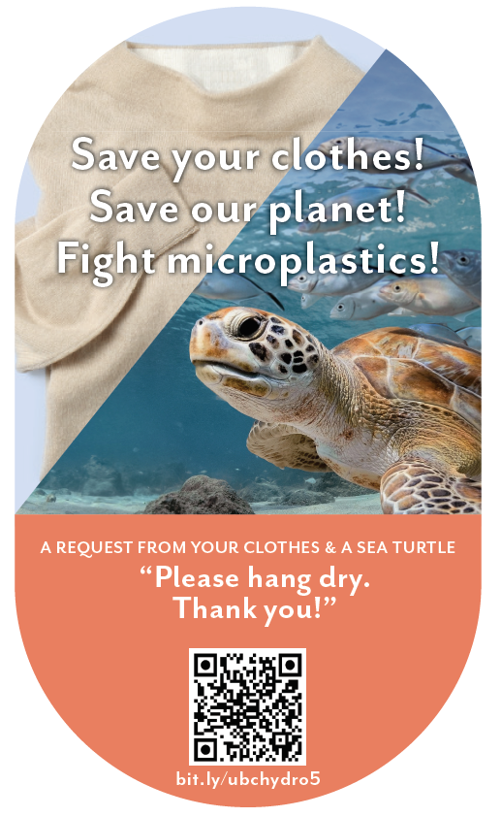
(1)
Study Design: Overview
Independent Variable: Participants randomly assigned to one of six conditions
(2)
(3)
(4)
(5)
(6)

Slide 7
Control (no decal)

Slide 8
Control (logging decal only)
As part of your participation in this study, we will mail you a decal to put on your washer or dryer, which will look like the following:

Slide 9
Sea Turtle + Bundled
When you machine wash and dry your clothes with hot water and hot air, “microplastics” come out of your clothes. In fact, experts say that between 700,000 and 12 million microfibres can be shed during one single load of laundry. It is estimated that laundry is responsible for 35% of microplastics in our oceans, seriously harming sea turtles and other marine life. You can save our planet by: - Re-wearing clothes more often - Combining loads to run fewer, larger loads of laundry - Washing laundry with cold water, rather than hot water or warm water - Hanging clothes to dry (inside or outside), rather than machine-drying clothes As part of your participation in this study, we will mail you a decal to put on your washer or dryer, which will look like the following:

Slide 10
Clothing + Bundled
When you machine wash and dry your clothes with hot water and hot air, “microplastics” come out of your clothes. In fact, experts say that between 700,000 and 12 million microfibres can be shed during one single load of laundry. This breaks down the fabric in your clothes, damaging it and shortening the amount of time you’ll be able to enjoy wearing it. You can save your clothes by: - Re-wearing clothes more often - Combining loads to, run fewer, larger loads of laundry - Washing laundry with cold water, rather than hot water or warm water - Hanging clothes to dry (inside or outside), rather than machine-drying clothes
As part of your participation in this study, we will mail you a decal to put on your washer or dryer, which will look like the following:

Slide 11
Turtle + Clothing + Bundled
When you machine wash and dry your clothes with hot water and hot air, “microplastics” come out of your clothes. In fact, experts say that between 700,000 and 12 million microfibres can be shed during one single load of laundry. This breaks down the fabric in your clothes, damaging it and shortening the amount of time you’ll be able to enjoy wearing it. It is also estimated that laundry is responsible for 35% of microplastics in our oceans, seriously harming sea turtles and other marine life. You can save your clothes and save our planet by: - Re-wearing clothes more often - Combining loads to, run fewer, larger loads of laundry - Washing laundry with cold water, rather than hot water or warm water - Hanging clothes to dry (inside or outside), rather than machine-drying clothes As part of your participation in this study, we will mail you a decal to put on your washer or dryer, which will look like the following:

Slide 12
Turtle + Clothing + Hang Dry
When you machine wash and dry your clothes with hot water and hot air, “microplastics” come out of your clothes. In fact, experts say that between 700,000 and 12 million microfibres can be shed during one single load of laundry. This breaks down the fabric in your clothes, damaging it and shortening the amount of time you’ll be able to enjoy wearing it. It is also estimated that laundry is responsible for 35% of microplastics in our oceans, seriously harming sea turtles and other marine life.
You can save your clothes and save our planet by: - Hanging clothes to dry (inside or outside), rather than machine-drying clothes As part of your participation in this study, we will mail you a decal to put on your washer or dryer, which will look like the following:

Slide 13
Summary: Decal Effectiveness vs Control
Condition | Intentions | Self-report | Logged Washing | Logged Drying | Metered Washing | Metered Drying
Turtle + Bundle | ✓ | † | ✓ | ✓ | † | ✓
Fleece + Bundle | ✓
Turtle + Fleece + Bundle | ✓ |  |  |  | †
Turtle + Fleece + Hang Dry | ✓ | † |  | ✓ |  | ✓

Slide 14
Energy Meter Results: kWh for logging participants
Condition | n | Total Energy | Wash Energy | Dry Energy | Ratio (Dry/Wash)
Control (Decal only) | 94 | 15,168 | 139 | 121 | 0.81
Turtle + Bundle Msg | 91 | 14,704 | 105† | 79* | 0.68**
Fleece + Bundle Msg | 98 | 15,778 | 141 | 121 | 0.8
Turtle + Fleece + Bundle Msg | 72* | 14,240 | 102† | 82* | 0.79
Turtle + Fleece + Hang Dry Msg | 92 | 14,410 | 122 | 86* | 0.69**
Symbols indicate significant differences from control. † p < .1, * p < .05, ** p < .01
Notes:
In Canada, the overall electricity consumption in 2020 totals 13499.43 kWh

Slide 15
Conclusions
In the context of a motivated sample of BC laundry doers, over a period of one year:
Decals can be an effective nudging tool for sustaining energy efficient behaviour over time
Intentions often do not translate into real behaviour change
Most effective: combining a single, novel motivator (microplastics turtle) with multiple behaviour change requests

Slide 16
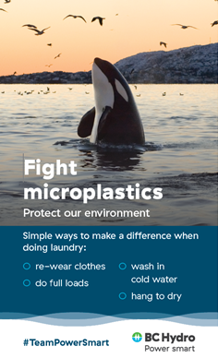
The Implemented Version

