Slide 1
The Sign Effect in Past and Future Discounting
Sarah Molouki, Chicago Booth
David J. Hardisty*, UBC Sauder
Eugene Caruso, UCLA Anderson
Notes:
Images from unsplash.com

Slide 2


Temporal Discounting
We care less about the future
Good things -> Now
Bad things -> Later
Sign effect:
We want to have good things now more strongly than we want to postpone bad things (Mischel, Grusec, & Masters, 1969; Thaler, 1981)
Notes:
Image from unsplash.com
You are on the airplane. Drink cart now or later? Writing letters of recommendation now or later?

Slide 3
The Sign Effect: Across Domains
Discount rates (Hardisty & Weber, 2009):
Dollar gains: 38%
Environmental gains: 38%
Health gains: 57%
Dollar losses: 7%
Environmental losses: 11%
Health losses: -1%

Slide 4
What causes the sign effect?
Loss aversion
Vs.
Contemplation utility

Slide 5
Loss Aversion?
Loss aversion (Tversky & Kahneman 1991):
losses weigh twice as much as gains
(See also : Baumeister et al 2001; Rozin & Royzman 2001)
Magnitude effect (Thaler 1981):
lower discount rates for larger outcomes
Sign effect = loss aversion + magnitude effect?
(Loewenstein & Prelec, 1992; Baucells & Bellezza 2017)

Slide 6
NOT Loss Aversion
Real choices (unpublished data):
Receive $70 now or $70 in a month?
100% choose now
Pay $70 now or $70 in a month?
47% choose later
Receive $140 now or $140 in a month?
100% choose now
Pay $35 now or $35 in a month?
50% choose later

Slide 7
Contemplation Emotions?
We derive pleasure and pain from contemplating future and past events (Loewenstein 1987; Baucells & Bellezza 2017)
Contemplation Emotions
  Anticipatory emotions
  Recall emotions
Lowers discount rates

Slide 8

Kiss from a movie star: when?
(Loewenstein, 1987)
“Normal” Discounting -> Now
Contemplation Emotions -> Later

Slide 9

Scheduling a dental procedure
Image from unsplash.com
“Normal” Discounting -> Later
Contemplation Emotions -> Now
Notes:
Image from unsplash.com

Slide 10
Contemplation Emotions?
Asymmetry
Lots of evidence for “dread” influencing intertemporal choice
(Berns et al 2006; Harris 2012; Hardisty & Weber 2019)
Not much evidence for “savoring” influencing intertemporal choice
(though see Chun, Diehl, & Nunes, 2017)
This asymmetry may drive the sign effect

Slide 11
A critical test: Future vs Past
We discount past events, even more than future events (Caruso, Gilbert, & Wilson, 2008)
Sign effect in the past?
Loss aversion account:
Sign effect should be the same in the past
Contemplation account:
Sign effect should be reduced or eliminated in the past

Slide 12
Overview
Study 1: Discounting and contemplation of hypothetical events
Study 2: Contemplation of (real) jellybeans & photographs
Study 3 (summary): Fancier version of Study 1

Slide 13
Study 1a
Sign x Tense with money

Slide 14
Study 1a: Methods
184 Mturkers
2 (gain vs loss) x 2 (future vs past)
Within subjects, counterbalanced
Gains (~$10) twice as big as losses (~$5)

Slide 15
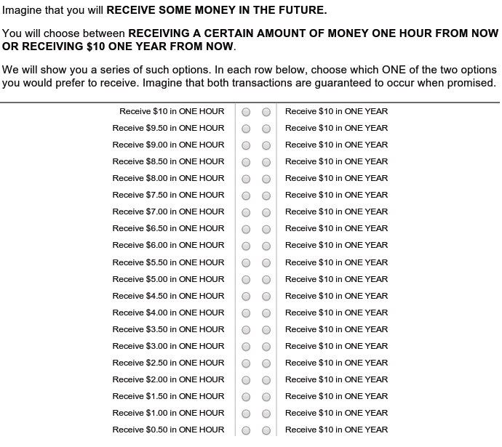

Slide 16
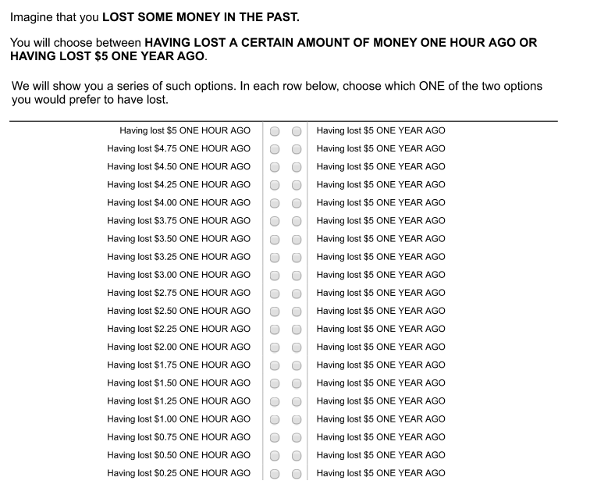

Slide 17
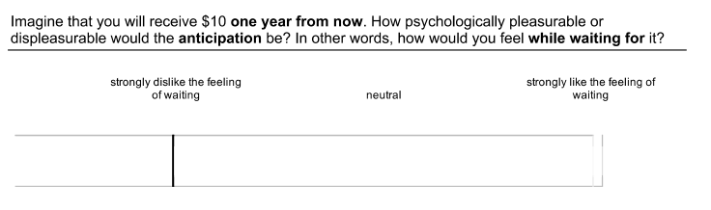
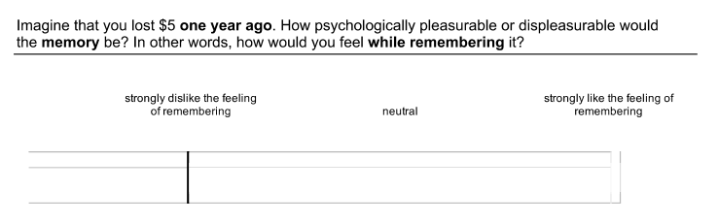
Study 1a: Contemplation Emotions

Slide 18
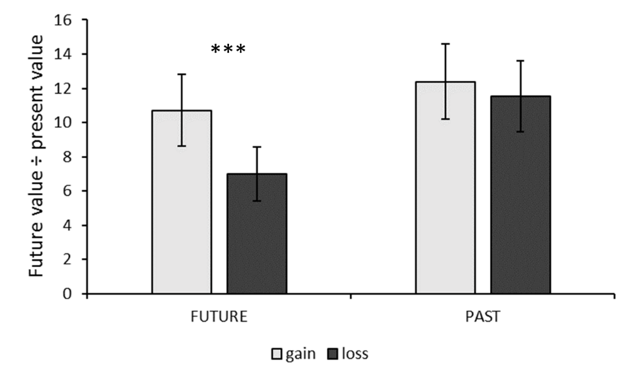
Study 1a: Discounting Results

Slide 19
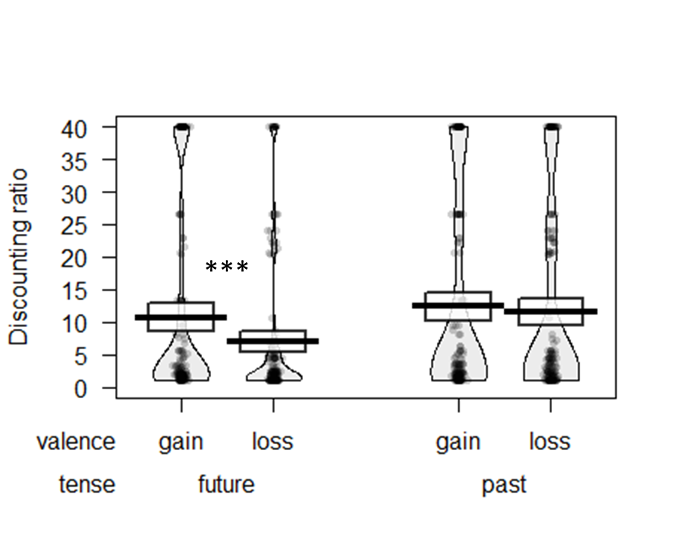
Study 1a: Discounting Results

Slide 20
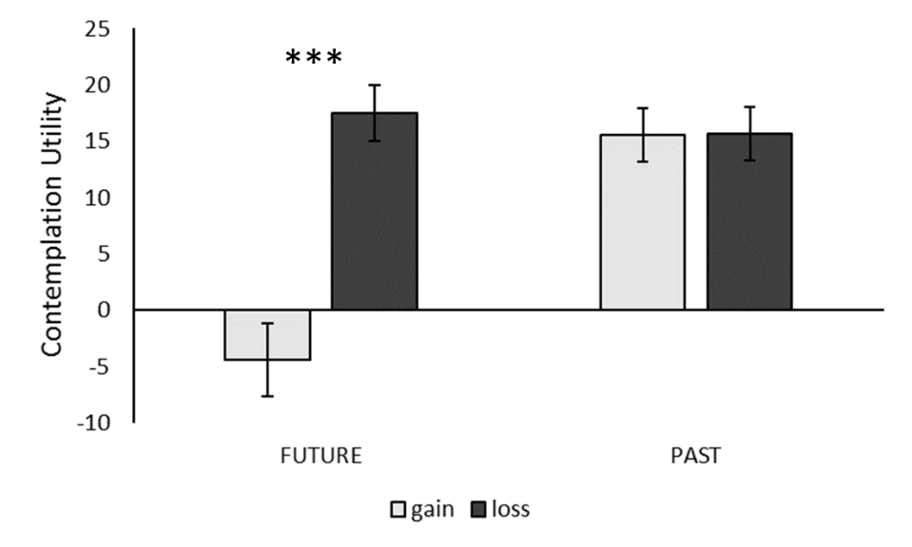
Study 1a: Contemplation Emotion Results

Slide 21
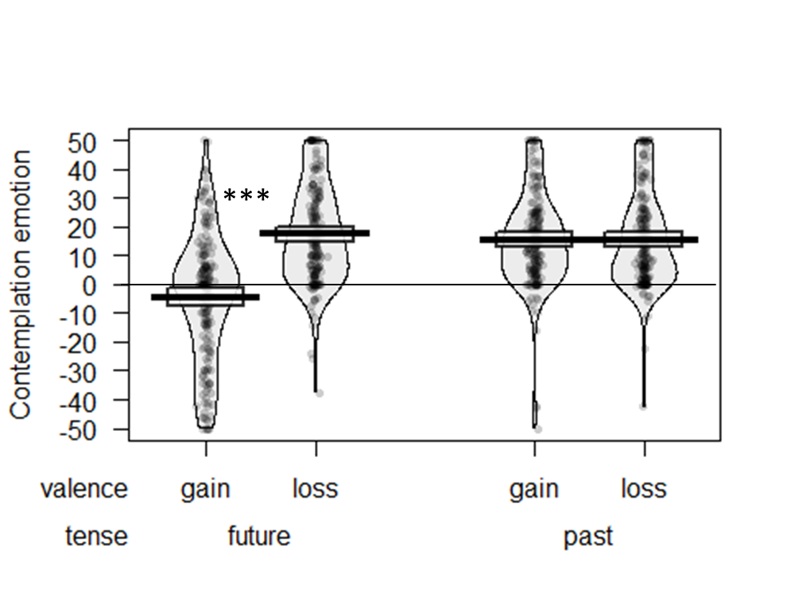
Study 1a: Contemplation Emotion Results

Slide 22
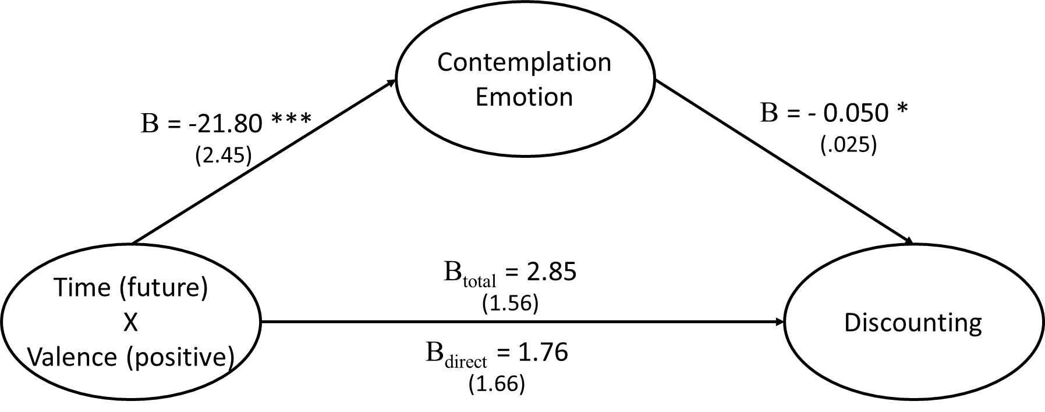
Study 1a: Mediation

Slide 23
Study 1b
Sign x Tense with hedonic events

Slide 24
Study 1b: Methods
186 Mturkers
Same design as Study 1a
Stimuli:
Pos: receiving a pleasant 1 hour massage
Neg: receiving an unpleasant (but non-harmful) 1 minute electric shock

Slide 25
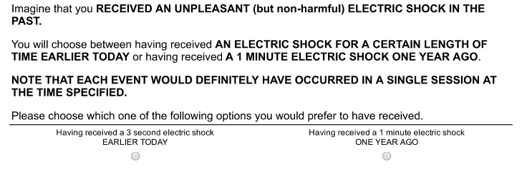
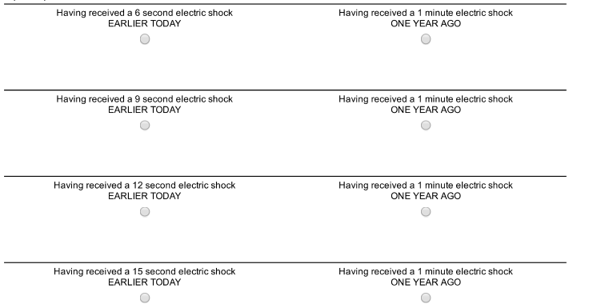

Slide 26
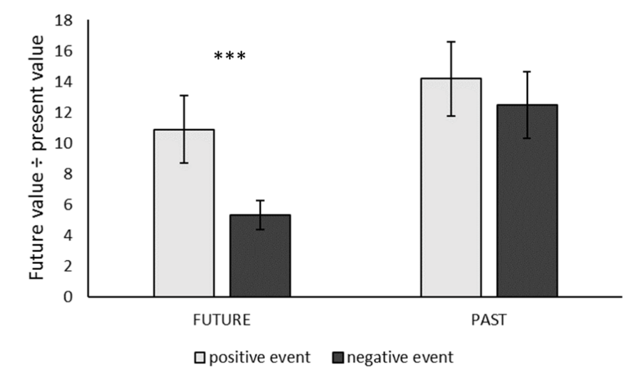
Study 1b: Discounting

Slide 27
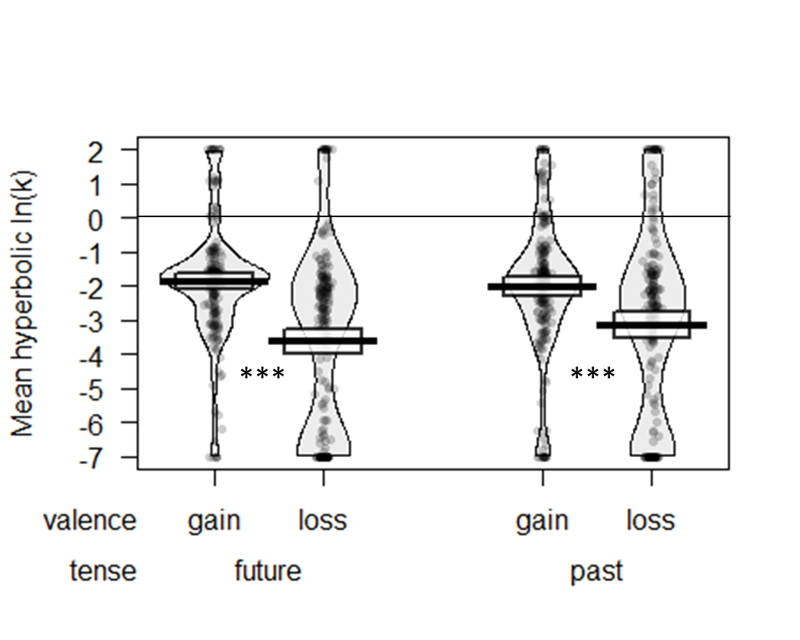
Study 1b: Discounting

Slide 28
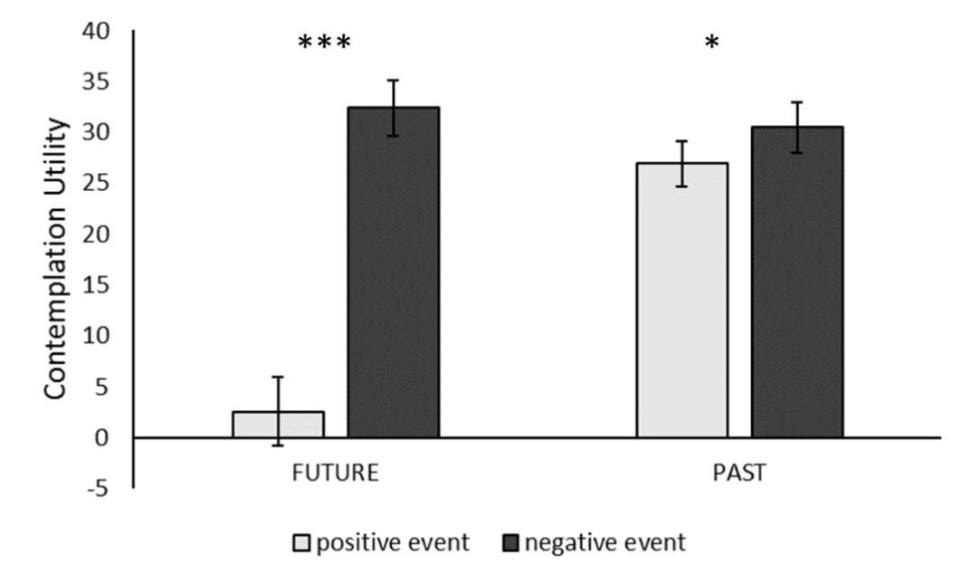
Study 1b: Contemplation emotion

Slide 29
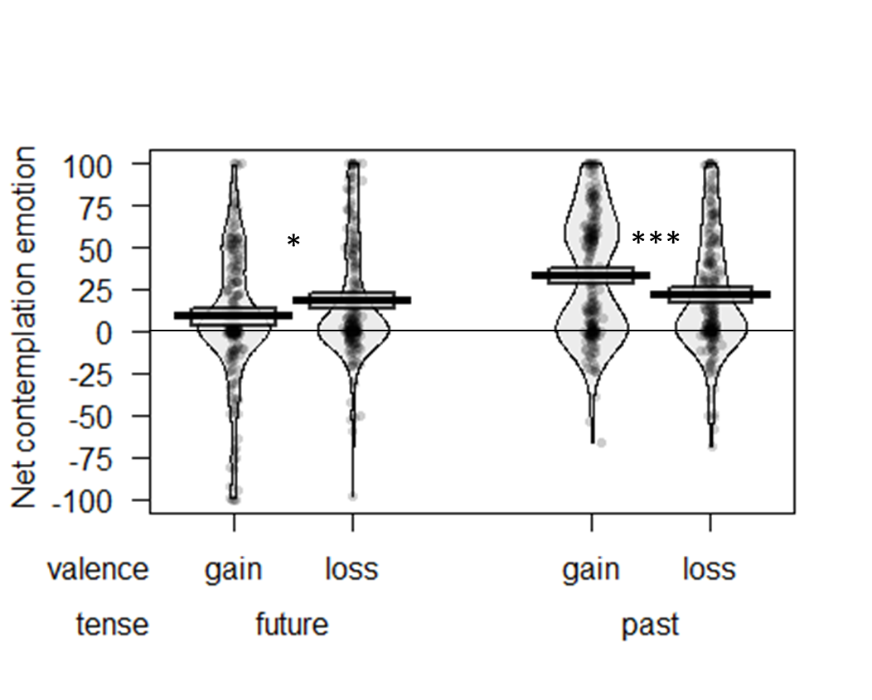
Study 1b: Contemplation emotion

Slide 30
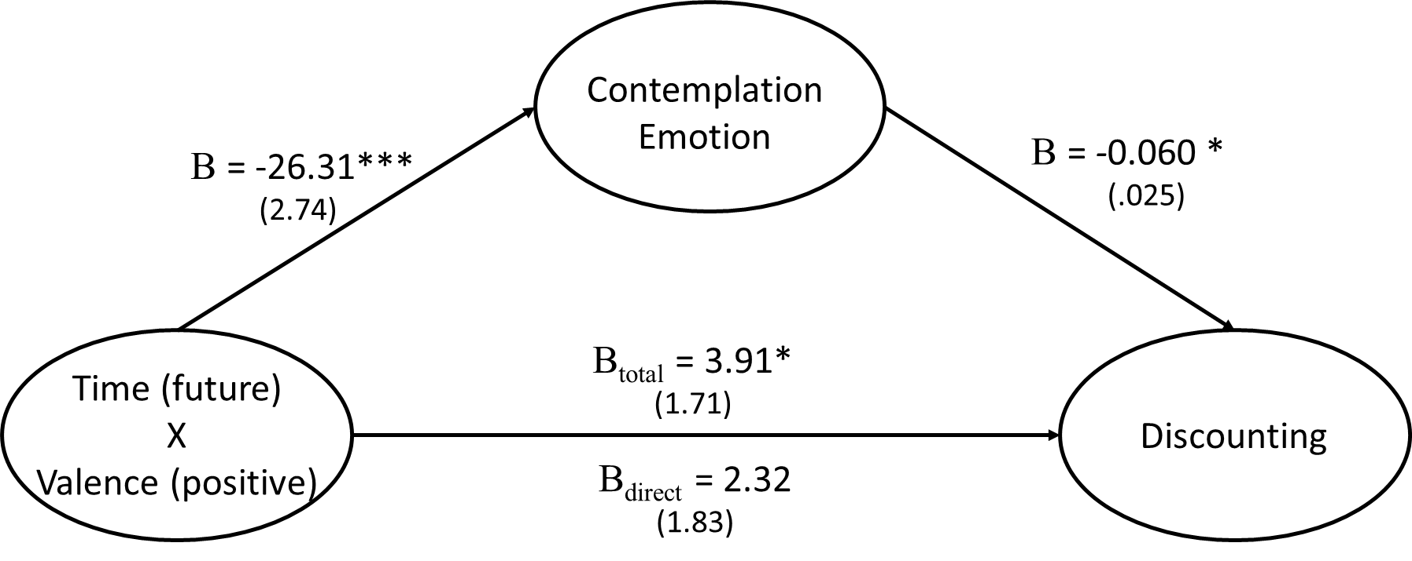
Study 1b: Mediation

Slide 31
Study 1: Discussion
Sign effect eliminated in past discounting
Contemplation utility:
  shows a similar pattern
  Mediates the sign X tense interaction
Study 2:
Real outcomes
Rule out demand/consistency effects
Why is contemplation utility of future gains so low?
  Contemplation of future positives is a mixed experience
  Contemplation of other events is unipolar

Slide 32
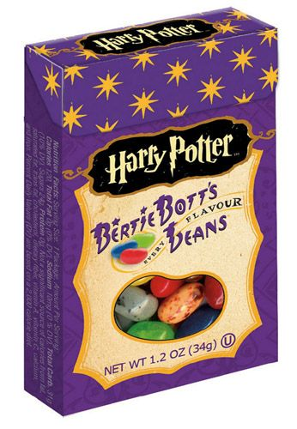
Study 2: Real Events
Notes:
Story here about attempting shocks and massages

Slide 33
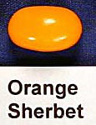
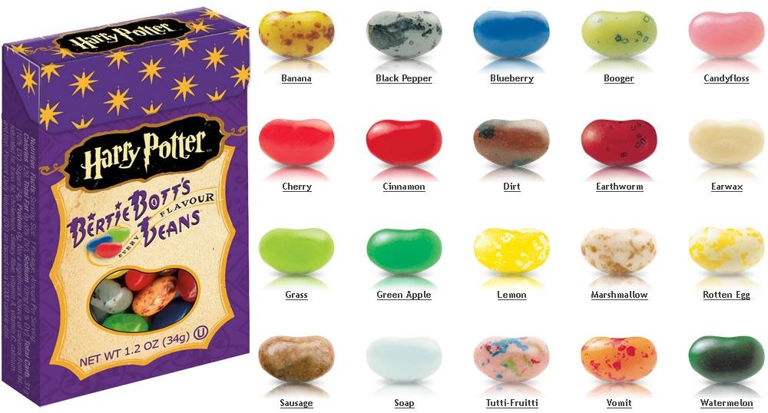
Study 2a: Stimuli

Slide 34
Study 2a: Methods
100 university students
2x3 design:
Flavor: pos vs neg, between subjects
Time: future vs present vs past, within subjects:
T1: Predicted experience and current anticipation
15 minutes filler tasks
T2: Rate experience
15 minutes filler
T3: Remembered experience and current recall emotion

Slide 35
Study 2a: Methods T1
The flavor you have been assigned to is:
dirt_____
15 minutes from now, you will be eating this jelly bean.

Slide 36
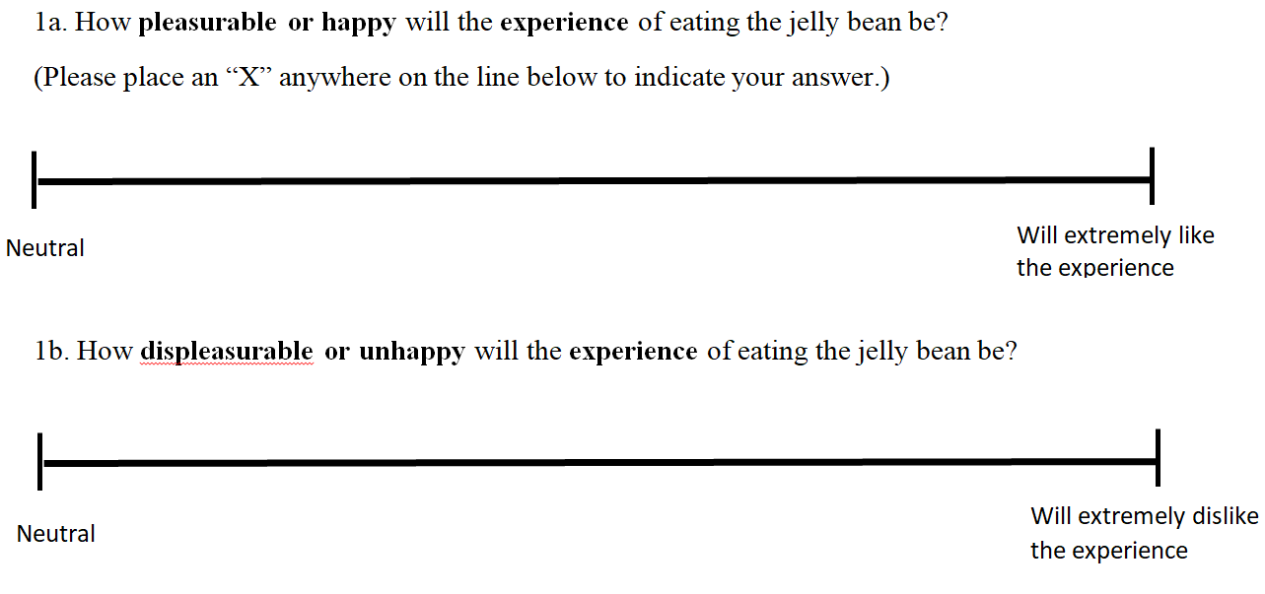
T1 Experience prediction

Slide 37
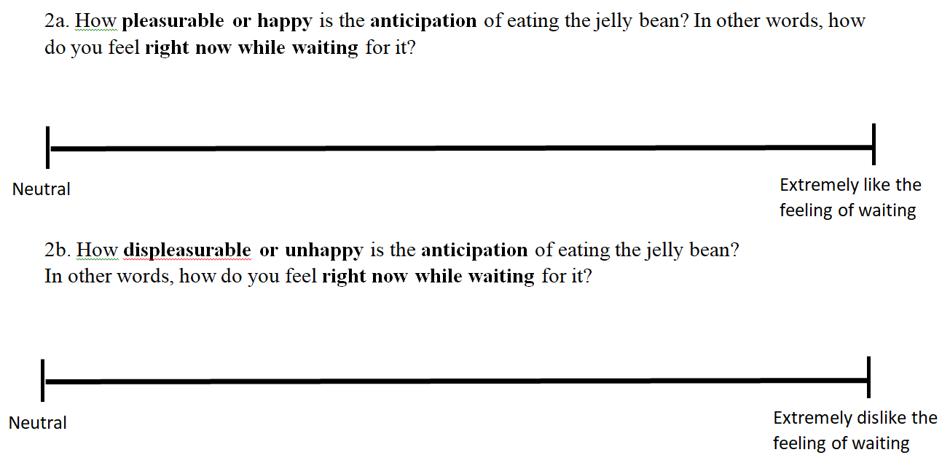
T1 Contemplation emotion

Slide 38
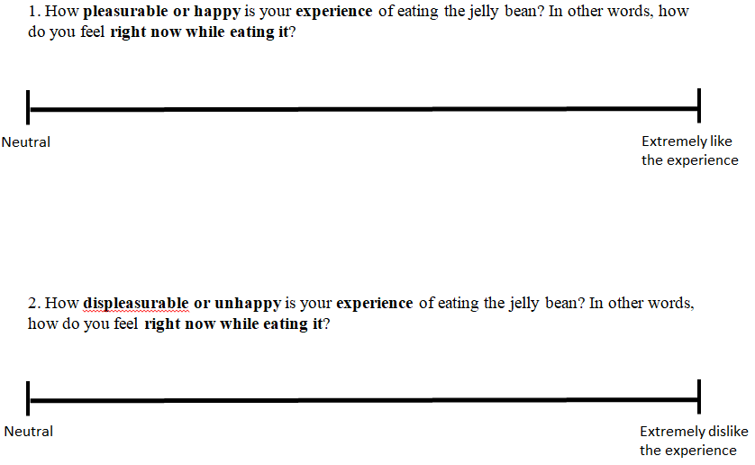
T2 Experience ratings

Slide 39
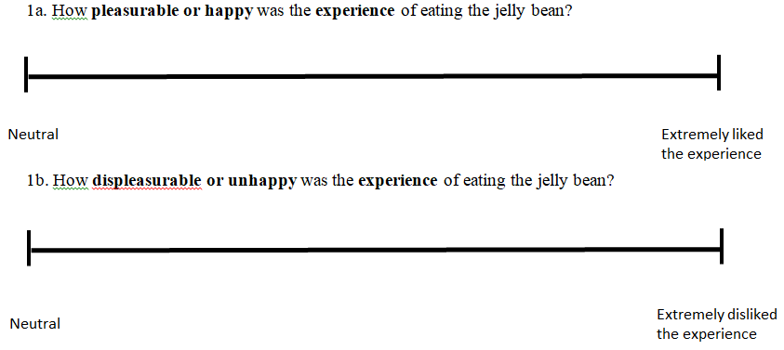
T3 Experience Memory

Slide 40
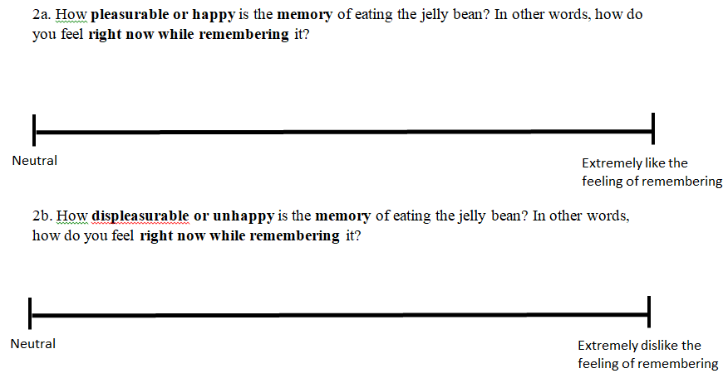
T3 Contemplation Emotion

Slide 41
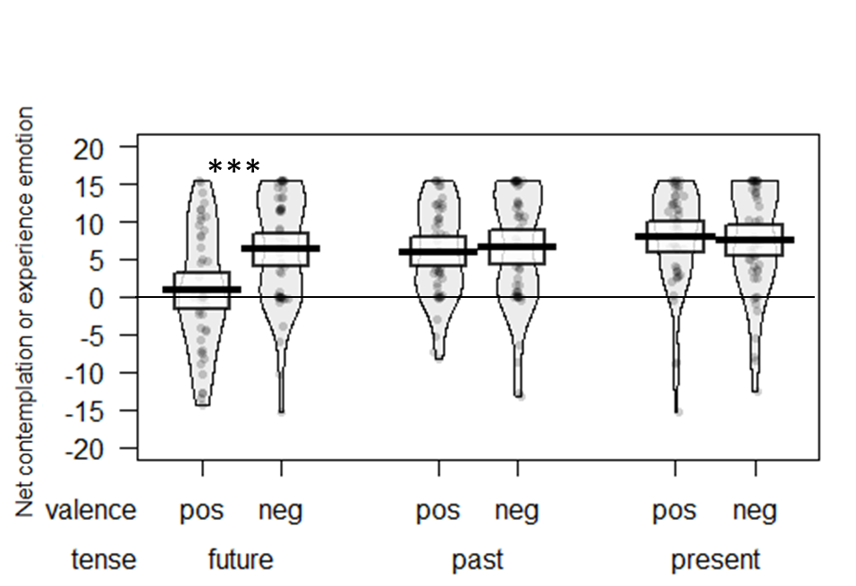
Study 2a Results: Contemplation Emotion

Slide 42
Study 2a: Discussion
Contemplation of future positive is a mixed experience (both positive and negative)
Contemplation of future negative is a unipolar negative experience
Contemplation of past positives and negatives are unipolar

Slide 43


Study 2B
We also did it with photos of puppies and cockroaches

Slide 44
Study 3
Alternative explanations

Slide 45
Study 3: Methods
Similar design to Study 1:
  Future vs past
  Positive vs negative
  Money vs hedonic
N = 400 MTurkers

Slide 46
Study 3: Methods
Individually titrate loss aversion. Median results:
  $10 gain = $5 loss
  60 minute massage = 10 second electric shock
A dynamic measure of discounting with greater range and precision (ToAD, Yoon & Chapman 2016)
Measured alternative processes:
  Connection to future/past self
  Thought frequency
Measure and adjusted for utility curvature

Slide 47
Study 3: Financial Utility Curvature

Slide 48
Study 3: Hedonic Utility Curvature
Seconds of electric shock
Minutes of massage

Slide 49
Study 3: Summary of Results
Key results replicated:
  Discount rates
  Contemplation utility
  Mediation
Adjusting for utility curvature: no effect
Connection to distant self & thought frequency:
  Predict discount rates
  Do not explain the sign X tense interaction

Slide 50
Conclusions
We discount gains more than losses in the future, but not in the past
The sign effect is NOT explained by loss aversion
The sign effect is partly explained by differences in contemplation emotions:
  Anticipation of future positive events is a mixed emotion
  Recall of past positive events feels good
  Contemplation of future and past losses always feels bad

Slide 51
Thank you!

