Slide 1

Ray Charles “Chuck” Howard, University of Virginia
Pinglan “Apple” Yang, University of British Columbia
Dale W. Griffin, University of British Columbiaa
Chongbo “Zack” Wang, HKU Business School
David J. Hardisty, University of British Columbia
Documenting and Debiasing
the
Income Prediction Bias

Slide 2





Co-authors & Funding
Chuck Howard
Apple Yang
Dale Griffin
Zack Wang

Slide 3

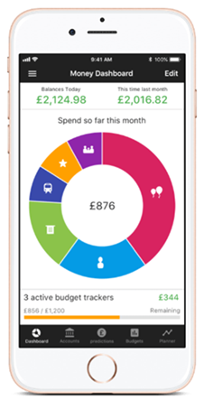

Motivation
Over 65% of US consumers predict income
(Zhang et al. 2020)
Notes:
Given the topic we’re discussing today, I think a useful place to start is with the observation that income prediction is a very common consumer behavior. In the US, for example, over 65% of consumers report that they spend at least some time estimating their future income, as part of their household budgeting process.
There are also reasons to believe that income misprediction can be consequential, and in particular, that overpredicting future income can be problematic. As an example, consider a consumer who needs to buy a new fridge. In deciding how much they can afford to spend, they predict that their income for the next month will be $2,000 and their other household expenses will be $1,500.
What about a recurring expense that keeps leaving them short each month, like rent or tuition?
What is a need the audience can relate to? Who is the type of person they can relate to?
“Interventions that help people accurately understand future expenses and income may thus minimize current spending and future debt.” → Hershfield et al. (2015)
Pictures from:
- Money Dashboard (partner)
https://www.pexels.com/photo/man-looking-at-an-empty-wallet-7927581/
https://twitter.com/cnbctv18live/status/1285086501387161601

Slide 4
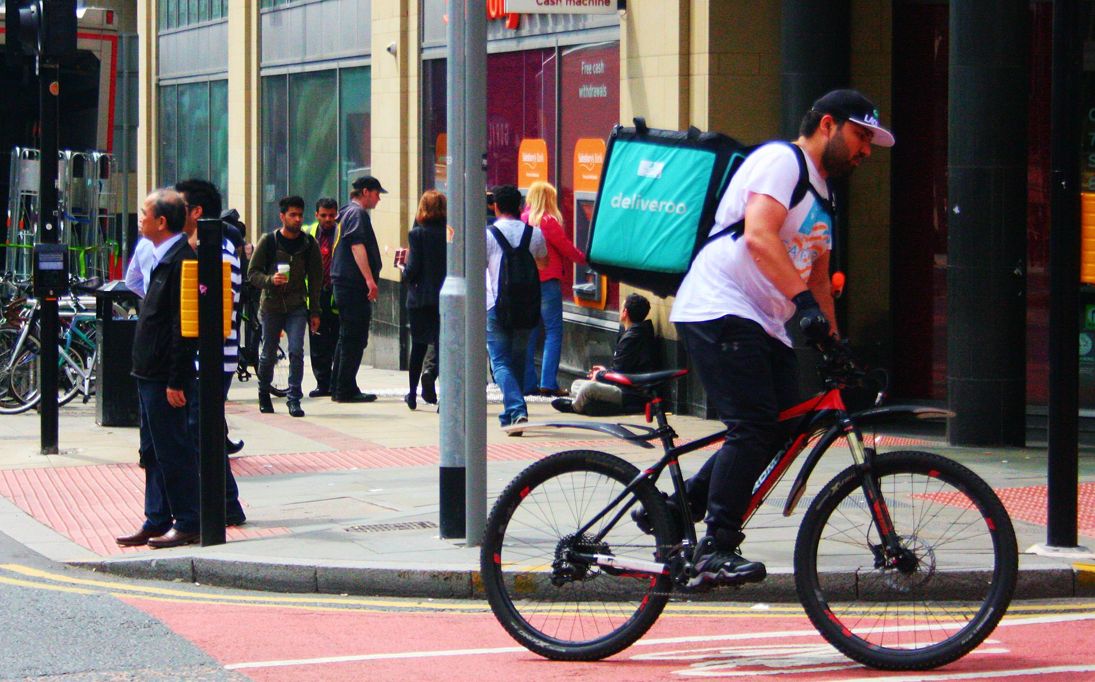
Motivation
Gig employment = temporary, freelance, or on-demand work
(Hershfield, Shu, and Benartzi, 2020; Ludwig et al., 2022)
Notes:
Gig economy employment refers to temporary, freelance work arrangements that are typically short-term, where independent contractors are hired on-demand.
For the purposes of today’s talk, we’re going to focus on gig workers for major tech platforms, such as Uber or Doordash
Picture credit: Gig worker. (2022, October 16). In Wikipedia. https://en.wikipedia.org/wiki/Gig_worker

Slide 5
Motivation
About one-third of the US labor market works in the gig economy, and gig income totals over $1.3 trillion annually (McFeely and Pendell 2018; Upwork 2021)
Globally, online gig work has increased 41% between 2016 and 2023
(World Bank Group, 2023)
Globally, 1.1 billion people work in the gig economy (Zgola 2021)
Notes:
Zgola (2021): https://www.forbes.com/sites/forbesbusinesscouncil/2021/08/12/will-the-gig-economy-become-the-new-working-class-norm/?sh=46e09497aee6
McFeely and Pendell (2018): https://www.gallup.com/workplace/240929/workplace-leaders-learn-real-gig-economy.aspx; One-third = about 55M people
Upwork (2021): https://www.upwork.com/press/releases/upwork-study-finds-59-million-americans-freelancing-amid-turbulent-labor-market
Statista (2022): https://www.forbes.com/sites/forbesbusinesscouncil/2021/08/12/will-the-gig-economy-become-the-new-working-class-norm/?sh=46e09497aee6
World Bank (2023): https://openknowledge.worldbank.org/entities/publication/ebc4a7e2-85c6-467b-8713-e2d77e954c6c
31% of US gig workers are full-time: https://www.pewresearch.org/internet/2021/12/08/the-state-of-gig-work-in-2021/
The article that directed me to the links above: https://fortunly.com/statistics/gig-economy-statistics/#gref

Slide 6
Motivation
Those experiencing income volatility:
are less likely to report saving (Fisher, 2010; Pew Charitable Trusts, 2017; TD Bank Group, 2017)
miss bill payments more often (Farrell and Greig, 2016; TD Bank Group, 2017)
have greater risk of mortgage delinquency, even independent of overall income amount (Diaz-Serrano, 2005)
have lower self-reported financial well-being and greater financial strain (Pew Charitable Trusts, 2017; TD Bank Group, 2017; Peetz & Robson, 2021; Goncharova & De La Rosa, 2026)
(causally) make more “impatient” financial choices (West et al., 2020; Peetz & Robson, 2021)
(causally) are less likely to plan ahead financially and less likely to save (Peetz, Robson, & Xuereb, 2021)
Notes:
Diaz-Serrano, L. (2005). Income volatility and residential mortgage delinquency
across the EU. J. Housing Econ. 14, 153–177. doi: 10.1016/j.jhe.2005.07.003
Farrell, D., and Greig, F. (2016). Paychecks, paydays, and the online platform
economy: Big data on income volatility. Washington, DC: JP Morgan Chase
Institute.
Fisher, P. J. (2010). Income uncertainty and household saving in the United States.
Family Consum. Sci. Res. J. 39, 57–74. doi: 10.1111/j.1552-3934.2010.02045.x
Goncharova, E., & De La Rosa, W. (2026). The Impact of Income Volatility on Subjective Wealth and Financial Behaviors. Working paper.
Peetz, J., Robson, J., & Xuereb, S. (2021). The role of income volatility and perceived locus of control in financial planning decisions. Frontiers in Psychology, 12, 638043.
Pew Charitable Trusts (2017). How Income Volatility Interacts with American
Families’ Financial Security. Hyatt Regency Chicago: Pew Charitable
Trusts.
TD Bank Group (2017). The impact of income volatility. Toronto: TD Bank Group
West, C., Whillans, A. V., and DeVoe, S. (2020). Income Volatility Increases
Financial Impatience. Working paper 21-053. Cambridge, MA: Harvard
Business School.

Slide 7
Motivation
Budgeting is commonly conceptualized as a two-stage process: (Choe and Kan 2021; Heath and Soll 1996; Lukas and Howard 2023; Sussman and Alter 2012; Thaler 1999)
  Consumers allocate their income to different budget categories
  Consumers track their spending in each category against their budget
Missing first step? Estimating Income
Notes:
Image source: https://unsplash.com/

Slide 8
Research Questions
RQ1: Is there an income prediction bias?
RQ2: Why do people overpredict?
RQ3: How can we improve prediction accuracy?

Slide 9
Roadmap
Background
Theory and hypotheses for RQ1 and RQ2
Descriptive Studies 1 and 2
Theory and hypotheses for RQ3
Intervention Studies 3 & 4
Discussion
Notes:
Roadmap for rest of talk: Theory and hypotheses related to RQ’s 1 and 2, then two main effect studies, then theory and hypotheses related to RQ3, then two debiasing studies.
Preview the studies: longitudinal, real gig workers, app data, etc.

Slide 10
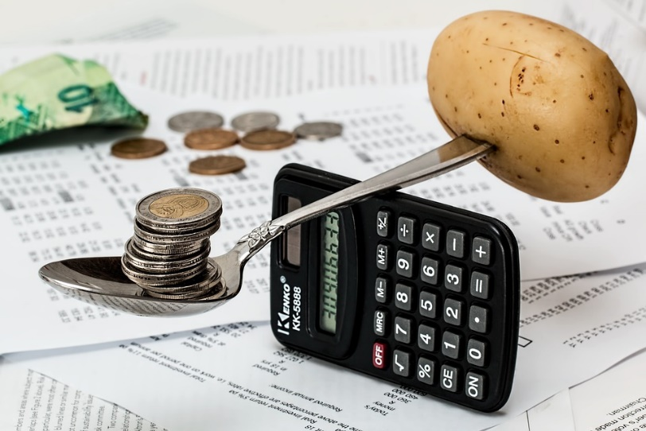
Background
Savings = Income – Expenses
Notes:
Image source: https://unsplash.com/

Slide 11

Background
Savings = Income – Expenses
Hershfield et al. 2011
Hershfield et al. 2018
Hershfield et al. 2020
Koehler et al. 2011
Shu & Payne 2015
Thaler & Benartzi 2004
Notes:
Image source: https://unsplash.com/
The Koehler et al cite pertains specifically to people underpredicting how much money they will save.
Hershfield, H. E., Goldstein, D. G., Sharpe, W. F., Fox, J., Yeykelis, L., Carstensen, L. L., & Bailenson, J. N. (2011). Increasing saving behavior through age-progressed renderings of the future self. Journal of marketing research, 48(SPL), S23-S37.
Hershfield, H. E., John, E. M., & Reiff, J. S. (2018). Using vividness interventions to improve financial decision making. Policy Insights from the Behavioral and Brain Sciences, 5(2), 209-215.
Hershfield, H. E., Shu, S., & Benartzi, S. (2020). Temporal reframing and participation in a savings program: A field experiment. Marketing Science, 39(6), 1039-1051.
Koehler, D. J., White, R. J., & John, L. K. (2011). Good intentions, optimistic self-predictions, and missed opportunities. Social Psychological and Personality Science, 2(1), 90-96.
Shu, S., & Payne, J. (2015). Psychological factors in savings and decumulation decisions. ACR North American Advances.
Thaler, R. H., & Benartzi, S. (2004). Save more tomorrow™: Using behavioral economics to increase employee saving. Journal of political Economy, 112(S1), S164-S187.

Slide 12
Background
Savings = Income – Expenses
Howard, Hardisty, Sussman, & Lukas 2022
Lukas and Howard 2022
Peetz & Buehler 2009, 2012, 2013
Peetz et al. 2015, 2016
Sussman & Alter 2012
Ülkümen et al. 2008
Notes:
Image source: https://unsplash.com/

Slide 13
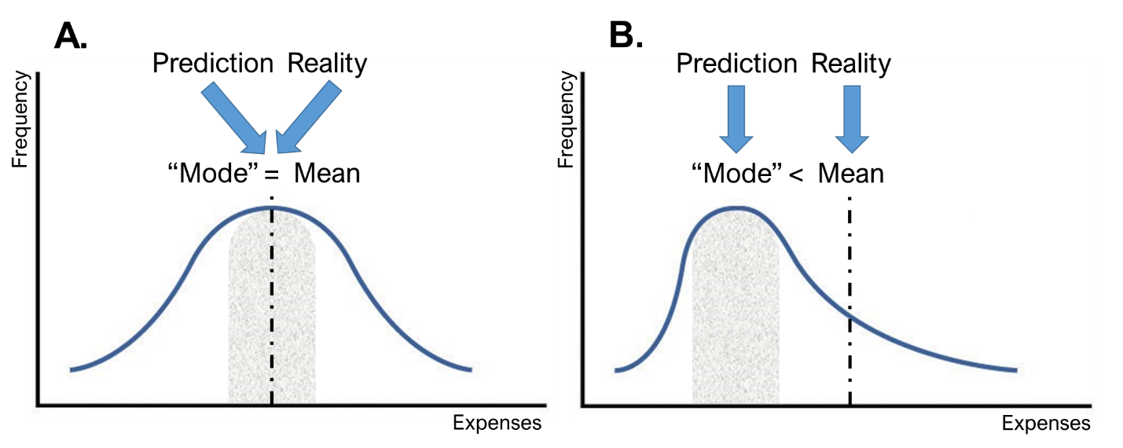
Background
Howard, Hardisty, Sussman, & Lukas (2022)
Notes:
But if you look at the work related to the income term in this equation you start to see a gap in the literature.

Slide 14
Background
Savings = Income – Expenses
Notes:
There are actually a number of structural & psychological differences between income and expenses:
Income = hours worked + hourly rate
Expenses are left bounded, but income is bounded on both sides (for most people)
Gig income is perhaps more controllable than expenses
Image source: https://unsplash.com/

Slide 15
Background
Savings = Income – Expenses
Zauberman and Lynch (2005)
Berman et al. (2016)
Betts (1996)
Webbink and Hartog (2004)
Jerrim (2015)
Peetz & Robson (2021)
Peetz, Robson, & Xuereb (2021)
Goncharova & De La Rosa (2026)
Notes:
You will find some work on subjective predictions of things like perceived financial slack or feelings of uncertainty, but that doesn’t tell us if consumers are inputting the right number for income in this budgeting equation.
Income categorization
Subjective perceptions of wealth or uncertainty
Labor econ literature typically doesn’t measure actual accuracy, and the time horizon (e.g., 5 or 10 years) doesn’t tell us much about the psychology of budgeting for the next week or month.
Wendy and Steph (a) hold income constant, (b) measure subjective uncertainty of “having enough,”, (C) measure “prediction” retrospectively, and (d) do it all in hypothetical studies on Mturk.
What makes income different? How is it a different psychological space? Skewness.
Our studies indicate that income occupies a different psychology space than expenses or savings, which makes it an important context for theory building.
Image source: https://unsplash.com/
Zauberman, G., & Lynch Jr, J. G. (2005). Resource slack and propensity to discount delayed investments of time versus money. Journal of Experimental Psychology: General, 134(1), 23.
Berman, J. Z., Tran, A. T., Lynch Jr, J. G., & Zauberman, G. (2016). Expense neglect in forecasting personal finances. Journal of Marketing Research, 53(4), 535-550.
De La Rosa, W., & Tully, S. M. (2022). The impact of payment frequency on consumer spending and subjective wealth perceptions. Journal of Consumer Research, 48(6), 991-1009.

Slide 16
Is there an income prediction bias?
The case for accuracy:
  Income targeting (Allon, Cohen, and Sinchaisri, 2018; Camerer et al., 1997; Thakral and Tô, 2021)
    Encouraged by some apps (Sheiber 2017)
  Apps provide real-time feedback on earnings
    Immediate feedback may improve calibration (e.g., Kahneman 2011)
  Students can have accurate salary expectations (Webbink and Hartog 2004)

Slide 17
Is there an income prediction bias?
The case for pessimistic predictions:
  Gamified apps keep workers working longer
  Inertia (working more after working for a longer period) (Allon, Cohen, and Sinchaisri, 2018)
  Income volitility reduces subjective estimates of wealth (Goncharova & De La Rosa; 2026)

Slide 18
Is there an income prediction bias?
The case for optimistic predictions:
  Predictions tend to be optimistic
    Expenses (e.g., Howard et al. 2022; Ülkümen et al. 2008)
    Savings (e.g., Koehler et al. 2011)
    Time (e.g., Buehler et al.1994; Kahneman and Tversky 1977)

Slide 19
Is there an income prediction bias?
H1: Consumers who work in the gig economy display an income prediction bias in which they over-predict future gig income.

Slide 20



Why do people overpredict?
# of hours
$ per hour
Notes:
A bias like this, if it exists, is almost certainly multiply determined. We focus specifically on determining if the bias is caused by overpredicting the # of hours I can work and/or the amount per hour.
Icons source: https://www.freeimages.com/

Slide 21
Why do people overpredict?
# of hours – reasons for bias
People neglect factors that will prevent them from working on specific tasks (e.g., Buehler et al. 1994, 2010; Kahneman and Tversky 1977; Kruger and Evans 2004)
  People overpredict total income in part because they overpredict the number of hours they will work
Notes:
There are an unlimited number of things that may pop up and stop you from working – the “unknown unknowns”
The flexibility of gig work is also its downfall. A “9-5 job” is protected time. Gig work can always be done later.

Slide 22
Why do people overpredict?
$ per hour – reasons for bias
People are overconfident (e.g., Lichtenstein et al.1977; Piehlmaier 2022; Stanovich and West, 1997)
Overconfidence is a driver of optimistic predictions (e.g., Dunning et al., 1990; Ulkumen et al., 2008)
  People might overpredict their total income in part because they overpredict their hourly wage

Slide 23
Why do people overpredict?
$ per hour – reasons for accuracy
Reservation wages are tied to expected wages (Brown and Taylor 2013)
Market competition sets ceiling (Hall and Krueger, 2018)
Hourly wages on Uber are relatively stable (Hall and Krueger, 2018)
$ per hour – reasons for underprediction
Hourly wage shocks tend to be positive
Notes:
If you accept the assumption that lower variability makes things easier to predict, that leads to the prediction that hourly wage estimates may be reasonably accurate.
Hall & Krueger (2018): Drivers appear to be attracted to the Uber platform largely because … earnings per hour do not vary much based on the number of hours worked. Drivers often cite the desire to smooth fluctuations in their income as one of their reasons for partnering with Uber.

Slide 24
Why do people overpredict?
H2: People tend to overpredict their gig hours more than hourly wage.

Slide 25
Study 1: The App Study
Purpose
Examine the magnitude, prevalence, and persistence of the bias for weekly and monthly predictions
Method
Conducted in partnership with KABU
Predict gig income for the next week and next month
  Wave 1: n = 49, M_{age} = 41.8, 100% men
  Wave 2: n = 39, M_{age} = 42.5, 100% men
Pregistration: https://aspredicted.org/B7M_4DH
Materials, Data, and Syntax for all studies: https://osf.io/69xwq/?view_only=b10b86b610ad41c08bcc10b7caca0d16
Notes:
Clarify that we asked people about all apps in Studies 2a and 2b
Preregistered icon citation: University of Melbourne (https://library.unimelb.edu.au/open-scholarship/preregistering_research)

Slide 26
Study 1: The App Study
Please take some time to estimate the total amount of money you will earn working for KABU in the next week.
How much money do you estimate you will earn (in total) working for KABU in the next week?
Over the past eight weeks, what percentage of your total income did you earn driving for KABU? (0-10%, 11-20%, ...)
How long have you been driving for KABU? (less than one month, 1-3 months, …)
Eight weeks of pre-study earnings data
Notes:
Key points to highlight here are (a) this study lets us measure the bias more accurately, (b) it shows whether the bias exists for monthly predictions as well as weekly predictions, and (c) it lets us determine if the bias persists over time.
Note: The dates I’ve included are approximations to use as a simple illustration.
This study was preregistered on aspredicted.org

Slide 27
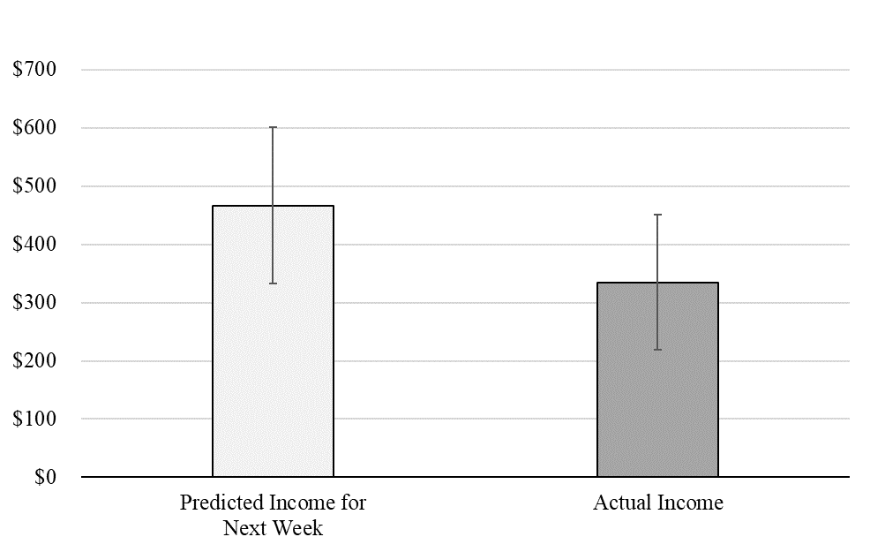

February Results
Week
Bias = $132.07 (28.3%)
t(48) = 4.01, p < .001, d = .57
r(47) = .87, p < .001
Notes:
r(47) = .87, p < .001
In the first survey, participants over-predicted their weekly income by an average of $132.07 or 28.3%, as revealed by a paired-samples t-test (M_{predicted_income} = $466.94, SD = 468.71; M_{actual_income} = $334.87, SD = 403.56; t(48) = 4.01, p < .001, d = .57). Moreover, the bias was prevalent: 75.5% of participants overpredicted to at least some extent, and 53.1% of participants over-predicted by $100 or more.
In the first survey, participants over-predicted their monthly income by an average of $347.43 or 20.1%, as revealed by a paired-samples t-test (M_{predicted_income} = $1724.52, SD = 1828.31; M_{actual_income} = $1377.09, SD = 1722.71; t(47) = 2.96, p = .005, d = .43). The bias was once again prevalent: 66.7% of participants over-predicted to at least some extent, and 50.0% of participants over-predicted by $300 or more.

Slide 28
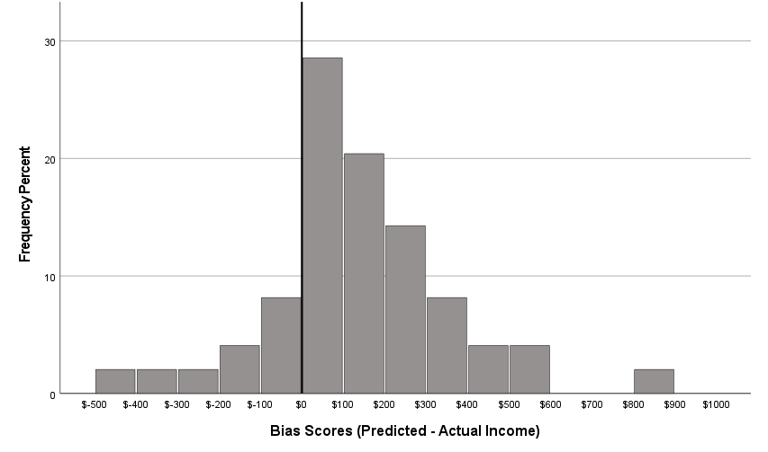
February Results
24.5%
75.5%
Notes:
Median is $100

Slide 29
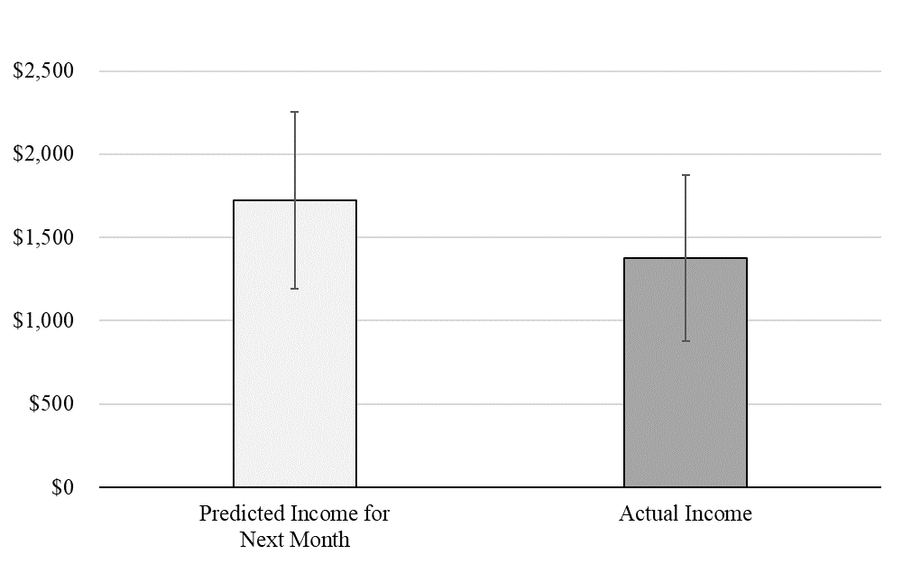
February Results
Month
Bias = $347.43 (20.1%)
t(47) = 2.96, p = .005, d = .43
r(47) = .90, p < .001
Notes:
r(47) = .90, p < .001
In the first survey, participants over-predicted their weekly income by an average of $132.07 or 28.3%, as revealed by a paired-samples t-test (M_{predicted_income} = $466.94, SD = 468.71; M_{actual_income} = $334.87, SD = 403.56; t(48) = 4.01, p < .001, d = .57). Moreover, the bias was prevalent: 75.5% of participants overpredicted to at least some extent, and 53.1% of participants over-predicted by $100 or more.
In the first survey, participants over-predicted their monthly income by an average of $347.43 or 20.1%, as revealed by a paired-samples t-test (M_{predicted_income} = $1724.52, SD = 1828.31; M_{actual_income} = $1377.09, SD = 1722.71; t(47) = 2.96, p = .005, d = .43). The bias was once again prevalent: 66.7% of participants over-predicted to at least some extent, and 50.0% of participants over-predicted by $300 or more.

Slide 30
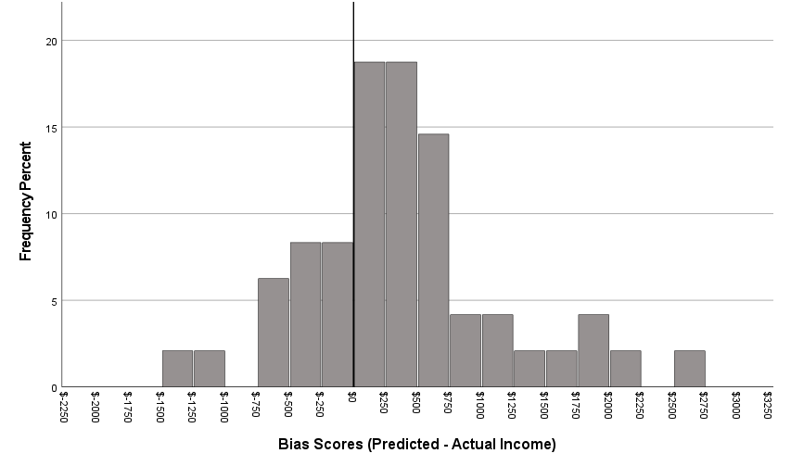
February Results
27.1%
72.9%
Notes:
Median = $301

Slide 31
March Results
Week
Bias = $118.82 (22.1%)
(p = .034)
Notes:
r(36) = .80, p < .001
In the first survey, participants over-predicted their weekly income by an average of $132.07 or 28.3%, as revealed by a paired-samples t-test (M_{predicted_income} = $466.94, SD = 468.71; M_{actual_income} = $334.87, SD = 403.56; t(48) = 4.01, p < .001, d = .57). Moreover, the bias was prevalent: 75.5% of participants overpredicted to at least some extent, and 53.1% of participants over-predicted by $100 or more.
In the first survey, participants over-predicted their monthly income by an average of $347.43 or 20.1%, as revealed by a paired-samples t-test (M_{predicted_income} = $1724.52, SD = 1828.31; M_{actual_income} = $1377.09, SD = 1722.71; t(47) = 2.96, p = .005, d = .43). The bias was once again prevalent: 66.7% of participants over-predicted to at least some extent, and 50.0% of participants over-predicted by $300 or more.

Slide 32
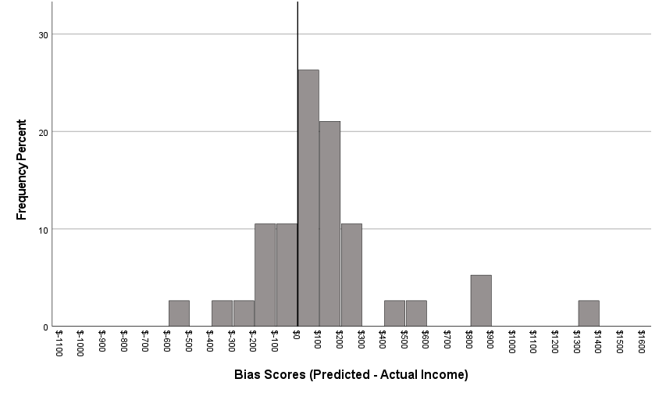
March Results
28.9%
71.1%

Slide 33
March Results
Month
Bias = $610.57 (27.8%)
(p = .003)
Notes:
r(36) = .83, p < .001
In the first survey, participants over-predicted their weekly income by an average of $132.07 or 28.3%, as revealed by a paired-samples t-test (M_{predicted_income} = $466.94, SD = 468.71; M_{actual_income} = $334.87, SD = 403.56; t(48) = 4.01, p < .001, d = .57). Moreover, the bias was prevalent: 75.5% of participants overpredicted to at least some extent, and 53.1% of participants over-predicted by $100 or more.
In the first survey, participants over-predicted their monthly income by an average of $347.43 or 20.1%, as revealed by a paired-samples t-test (M_{predicted_income} = $1724.52, SD = 1828.31; M_{actual_income} = $1377.09, SD = 1722.71; t(47) = 2.96, p = .005, d = .43). The bias was once again prevalent: 66.7% of participants over-predicted to at least some extent, and 50.0% of participants over-predicted by $300 or more.

Slide 34
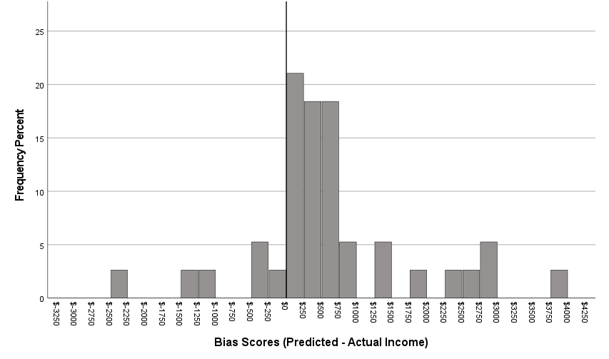
March Results
15.8%
84.2%

Slide 35
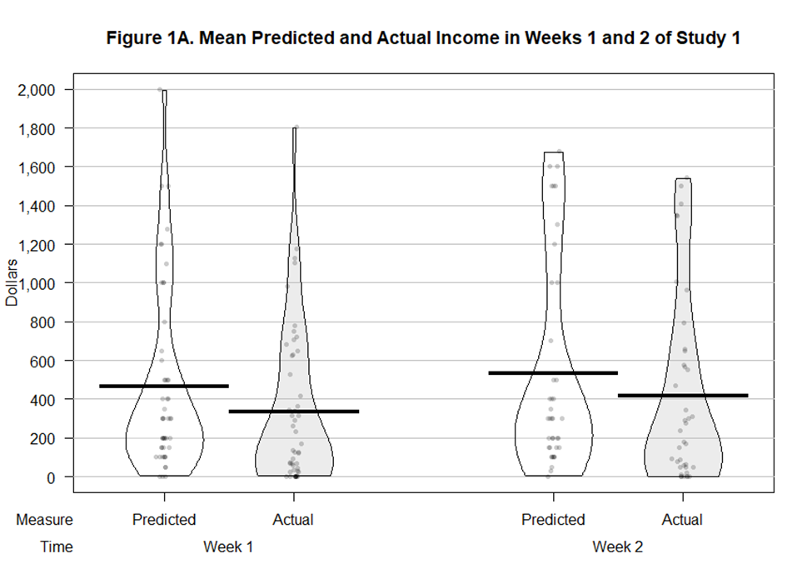
Predicted vs Actual Weekly Income
Notes:
r(47) = .87, p < .001
In the first survey, participants over-predicted their weekly income by an average of $132.07 or 28.3%, as revealed by a paired-samples t-test (M_{predicted_income} = $466.94, SD = 468.71; M_{actual_income} = $334.87, SD = 403.56; t(48) = 4.01, p < .001, d = .57). Moreover, the bias was prevalent: 75.5% of participants overpredicted to at least some extent, and 53.1% of participants over-predicted by $100 or more.
In the first survey, participants over-predicted their monthly income by an average of $347.43 or 20.1%, as revealed by a paired-samples t-test (M_{predicted_income} = $1724.52, SD = 1828.31; M_{actual_income} = $1377.09, SD = 1722.71; t(47) = 2.96, p = .005, d = .43). The bias was once again prevalent: 66.7% of participants over-predicted to at least some extent, and 50.0% of participants over-predicted by $300 or more.

Slide 36
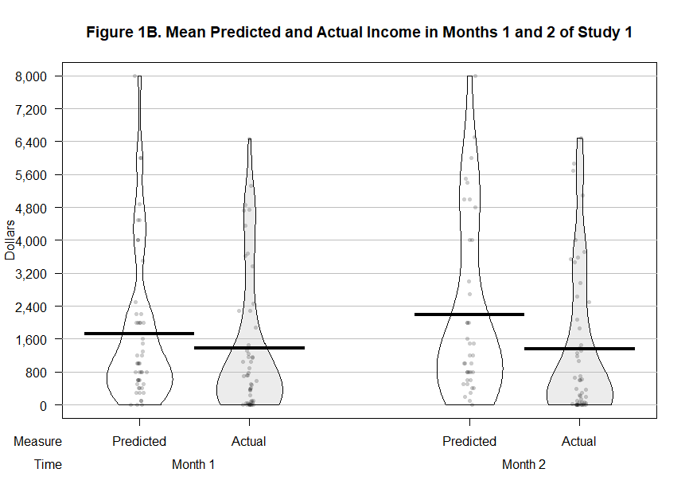
Predicted vs Actual Monthly Income
Notes:
r(47) = .87, p < .001
In the first survey, participants over-predicted their weekly income by an average of $132.07 or 28.3%, as revealed by a paired-samples t-test (M_{predicted_income} = $466.94, SD = 468.71; M_{actual_income} = $334.87, SD = 403.56; t(48) = 4.01, p < .001, d = .57). Moreover, the bias was prevalent: 75.5% of participants overpredicted to at least some extent, and 53.1% of participants over-predicted by $100 or more.
In the first survey, participants over-predicted their monthly income by an average of $347.43 or 20.1%, as revealed by a paired-samples t-test (M_{predicted_income} = $1724.52, SD = 1828.31; M_{actual_income} = $1377.09, SD = 1722.71; t(47) = 2.96, p = .005, d = .43). The bias was once again prevalent: 66.7% of participants over-predicted to at least some extent, and 50.0% of participants over-predicted by $300 or more.

Slide 37
Bias Score Correlations
Correlation between bias scores
Notes:
Week1 and Week2 bias scores are correlated (r = .47, p = .002). Month1 and Month2 bias scores are correlated (r = .59, p < .001). The week1 and month1 scores are correlated, as are the week2 and month2 scores. This indicates that people do not try to compensate for underearning?

Slide 38
Individual Differences
The bias is not correlated with gig experience
The bias is not correlated with % of income earned from gig
The bias is correlated with pre-study income variability
Notes:
Experience is not correlated with income predictions

Slide 39
Study 1 Discussion
The bias is large, prevalent, and persistent
The bias is associated with income variability, but not with gig experience or % of total income earned
Limitations:
  Can’t observe hours (or hourly wage)
  Population is small
Notes:
Experience is not correlated with income predictions

Slide 40
Studies 2a-2c: The Diary Studies
Purpose
Test H1 and H2
Test across different gig platforms and recruitment channels
Method
Predict income and hours for the next week
Report income and hours for the past week
Notes:
To explore our first research question, we began by running a trio of financial diary studies. A secondary purpose of these studies was to figure out the best way to recruit gig workers to participate in our studies, so we sampled from three different gigs, through three different channels.
In Study 1 we recruited Uber drivers by making an organic (i.e., non-paid) reddit post on r/uberdrivers/, which is “The Uber Driver’s Subreddit”
In Study 2 we recruited online workers through Amazon Mechanical Turk
In Study 3 we recruited food delivery app workers through paid advertisements on relevant subreddits
The structure of these studies was the same: We first asked people to predict their gig income for the next week, then one week later we had them report how much they actual earned.

Slide 41
Study 2a
Uber drivers
Recruitment channel = organic reddit post in r/uberdrivers
Initial sample = 71
Final sample = 38 (M_{age} = 35.0, 11.3% female)
BTW: Make sure you get approval from mods before posting a survey link!

Slide 42
Study 2b
MTurkers
Recruitment channel = Amazon Mechanical Turk
Initial sample = 200
Final sample = 129 (M_{age} = 34.7, 41.5% female)

Slide 43
Study 2c
Food delivery app drivers
Recruitment channel = paid ads in relevant subreddits
Initial sample = 85
Final sample = 47 (M_{age} = 30.4, 24.7% female)

Slide 44
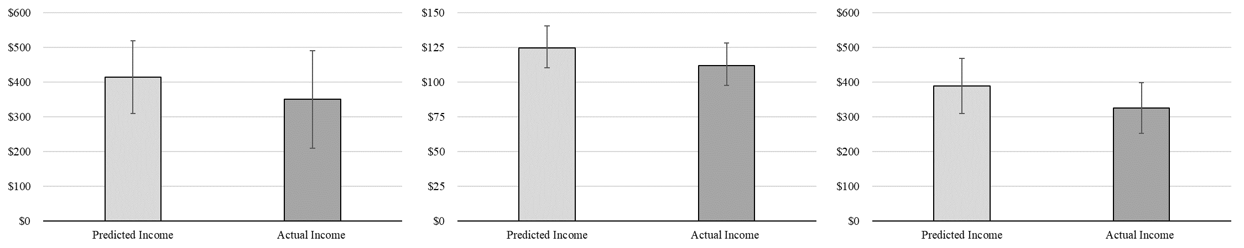
Income
Uber Drivers
Bias = 18.2%
MTurkers
Bias = 11.6%
Delivery Drivers
Bias = 19.9%

Slide 45
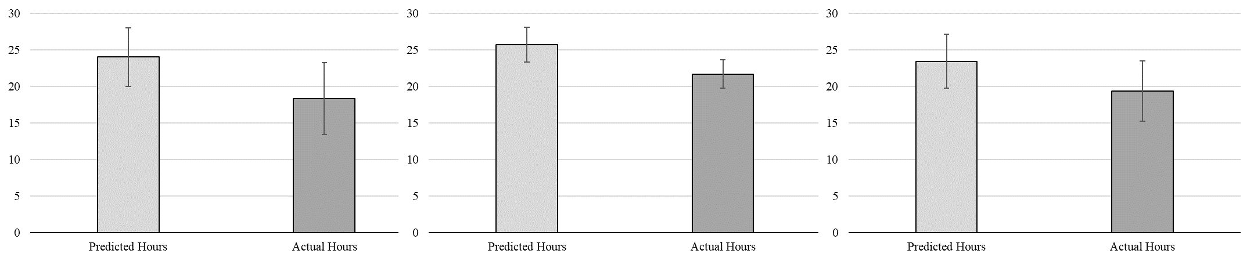
Hours
Uber Drivers
Bias = 31.2%
MTurkers
Bias = 18.6%
Delivery Drivers
Bias = 21.2%

Slide 46
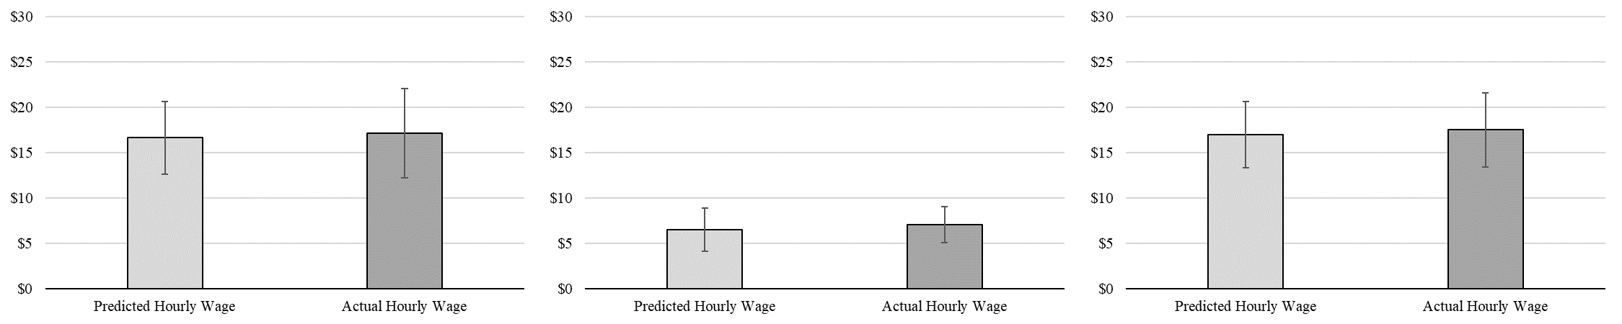
Hourly Wage
Uber Drivers
Bias = −$0.50
MTurkers
Bias = −$0.55
Delivery Drivers
Bias = −$0.52

Slide 47
Study 2 Discussion
Replicates the income prediction bias (H1)
Provides evidence that people overpredict their hours but not their hourly wage (H2)

Slide 48
How can we debias income predictions?
Intervention #1: Taking an “outside view”
Prediction accuracy can be improved by considering relevant past outcomes (e.g., Buehler et al. 1994; Buehler, Griffin, & Ross, 2002; Kahneman & Tversky 1979; Kahneman & Lovallo, 1993; Lovallo, Clarke, & Camerer, 2012)
H3: Prompting people to consider their average past earnings before predicting their future earnings reduces the income prediction bias
Notes:
We test two interventions in this paper, both of which are based on the idea that prediction biases occur because people do not consider the full distribution of possible outcomes.
"Inside view" vs "outside view" forecasting has been defined in slightly different ways by different scholars (Kahneman & Lovallo, 1993; Lovallo, Clarke, & Camerer, 2012; Buehler, Griffin, & Ross, 2002), but in general an inside view forecast "is generated by focusing on the case at hand, by considering the plan and the obstacles to its completion" (Kahneman & Lovallo, 1993), while an outside view forecast "focuses on the statistics of a class of cases chosen to be similar in relevant respects to the present one". In short, the inside vs outside approaches differ primarily in whether forecasters treat the information to be estimated "as a unique case or as an instance of a category of similar problems" (Buehler, Griffin, & Ross, 2002).

Slide 49
How can we debias income predictions?
Intervention #2: An “atypical” intervention (Howard et al. 2022)
Perhaps gig workers have negatively skewed income (assumption)
Predictions are based on typical past outcomes
Typical = mode
If outcomes are negatively skewed with mode > mean, then people will over-predict
Could also be a nudge to “system 2”, correcting optimism
H4: Prompting people to consider reasons why their schedule might be different than usual reduces the income prediction bias

Slide 50
Study 3: The Debiasing Study
Sample
662 food delivery app drivers (M_{age} = 30.0, 35.0% female)
Recruitment channel = paid ads in relevant subreddits
Preregistration: https://aspredicted.org/blind.php?x=nu8j4c
Notes:
Preregistered icon citation: University of Melbourne (https://library.unimelb.edu.au/open-scholarship/preregistering_research)

Slide 51
Study 3: The Debiasing Study
Method
Start of the week:
Which food delivery apps do you currently work for? Please select all that apply.
Predict gig income for next week in 1 of 3 conditions:
  Control
  Outside view (e.g., Buehler, Griffin, and Ross 1994)
  “Atypical” condition (Howard et al. 2022)
Report gig income and hours at the end of the week

Slide 52
Study 3: The Debiasing Study
Outside view condition
Please take some time to estimate the total amount of money you have earned working for food delivery apps over the past four weeks.
How much money do you estimate you have earned (in total) working for food delivery apps over the past four weeks?
$

Slide 53
Study 3: The Debiasing Study
Outside view condition
Over the past 4 weeks you estimate you have earned $X per week working for food delivery apps. Considering that experience, how much money do you estimate you will earn working for food delivery apps in the next week?
$

Slide 54
Study 3: The Debiasing Study
Atypical condition
Please take some time to consider reasons why the number of hours you work for food delivery apps in the next week might be different than usual.
Please list 2 reasons why the number of hours you work for food delivery apps in the next week might be different than usual.

Slide 55
Study 3: The Debiasing Study
Atypical condition
Keeping in mind your answer to the previous question, how much money do you estimate you will earn (in total) working for food delivery apps in the next week?
$

Slide 56
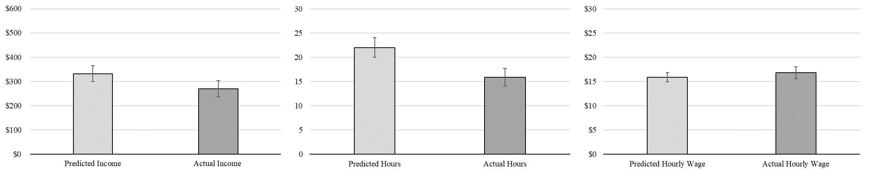
Control Condition Results
Total Income
Bias = 23.2%
(p < .001)
Hours
Bias = 38.8%
(p < .001)
Hourly Wage
Bias = -$0.90
(p = .10)

Slide 57
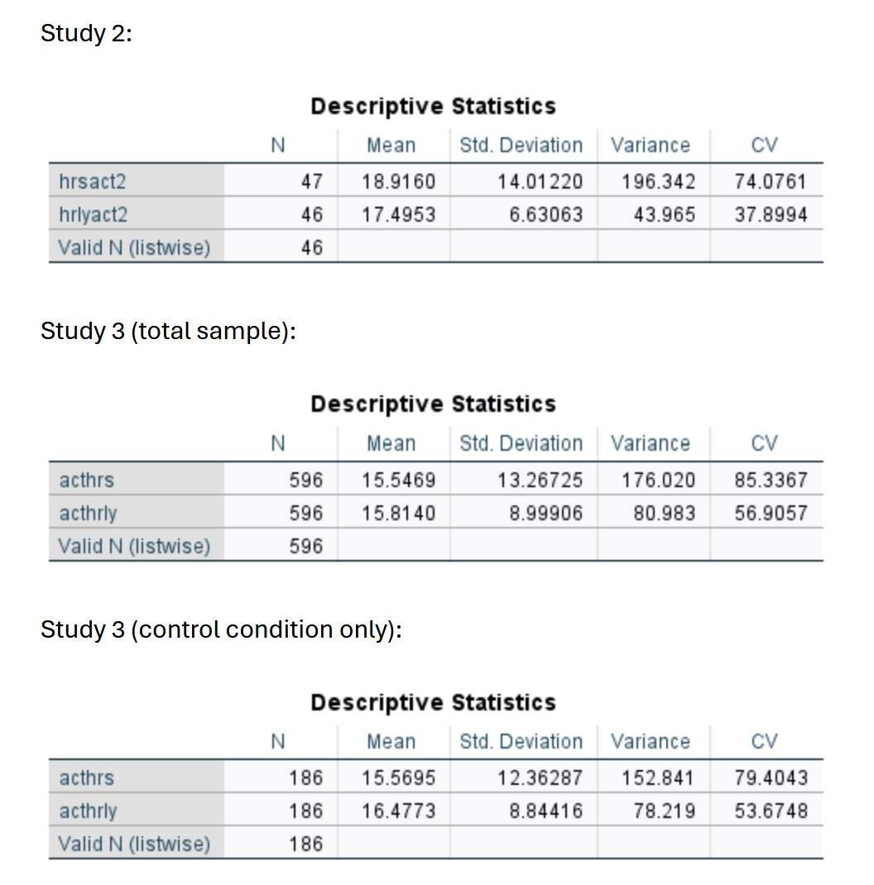
Comparing Variability

Slide 58
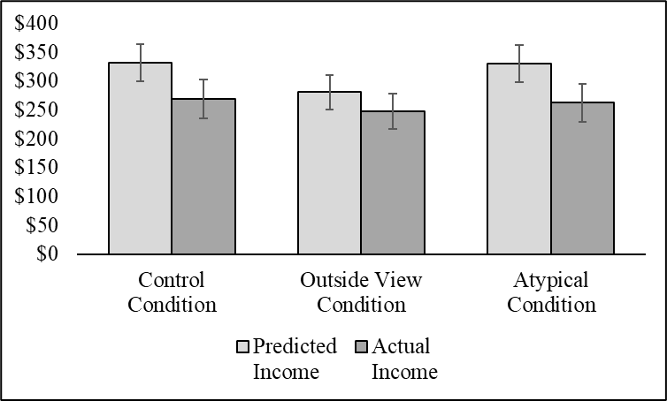
Intervention Results
23.2%***
13.4%**
25.7%***
*p < .05, **p < .01, ***p < .001
Notes:
The bias is a little more than 40% smaller in the outside view condition versus control.

Slide 59
Intervention Results
23.2%***
13.4%**
25.7%***
Interaction: F(1, 659) = 3.02, p = .050
*p < .05, **p < .01, ***p < .001
Notes:
The bias is a little more than 40% smaller in the outside view condition versus control.

Slide 60
Intervention Results
p = .024
p = .028
Interaction: F(1, 659) = 3.02, p = .050

Slide 61
Intervention Results
p = .35
p = .52
Interaction: F(1, 659) = 3.02, p = .050

Slide 62
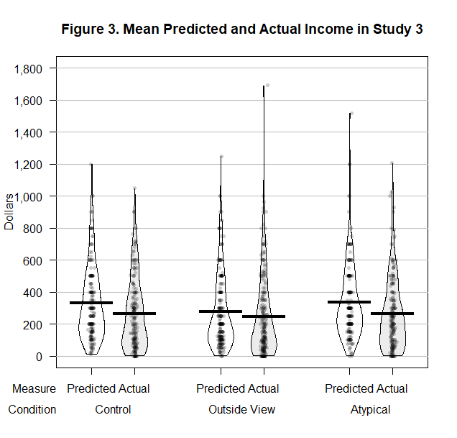
Intervention Results

Slide 63
Study 3 Discussion
Replicates Studies 1 and 2
Outside view intervention reduces the bias
Atypical intervention strikes out
Discussion

Slide 64

Study 4: Hours or Hourly Wage?
Purpose
Interventions targeting expected hours versus hourly wage.
Sample
450 food delivery app drivers (M_{age} = 32.2, 27.9% female)
Recruitment channel = paid ads in relevant subreddits
Notes:
Preregistered icon citation: University of Melbourne (https://library.unimelb.edu.au/open-scholarship/preregistering_research)

Slide 65
Study 4: Hours or Hourly Wage?
Method
Cross-sectional design
Four conditions:
  Control
  Outside view for income
  Outside view for hours
  Outside view for hourly wage

Slide 66
Study 4: Hours or Hourly Wage?
Outside view for hours
Please take some time to estimate the total number of hours you have worked for food delivery apps over the past four weeks.
How many hours do you estimate you have worked (in total) for food delivery apps over the past four weeks?

Slide 67
Study 4: Hours or Hourly Wage?
Outside view for hours
Over the past 4 weeks you estimate you have worked X hours per week for food delivery apps.
Considering that experience, how much money do you estimate you will earn working for food delivery apps in the next week?

Slide 68
Study 4: Hours or Hourly Wage?
Outside view for hourly wage
Please take some time to estimate your hourly wage while working for food delivery apps over the past four weeks.
How much money per hour do you estimate you earned working for food delivery apps over the past four weeks?

Slide 69
Study 4: Hours or Hourly Wage?
Outside view for hourly wage
Over the past 4 weeks you estimate you have earned X per hour working for food delivery apps.
Considering that experience, how much money do you estimate you will earn in total working for food delivery apps in the next week?

Slide 70
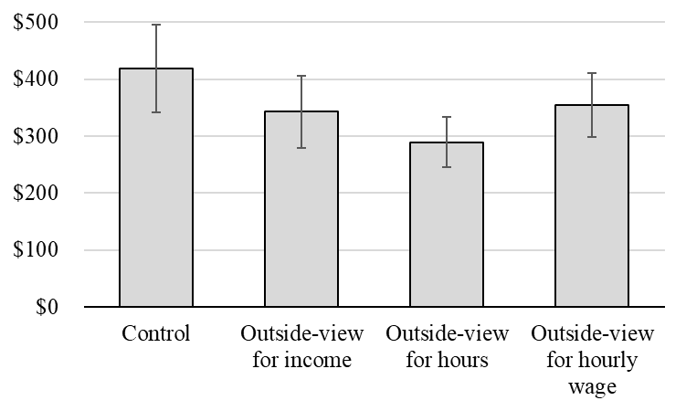
Study 4: Hours or Hourly Wage?
(F(3, 446) = 2.85, p = .037, η_{p}² = .02)

Slide 71
Study 4: Hours or Hourly Wage?
p = .004

Slide 72
Study 4: Hours or Hourly Wage?
p = .082

Slide 73
Study 4: Hours or Hourly Wage?
p = .15
Notes:
Expected hourly wage was about $16 and expected hours was about 24 hours.

Slide 74
Study 4 Discussion
Overall, outside view intervention was effective (H3)
Directionally (but not significantly) stronger when focused on hours
Discussion

Slide 75
Summary
RQ1: Is there an income prediction bias?
Yes, participants in our studies display an income prediction bias in which they significantly over-predict their gig income.
Notes:
Roadmap for rest of talk: Theory and hypotheses related to RQ’s 1 and 2, then four main effect studies, then theory and hypotheses related to RQ3, then two debiasing studies.
Preview the studies: longitudinal, real gig workers, app data, etc.

Slide 76
Summary
RQ2: Why do people overpredict?
People overpredict their gig hours but not their hourly wage
Notes:
Roadmap for rest of talk: Theory and hypotheses related to RQ’s 1 and 2, then four main effect studies, then theory and hypotheses related to RQ3, then two debiasing studies.
Preview the studies: longitudinal, real gig workers, app data, etc.

Slide 77
Summary
RQ3: How can we debias predictions?
Accuracy can be improved by taking an outside view, but not by considering atypical outcomes.
Notes:
Roadmap for rest of talk: Theory and hypotheses related to RQ’s 1 and 2, then four main effect studies, then theory and hypotheses related to RQ3, then two debiasing studies.
Preview the studies: longitudinal, real gig workers, app data, etc.

Slide 78
General Discussion
The atypical intervention works really well for expense predictions (Howard et al. 2022)
The failure of the atypical intervention for income predictions suggests that income is structurally and/or psychologically different than expenses
Notes:
30% of participants listed reasons why their income would be higher, vs 49% who listed reasons why their income be lower and 21% who gave an ambiguous answer.

Slide 79
General Discussion
Budgeting is typically conceptualized as a two-stage process (Choe and Kan, 2021; Heath and Soll, 1996; Lukas and Howard, 2023, Sussman and Alter, 2012; Thaler, 1999)
  Budget Setting
  Expense Tracking
But when income is variable, income prediction precedes budget setting
  A three-stage model that incorporates income prediction as an antecedent of budget setting would provide a more complete picture of the budget process
Notes:
Although working in the gig economy offers people perks like flexible hours, it also makes it hard to predict income, which may have negative consequences for consumers’ financial well-being.

Slide 80
Next Steps
Process: What do people think about as they predict?
Do incentives improve accuracy?
Measures of downstream consequences
Is overprediction ever beneficial?
Directly compare (the psychology of) income and expense predictions
Notes:
How and why do income and expenses occupy a different psychological space

Slide 81
THANK YOU!

Slide 82
Bonus Slides

Slide 83
Study 5: Budgeting Consequences
Purpose
Do income predictions influence consumer budgeting?
Sample
497 undergraduate commerce students (M_{age} = 21.26; 50.0% female)
Participated for course credit
Notes:
Preregistered icon citation: University of Melbourne (https://library.unimelb.edu.au/open-scholarship/preregistering_research)

Slide 84
Study 5: Budgeting Consequences
Methods
Scenario study
2-condition between-subjects design:
typical income prediction ($1,200/month – population median)
vs.
high income prediction ($1,500/month – 25% higher, typical IPB)
Notes:
Preregistered icon citation: University of Melbourne (https://library.unimelb.edu.au/open-scholarship/preregistering_research)

Slide 85
Study 5: Budgeting Consequences
Materials
“Welcome to our study about discretionary spending, which is defined as non-essential spending like entertainment, social activities with friends, and so on.” (Page break.)
“Imagine you are trying to set a budget for the next month. After thinking about it, you estimate that your total income for next month will be $1,200 [$1,500].” (Page break.)
“Continue to assume that your total income for next month will be $1,200 [$1,500]. How much money would you budget for discretionary spending?
$________ ”
Notes:
Preregistered icon citation: University of Melbourne (https://library.unimelb.edu.au/open-scholarship/preregistering_research)

Slide 86
Study 5: Budgeting Consequences
Results
budget for discretionary spending
typical prediction condition: M = $283.90, SD = 191.33
high prediction condition: M = $345.51, SD = 221.27
t(495) = 3.32, p < .001, d = .30
Notes:
Preregistered icon citation: University of Melbourne (https://library.unimelb.edu.au/open-scholarship/preregistering_research)

Slide 87
Study 5 Discussion
In a scenario study, experimentally increasing income predictions also increased discretionary spending intentions
Discussion

