Slide 1
Researching Green:
Consumer Financial Decision Making
Faculty-wide Seminar
Apr 4, 2024
Notes:
This will be a broad talk, offering little tastes of many different projects, so that hopefully you learn something, we can connect on something, entertain you, and let’s be honest part of me wants to impress you.

Slide 2



My Research
Green research and researching green
Combination of field and lab data
Green research that’s not ready for primetime:
Notes:
Images on the left from ChatGPT. Image on the right from Hardisty et al (2024).

Slide 3
Researching Green
Three big questions for today. How do consumers:
predict their future expenses & income?
evaluate restricted promotions?
allocate their charitable contributions?
Notes:
Image from ChatGPT

Slide 4
How do consumers predict their future expenses & income?
Notes:
Image from ChatGPT

Slide 5
Financial mis-prediction can be costly
Early withdrawals from 401(k) retirement savings costs consumers approximately $7 billion a year in penalties, most often to cover unpredicted expenses (Fellowes and Willemin, 2013)
2 million Americans per year use a payday loan to cover unpredicted expenses (Pew 2012), with annual interest rates exceeding 400% (Consumer Federation of America 2018)
Budgets based on inaccurate income predictions lead to suboptimal spending decisions (Heath and Soll 1996)

Slide 6
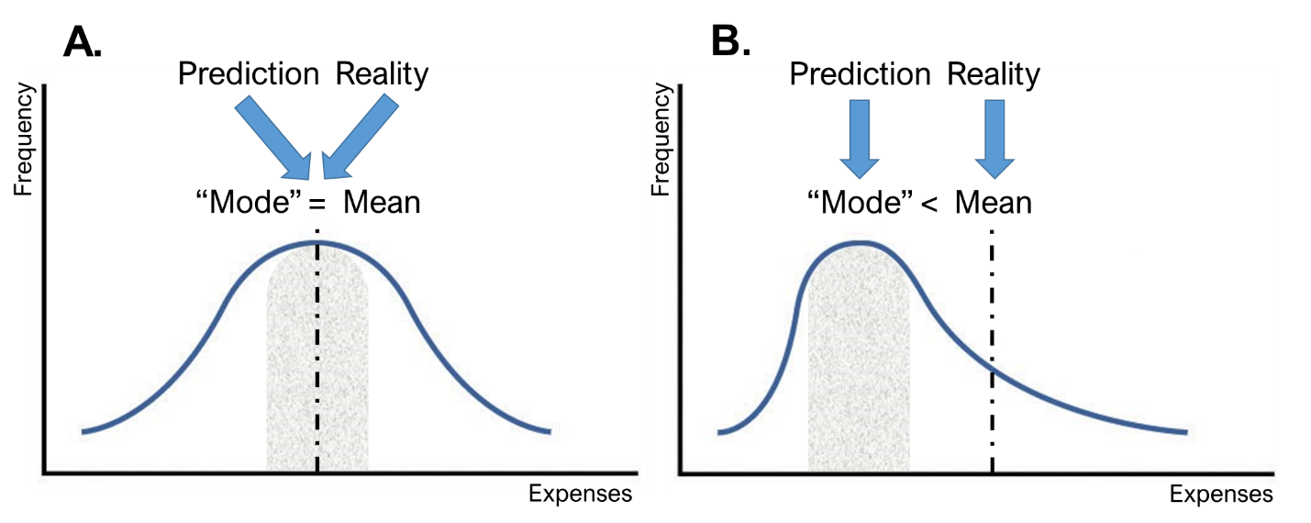
Expense Prediction: Why?
“How much will you spend next week?”
~83% of people predict typical expenses, leading to underprediction
Howard, R. C., Hardisty, D. J., Sussman, A., & Lukas, M. F. (2022). Understanding and Neutralizing the Expense Prediction Bias: the Role of Accessibility, Typicality, and Skewness. Journal of Marketing Research, 59(2), 435-452.
Notes:
This was inspired by Danny Kahneman’s work on extension neglect

Slide 7
Study with Vancity
Vancity members predicted and reported their expenses each week for four weeks
In the fifth week, half the participants received our atypical intervention:
“Please take some time to consider why your expenses for the next week might be different from a typical week. In the spaces provided below, please type 3 reasons why your expenses for next week might be different from a typical week.”
Howard, R. C., Hardisty, D. J., Sussman, A., & Lukas, M. F. (2022). Understanding and Neutralizing the Expense Prediction Bias: the Role of Accessibility, Typicality, and Skewness. Journal of Marketing Research, 59(2), 435-452.

Slide 8
Weekly Expense Prediction Accuracy
Howard, R. C., Hardisty, D. J., Sussman, A., & Lukas, M. F. (2022). Understanding and Neutralizing the Expense Prediction Bias: the Role of Accessibility, Typicality, and Skewness. Journal of Marketing Research, 59(2), 435-452.

Slide 9
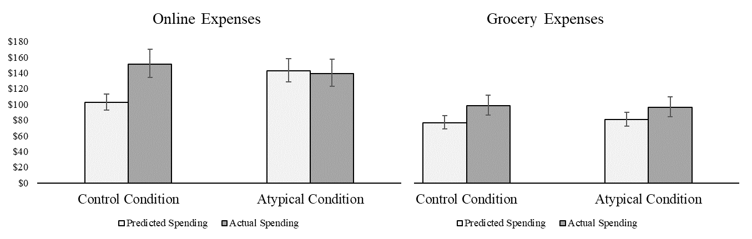
Money Dashboard Study
Objective measure of expenses
“Online” expenses are highly skewed, “Grocery“ expenses are normal
Howard, R. C., Hardisty, D. J., Sussman, A., & Lukas, M. F. (2022). Understanding and Neutralizing the Expense Prediction Bias: the Role of Accessibility, Typicality, and Skewness. Journal of Marketing Research, 59(2), 435-452.

Slide 10
Expense Prediction Summary
On average, consumers underpredict their future expenses
This happens because they predict typical expenses (the mode) and neglect atypical expenses
Prompting consumers to consider atypical expenses eliminates the bias
Howard, R. C., Hardisty, D. J., Sussman, A., & Lukas, M. F. (2022). Understanding and Neutralizing the Expense Prediction Bias: the Role of Accessibility, Typicality, and Skewness. Journal of Marketing Research, 59(2), 435-452.

Slide 11
Gig income is on the rise
Gig work is temporary, freelance, or on-demand work (Hershfield, Shu, and Benartzi 2020; Ludwig et al. 2022)
Globally, online gig work has increased 41% between 2016 and 2023 (World Bank Group, 2023)
Approximately one-third of the US labor market works in the gig economy (McFeely and Pendell 2018), and gig income in the US totals over $1.3 trillion annually (Ozimek 2021)
Howard, R. C., Hardisty, D. J., Griffin, D. W., & Wang, C. (Working paper.) Income Prediction Bias In The Gig Economy.

Slide 12
Income Prediction in the Gig Economy
Gig income is variable, but relatively normally distributed within individuals
Is there an income prediction bias?
If so, why, and how can we improve accuracy?
Howard, R. C., Hardisty, D. J., Griffin, D. W., & Wang, C. (Working paper.) Income Prediction Bias In The Gig Economy.

Slide 13
Income Prediction in the Gig Economy
Gig income is variable, but relatively normally distributed within individuals
Is there an income prediction bias?
If so, why, and how can we improve accuracy?
Howard, R. C., Hardisty, D. J., Griffin, D. W., & Wang, C. (Working paper.) Income Prediction Bias In The Gig Economy.

Slide 14
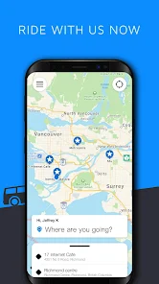
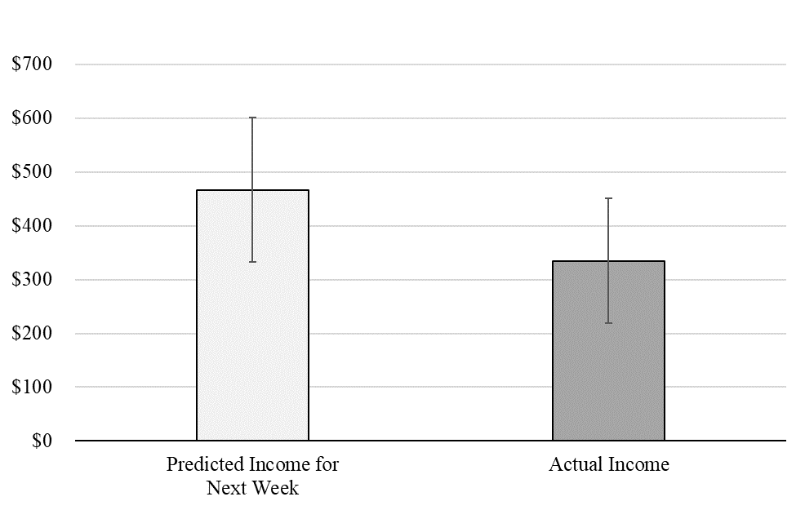
Field Study with KABU
Week
Bias = $132.07 (28.3%)
t(48) = 4.01, p < .001, d = .57
r(47) = .87, p < .001
Howard, R. C., Hardisty, D. J., Griffin, D. W., & Wang, C. (Working paper.) Income Prediction Bias In The Gig Economy.

Slide 15
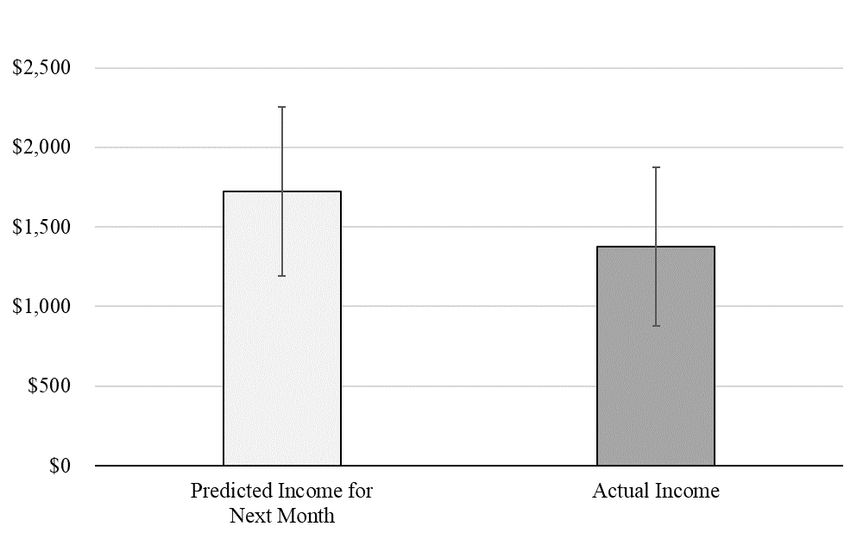
Field Study with KABU
Month
Bias = $347.43 (20.1%)
t(47) = 2.96, p = .005, d = .43
r(47) = .90, p < .001
Howard, R. C., Hardisty, D. J., Griffin, D. W., & Wang, C. (Working paper.) Income Prediction Bias In The Gig Economy.

Slide 16
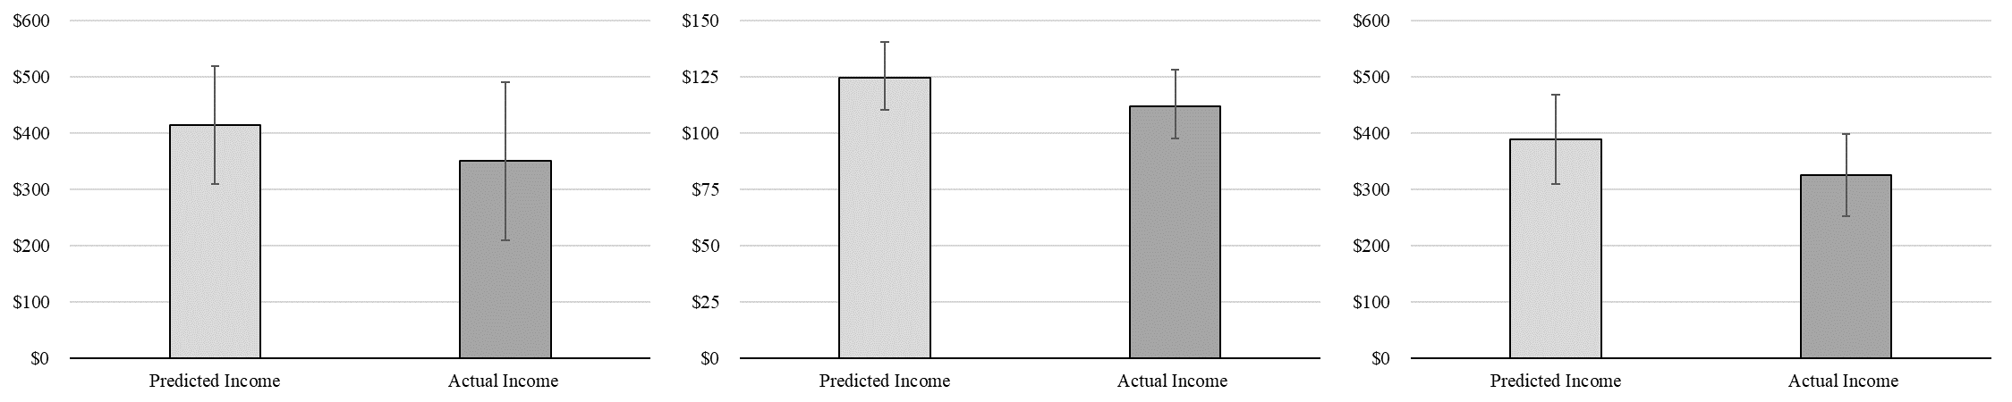
Online surveys of income across different gigs
Uber Drivers
Bias = 18.2%
(p = .053)
MTurkers
Bias = 11.6%
(p = .034)
Delivery Drivers
Bias = 19.9%
(p = .014)
Why?
Howard, R. C., Hardisty, D. J., Griffin, D. W., & Wang, C. (Working paper.) Income Prediction Bias In The Gig Economy.

Slide 17
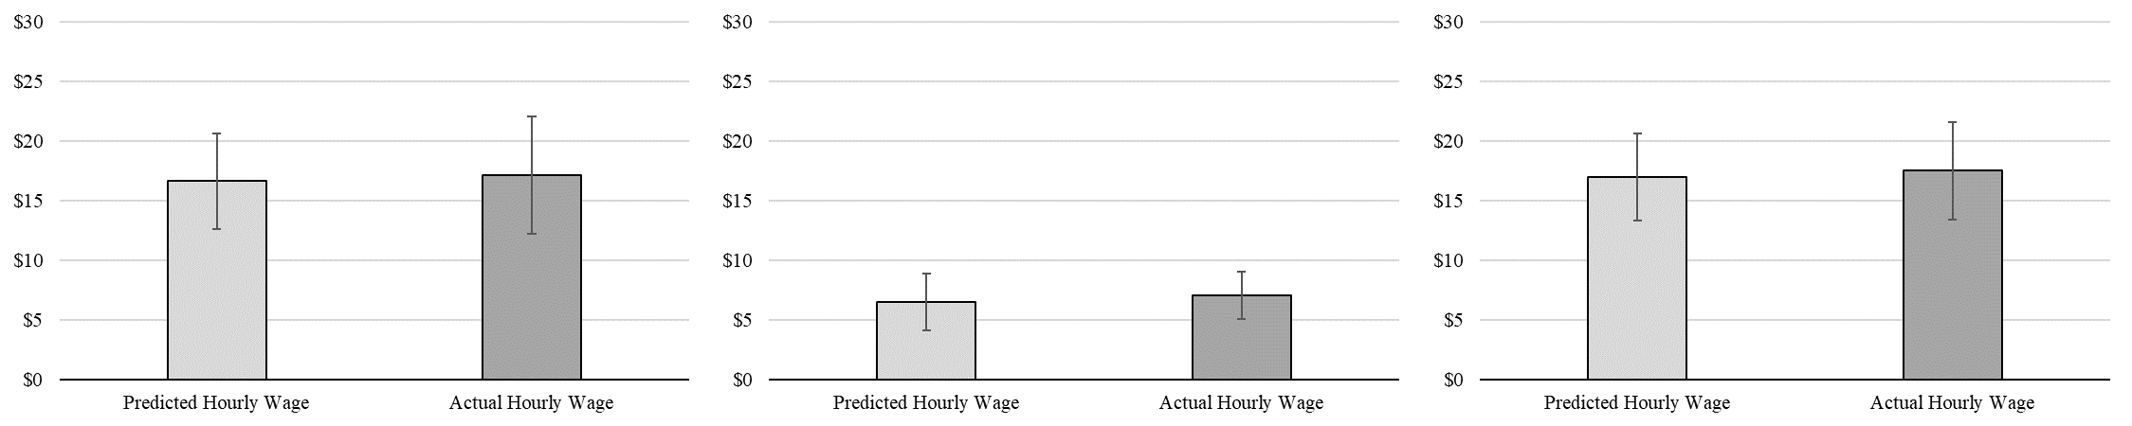
Hourly wage prediction accuracy
Uber Drivers
Bias = −$0.50
(p = .70)
MTurkers
Bias = −$0.55
(p = .09)
Delivery Drivers
Bias = −$0.52
(p = .56)
So, why?
Howard, R. C., Hardisty, D. J., Griffin, D. W., & Wang, C. (Working paper.) Income Prediction Bias In The Gig Economy.

Slide 18
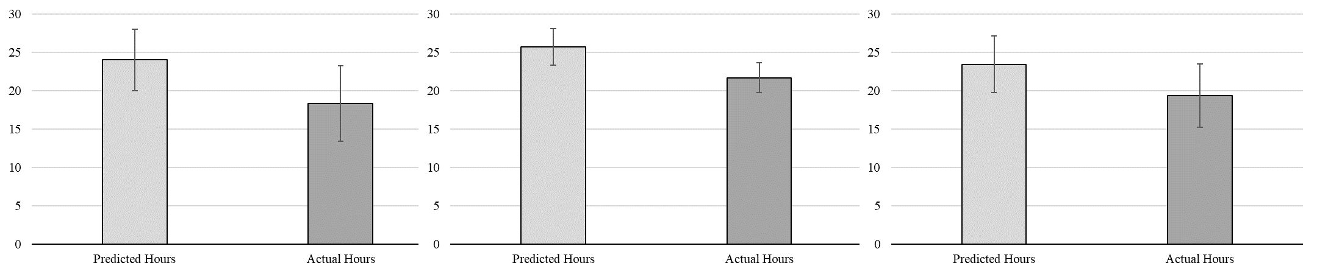
Hours worked prediction accuracy
Uber Drivers
Bias = 31.2%
(p < .001)
MTurkers
Bias = 18.6%
(p < .001)
Delivery Drivers
Bias = 21.2%
(p = .001)
How do we fix it?
Howard, R. C., Hardisty, D. J., Griffin, D. W., & Wang, C. (Working paper.) Income Prediction Bias In The Gig Economy.

Slide 19
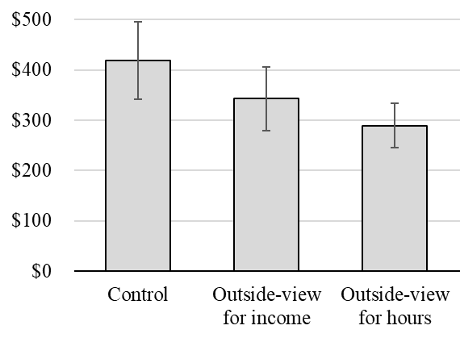
Intervention: Outside View
How many hours do you estimate you have worked (in total) for food delivery apps over the past four weeks?
______ hours
Over the past 4 weeks you estimate you have worked [X] hours per week for food delivery apps.
Considering that experience, how much money do you estimate you will earn working for food delivery apps in the next week?
$______
p = .004
Howard, R. C., Hardisty, D. J., Griffin, D. W., & Wang, C. (Working paper.) Income Prediction Bias In The Gig Economy.

Slide 20
Gig Income Summary
On average, gig workers overpredict their future income
This happens because they underpredict how many hours they will work (planning fallacy)
Prompting workers to consider their previous average hours reduces predictions & improves accuracy
Howard, R. C., Hardisty, D. J., Griffin, D. W., & Wang, C. (Working paper.) Income Prediction Bias In The Gig Economy.

Slide 21
How do consumers evaluate restricted promotions?
Notes:
Image from ChatGPT

Slide 22
Restricted Promotions
Which is more appealing to consumers, leading to purchase intentions for a grocery store?
$2 off
$2 off, minimum purchase $4
Consumers compare the unrestricted $2 to an internal reference point: the amount they typically spend in that context
“$2 off“ feels like $2 / $13 = 15% off
The “minimum purchase $4“ is a salient external reference point that overrides the internal reference point
“$2 off“ feels like $2 / $4 = 50% off
Du, G., & Hardisty, D. J. (Working paper.) When Do Purchase Precondition Promotions Work? The Role of External Reference Points

Slide 23
Threshold Promotions
Which is more appealing to consumers, leading to purchase intentions for a grocery store?
$2 off
$2 off, minimum purchase $4
Consumers compare the unrestricted $2 to an internal reference point: the amount they typically spend in that context
“$2 off“ feels like $2 / $13 = 15% off
The “minimum purchase $4“ is a salient external reference point that overrides the internal reference point
“$2 off“ feels like $2 / $4 = 50% off
Du, G., & Hardisty, D. J. (Working paper.) When Do Purchase Precondition Promotions Work? The Role of External Reference Points

Slide 24
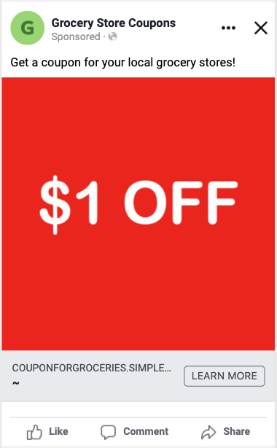
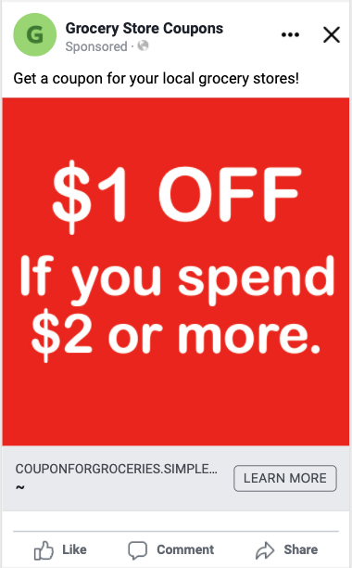
Facebook Ads Study: Click Rate
Warning!!! Most ad AB Tests are not true experiments, due to sampling optimization. Yet 58% of previous papers labeled them as experiments.
CTR = 0.88% CTR = 1.13%
p < .001
Du, G., & Hardisty, D. J. (Working paper.) When Do Purchase Precondition Promotions Work? The Role of External Reference Points.
Boegershausen, J., Yi, S., Cornil, Y. & Hardisty, D. J. (working paper). Testing the Digital Frontier: Opportunities and Validity Trade-offs in Digital Quasi-Experiments.

Slide 25
Threshold Promotions: Purchase Intention
N = 400 U.K. participants from Prolific
“Imagine that you find a coupon in a flyer for a department store near where you live”
2 × 2 Between-participants:
Discount format
Absolute (£2 off any purchase) vs. Percentage (10% off any purchase)
Purchase precondition
Unrestricted vs. Restricted (minimum purchase £3)
Du, G., & Hardisty, D. J. (Working paper.) When Do Purchase Precondition Promotions Work? The Role of External Reference Points

Slide 26
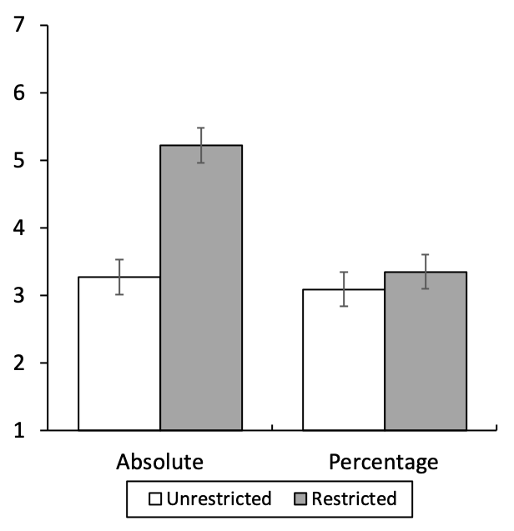
Threshold Promotions: Purchase Intention
p = .003
NS
Error Bars = 95% CI
Interaction:
F (1, 396) = 9.14
p = .003
Du, G., & Hardisty, D. J. (Working paper.) When Do Purchase Precondition Promotions Work? The Role of External Reference Points

Slide 27
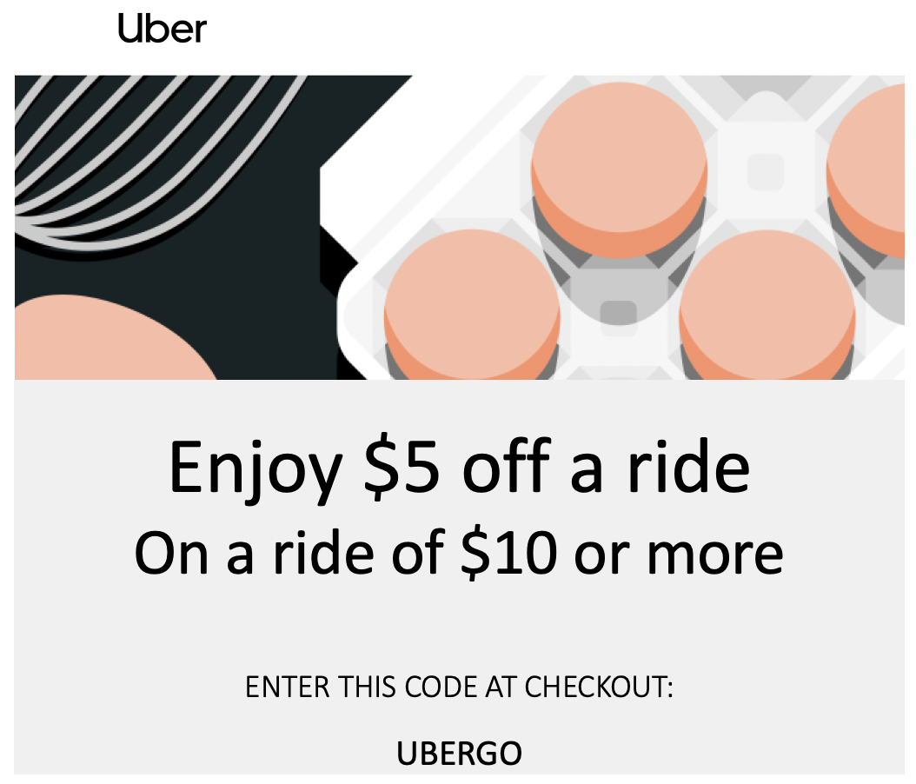
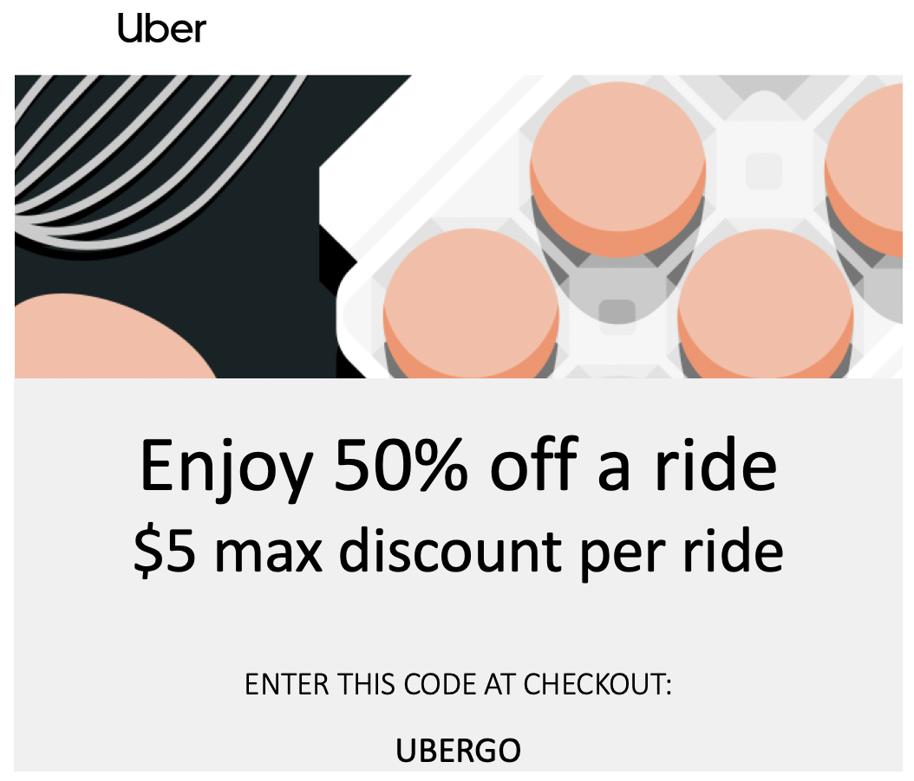
Capped Promotions: Fairness
Threshold Promotion
Capped Promotion
Yi, S., Hardisty, D. J., Griffin, D. W., & Allard, T. (working). The Price That Binds: Perceived Fairness and the Effectiveness of Restricted Price Promotions.

Slide 28
Capped Promotions: Fairness
Another reference point is expectations, such as what the firm could have offered.
With “50% off, max $5”:
Could have received 50% of usual spending (e.g., $10 off a $20 spend)
Actually receiving $5 at most
This (negative expectation disconfirmation) feels unfair, reducing purchase intention
Yi, S., Hardisty, D. J., Griffin, D. W., & Allard, T. (working). The Price That Binds: Perceived Fairness and the Effectiveness of Restricted Price Promotions.

Slide 29
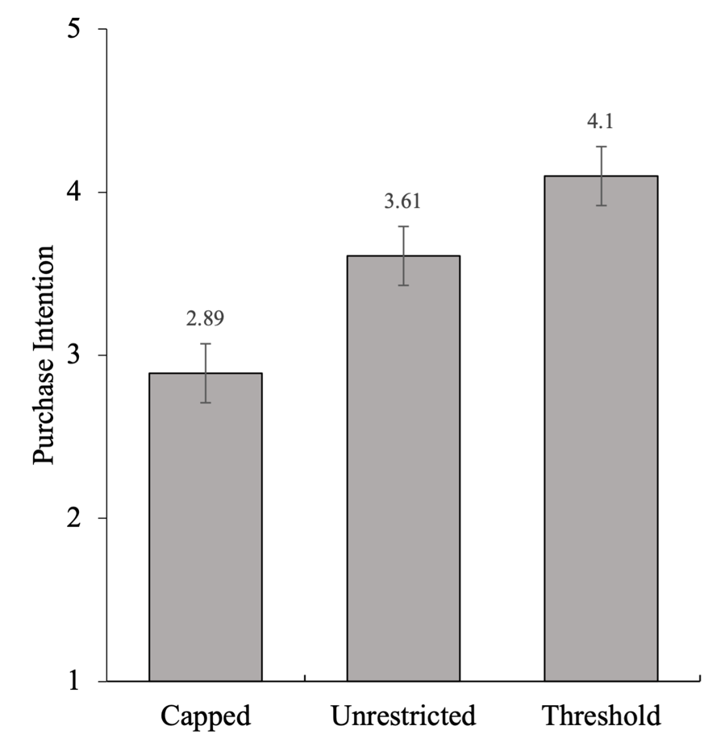
Capped Promotions
Capped: "Enjoy 60% off. $3 max discount on an order”
Threshold: "Enjoy $3 off on an order of $5 or more”
Unrestricted: "Enjoy $3 off”
Fairness & Purchase Intention (Counterbalanced)
Note: Error bars = ±1 standard error.
(N = 600, US Prolific)
Yi, S., Hardisty, D. J., Griffin, D. W., & Allard, T. (working). The Price That Binds: Perceived Fairness and the Effectiveness of Restricted Price Promotions.

Slide 30
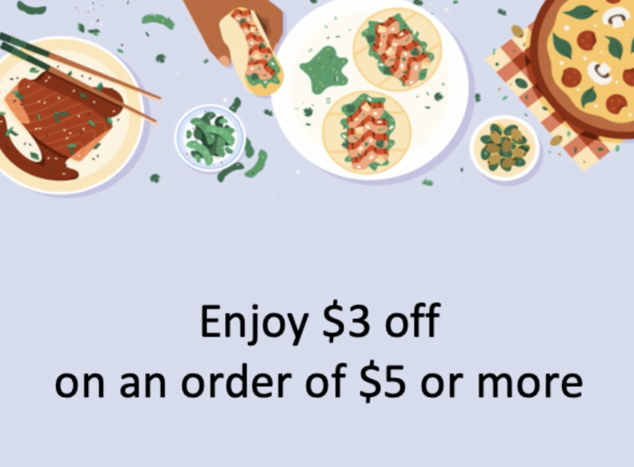
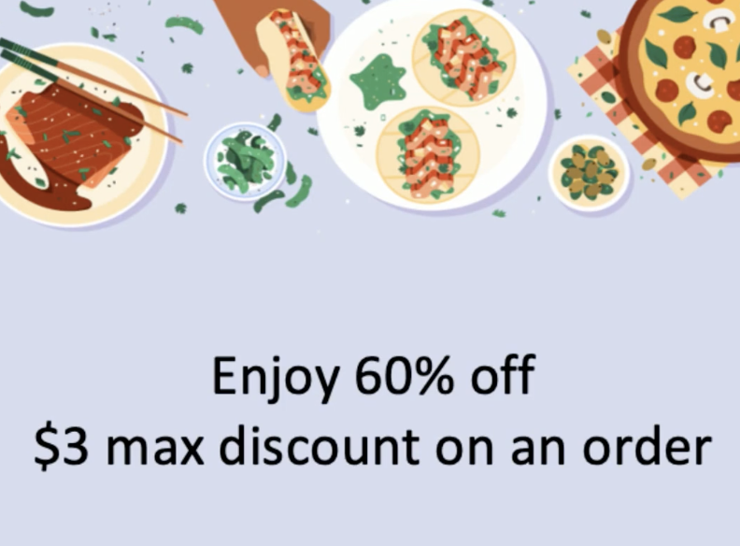
Capped Promotions: TikTok Study
Warning! This is not a true experiment.
n = 131,443 views
Threshold (1.38%) > Capped (1.25%),
p = .021*
Yi, S., Hardisty, D. J., Griffin, D. W., & Allard, T. (working). The Price That Binds: Perceived Fairness and the Effectiveness of Restricted Price Promotions.

Slide 31
Capped Promotions: Mediation Model
Capped promotions violate expectations and are seen as unfair, reducing purchase intention
Indirect Effect: -.23 (.05), bootstrapped 95% CI = [-0.34, -0.14].
Applicability
B = 0.91***
B = .17***
Capped(1) vs Threshold (0)
Purchase Intention
Purchase Intention
B = -.06
Notes:
A mediation analysis using Process Macro (Model 6; Hayes) reveal that the effect of promotion framing on purchase intention is serially mediated by negative expectation disconfirmation and fairness perception, the indirect effect is 0.23 (BootSE = 0.05), bootstrapped 95% CI = [0.14, 0.34].

Slide 32
Restricted Promotions Summary
Consumers evaluate promotions by comparing them to salient reference points (internal and external).
This can lead to seemingly irrational implied preference rankings:
“$5 off on $10 or more” > “$5 off” > “50% off, max $5”
Du, G., & Hardisty, D. J. (Working paper.) When Do Purchase Precondition Promotions Work? The Role of External Reference Points
Yi, S., Hardisty, D. J., Griffin, D. W., & Allard, T. (working). The Price That Binds: Perceived Fairness and the Effectiveness of Restricted Price Promotions.

Slide 33
How do consumers allocate their charitable contributions?
Notes:
Image from ChatGPT

Slide 34
“Please create the same image, except the consumer should be a Chinese female”
Notes:
Images from ChatGPT

Slide 35
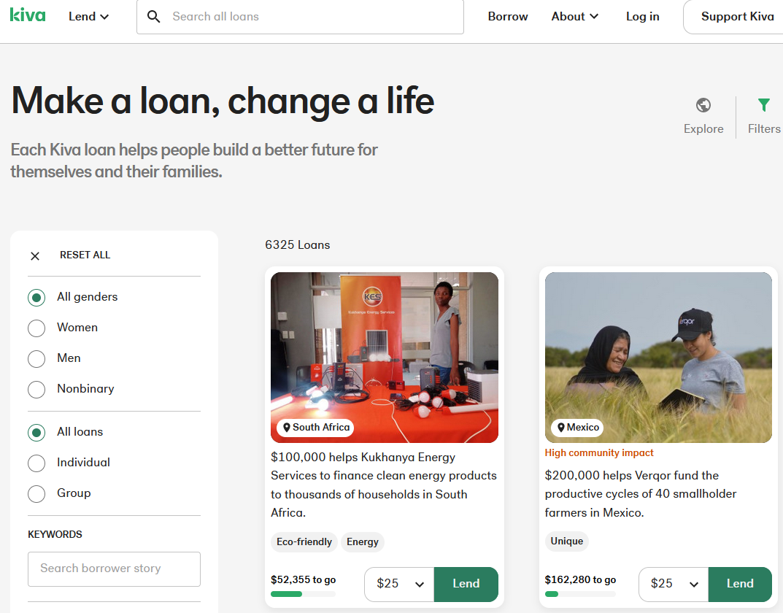
Charitable Donation: Closing the Gap
When deciding between two or more charities (“joint evaluation”), consumers give to the charity farther from its goal
Habib, R., Hardisty, D. J., Kim, B., & White, K. (conditional accept). Habib, R. The Closing-the-Gap Effect: Joint Evaluation Leads Donors to Help Charities Further from Their Goal. Journal of Marketing Research.

Slide 36
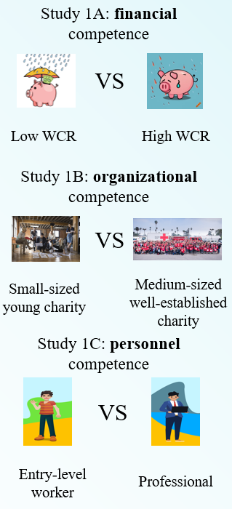
Charitable Donation: the Competence Curse
When deciding between two or more charities, consumers use perceived competence as a signal of need, and often donate to the lower competence charity
Zhang, L., Allard, T., Hardisty, D. J., & Wang, S. (working paper). The Charity Competence Curse: When Signals of Managerial Competence Backfire.

Slide 37
Charity Research Summary
When comparing charities, consumers typically donate to the charity they perceive as needier, even if this is less effective & impactful

Slide 38
Co-authors of this research
Thomas Allard
Johannes Boegershausen
Yann Cornil
Guanzhong Du
Dale Griffin
Rishad Habib
Chuck Howard
Marcel Lukas
Abby Sussman
Yanwen Wang
Shane Wang
Kate White
Shangwen Yi
Shirley Zhang

Slide 39
Thank You!

Slide 40
Questions?

