Slide 1

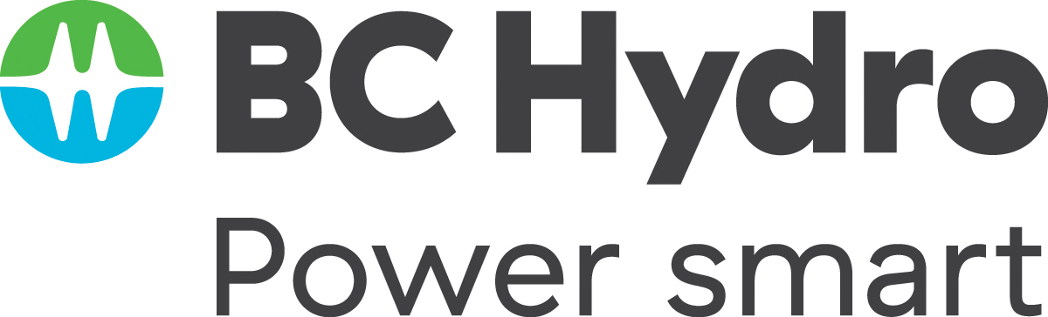
Twice as nice?
A Longitudinal Field Study of Separate vs. Combined Nudges for Household Laundry Behaviours

Slide 2
Co-Authors & Partners
UBC
David Hardisty
Kirstin Appelt
Sid Mookerjee
Yanwen Wang
Jiaying Zhao
BC Hydro
Arien Korteland
Valerie Rodrigues
Netu Sidhu

Slide 3
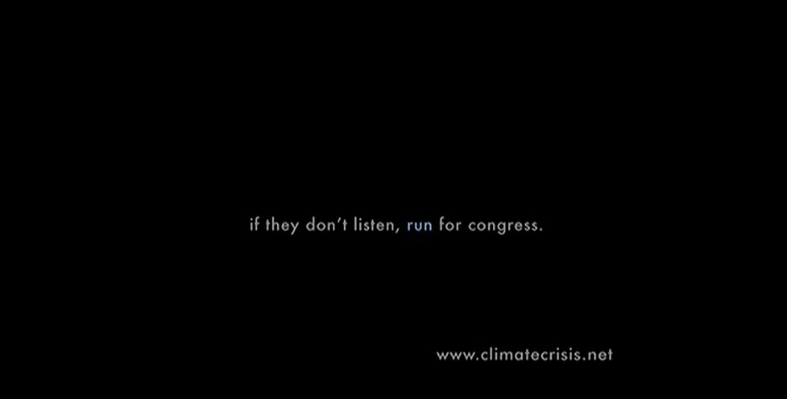
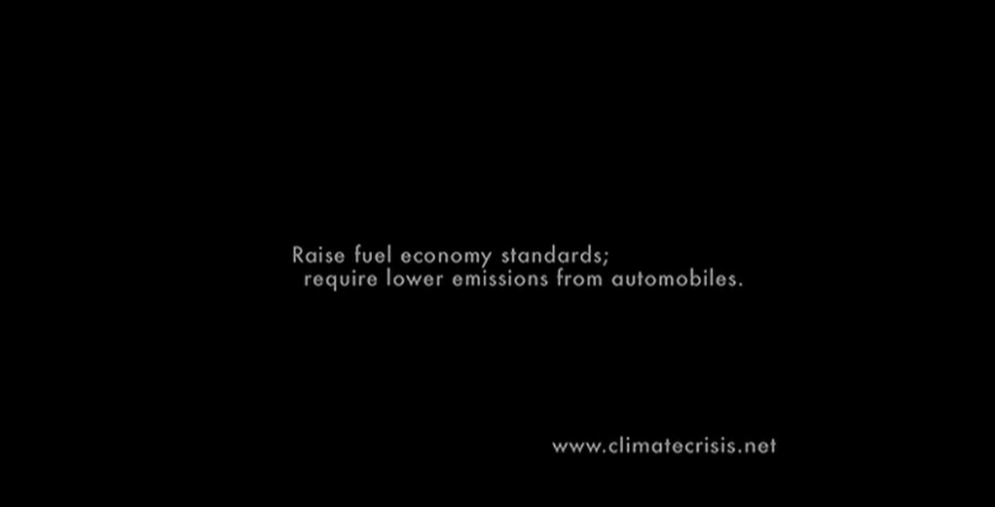
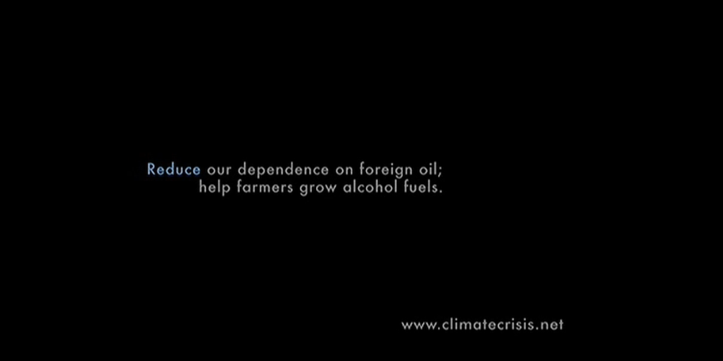
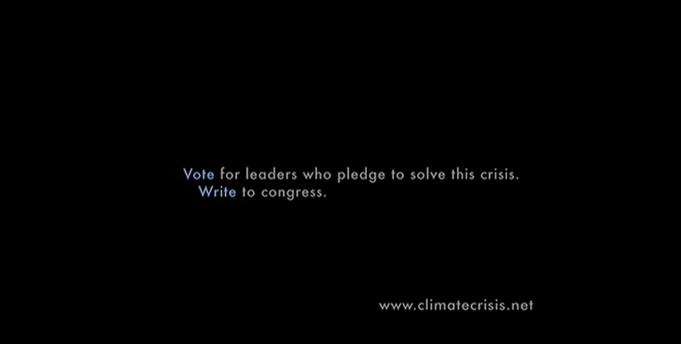
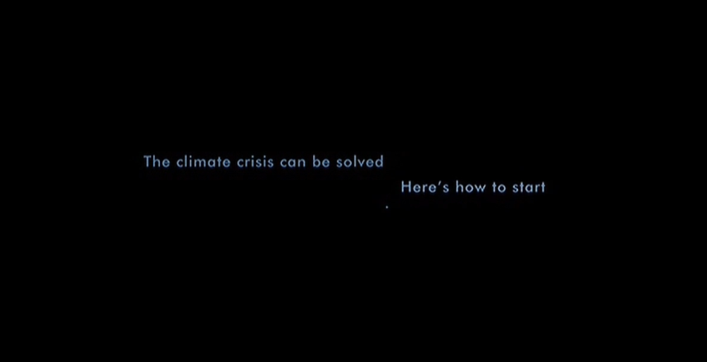
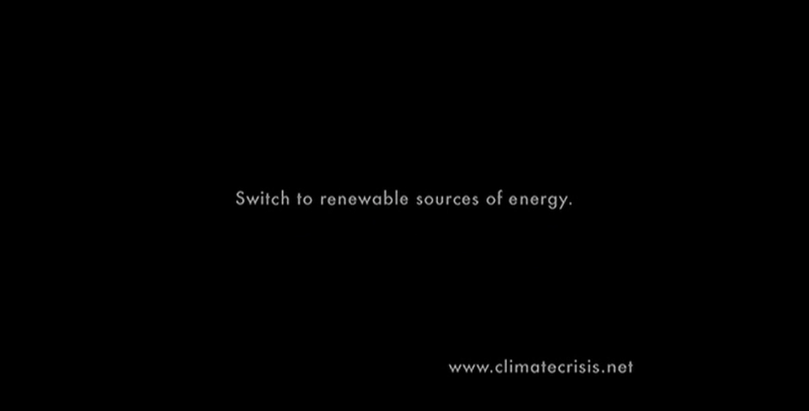
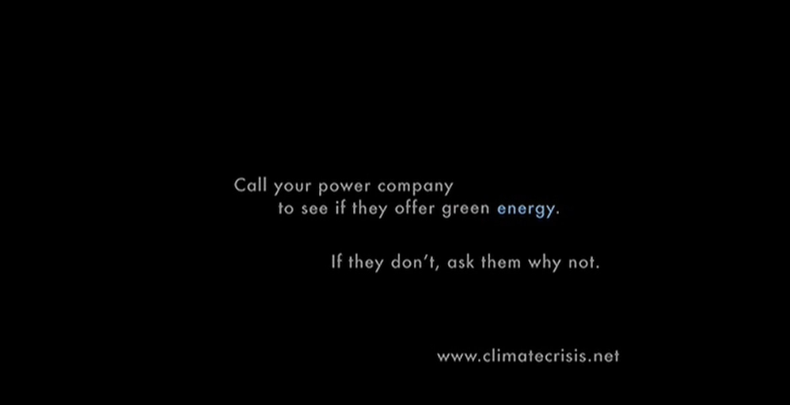
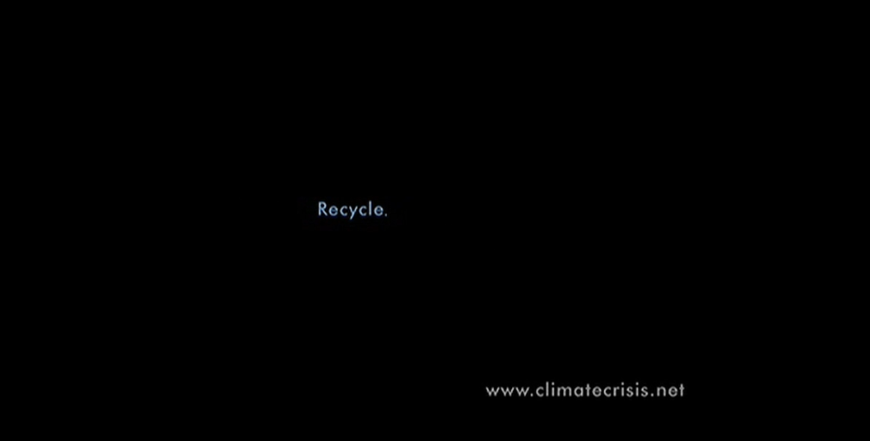
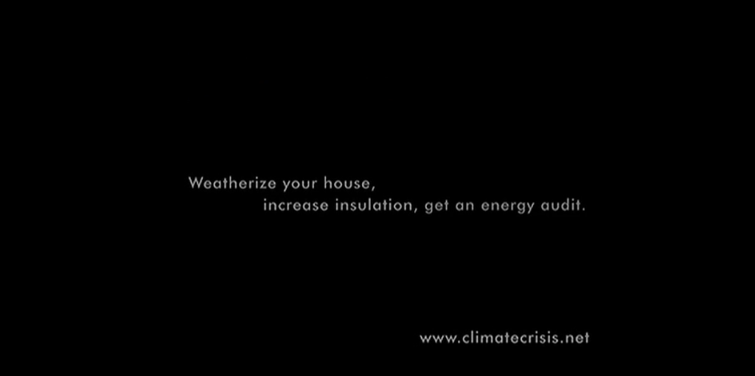
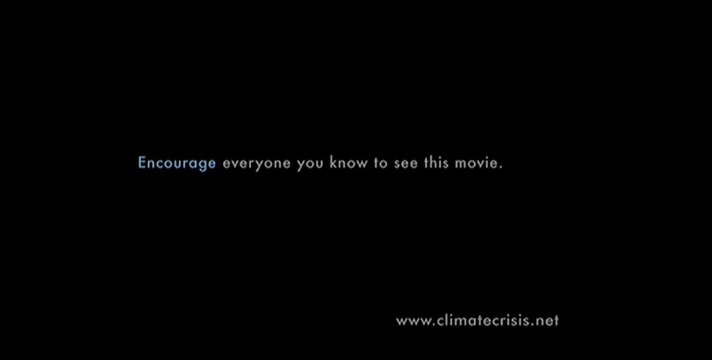
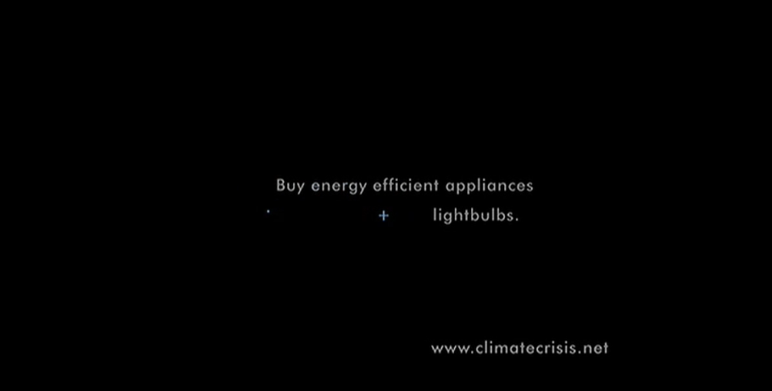
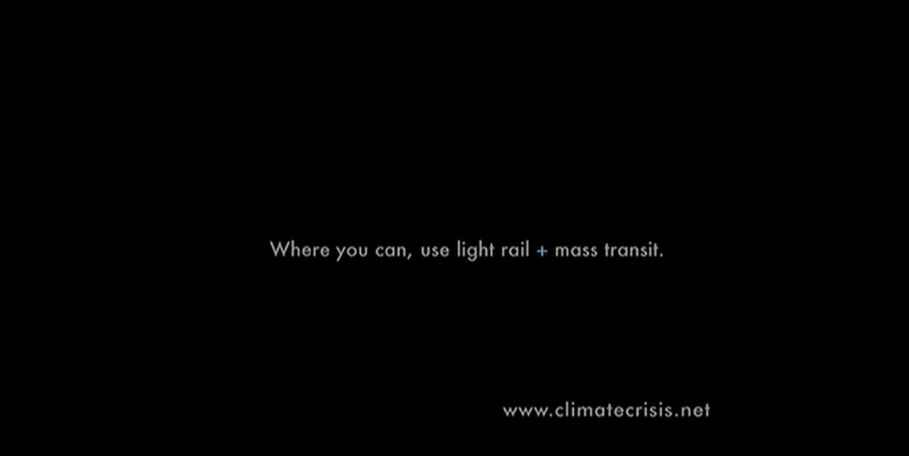
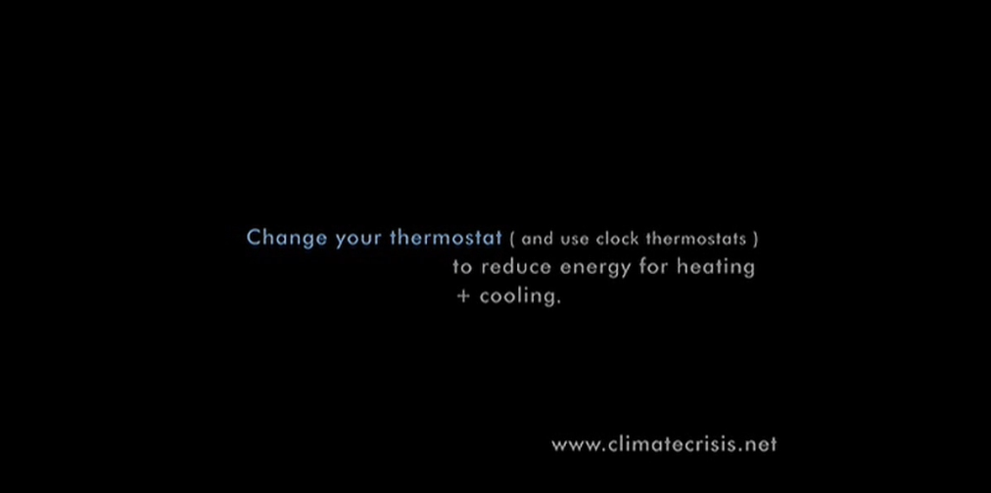
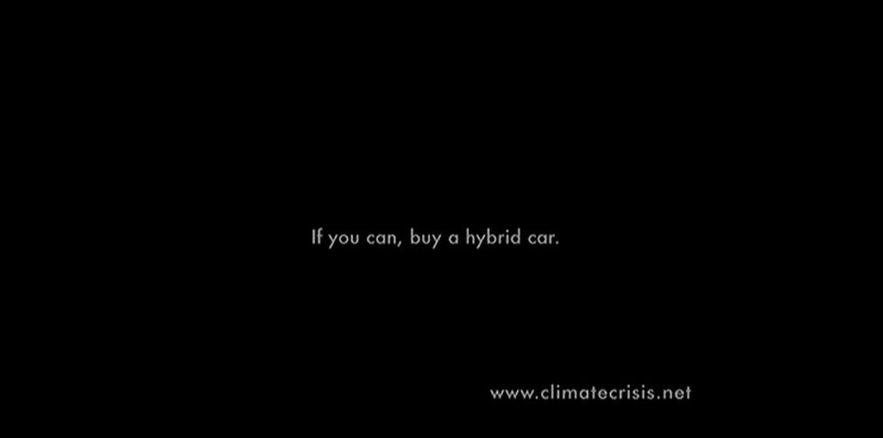
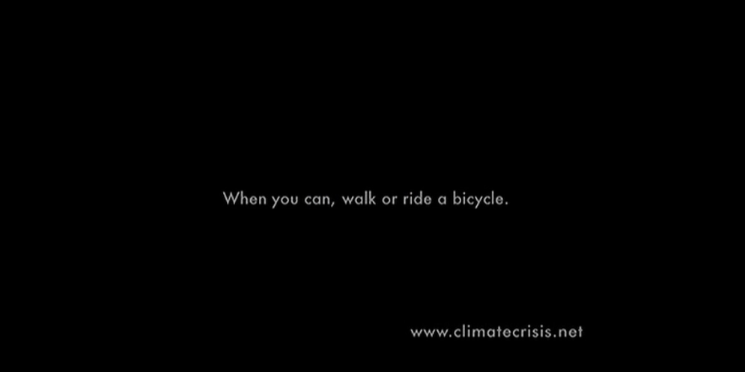
Motivation
Who’s seen An Inconvenient Truth?

Slide 4
Research Questions
In an applied, “Behavioural Insights” setting:
How to nudge sustainable behaviour change?
Better to use “prosocial” motivation, “pro-self” motivation, or both together?
Better to make many questions for behaviour change, or focus on one?

Slide 5
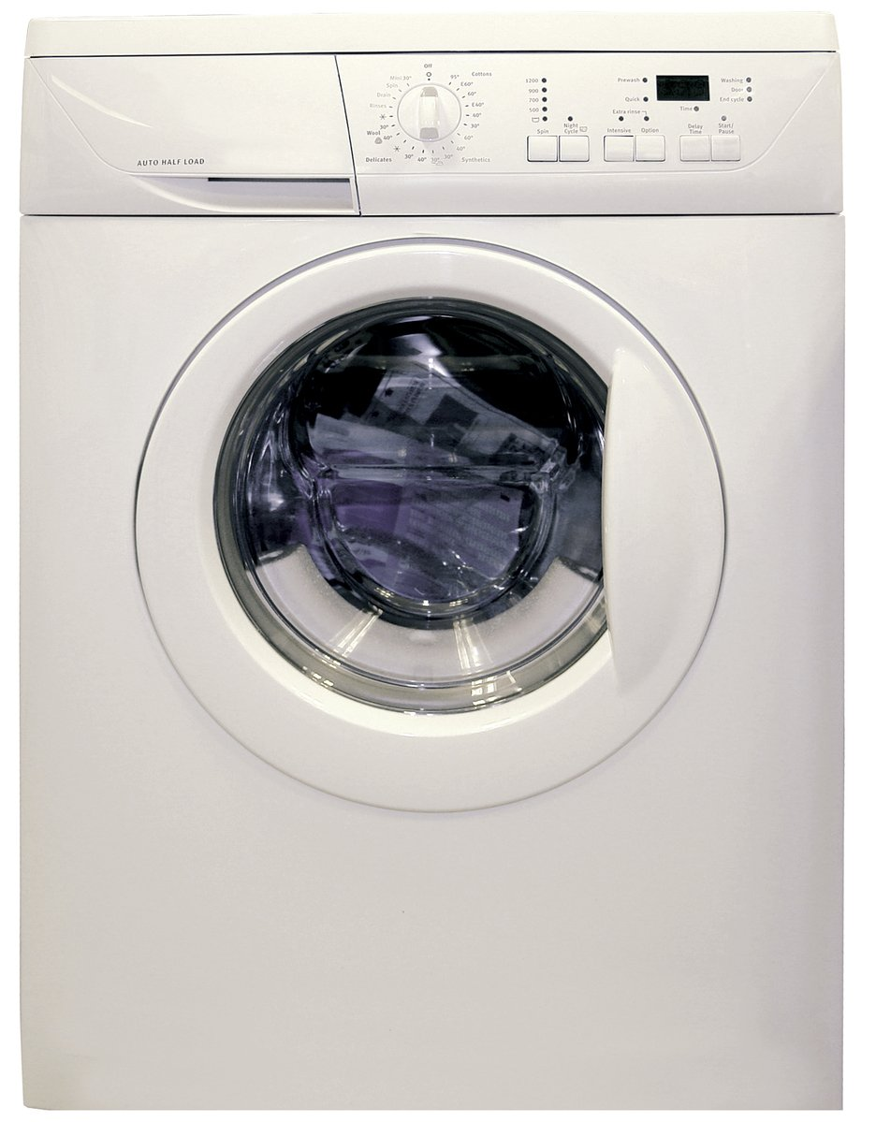
Target Behaviours
Laundry represents about 19% - 28% of home energy use in houses using electric water heating
(BC Hydro calculations based on data from https://www.energystar.gov/ )
Little research on changing laundry behaviour
Target behaviours:
Re-wear
Combine loads
Use cold water
Hang dry clothes
Image credit: https://en.wikipedia.org/wiki/Clothes_dryer#/media/File:Clothes_Dryer.jpg
Notes:
Image source: https://www.freeimages.com/photo/washing-machine-1418432

Slide 6
Brief Literature Review

Slide 7
Brief Literature Review
Spillover effects
  Meta-analysis shows positive spillover effects on intentions, but small negative effects on actual behaviour and policy support (Maki et al., 2019)
  Single request vs multiple simultaneous requests??
Monetary vs. environmental motivation
  Financial and environmental framing both improve energy efficient purchases, especially when scaled up (Camilleri & Larrick 2014; Ungemach et al 2018)
  Financial and environmental messaging both improve energy saving intentions (Steinhorst, Klöckner, & Matthies, 2015; Steinhorst & Klöckner, 2018), but not actual behaviour (Steinhorst & Klöckner, 2018)

Slide 8
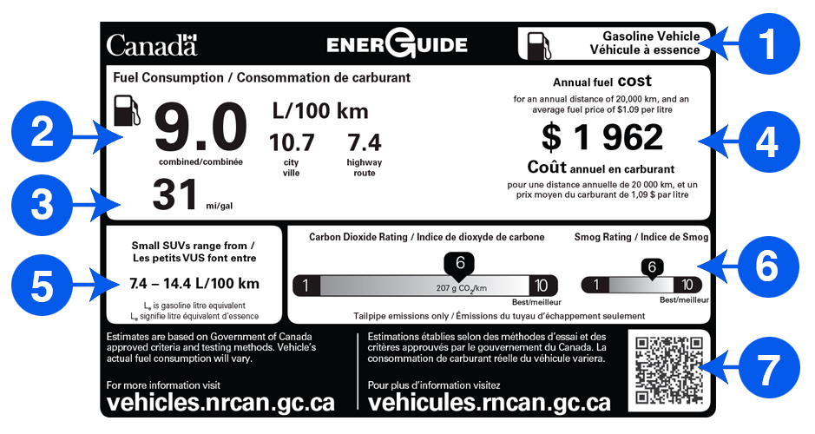
Literature Review
Image credit: https://www.nrcan.gc.ca/energy-efficiency/energuide-canada/energuide-vehicles/21010

Slide 9
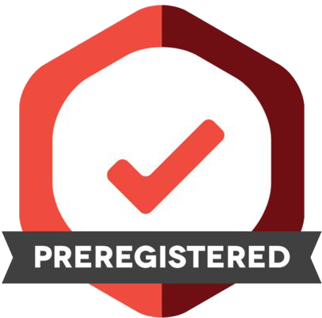
Study Design
Pre-registration: https://aspredicted.org/WWZ_WQ3

Slide 10
Study Design: Participants
1,210 BC Hydro customers recruited from BC Hydro’s Team Power Smart program and completed the first survey
Follow-up surveys every 3 months, for 1 year total
Must have Washing Machine & Clothes Dryer and pay BC Hydro bill
64% women, mean age = 57
Research questions:
Long term impact of decal nudge?
Pro-environment message, pro-self, or both?
Request many behavior changes, or just one hard one?
Notes:
Note: 1,647 agreed to participate in advance, but only 1,158 completed the time 1 survey, mostly due to blocked emails from Microsoft-related email addresses (such as @hotmail, @outlook, @msn, and @live email addresses) blocking our emails.

Slide 11
Study Design: Overview
Independent Variable: Participants randomly assigned to one of six conditions
  Control (no decal)
  Control (QR logging decal)
  Turtle appeal to change 4 behaviours
  Fleece appeal to change 4 behaviours
  Turtle + fleece appeal to change 4 behaviours
  Turtle + fleece appeal to hang dry
Dependent Variables:
  Laundry behaviour change intentions to re-wear, combine loads, cold water, hang-dry
  Retrospective self-report of efficiency behaviours, every 3 months for one year
  Ongoing log of laundry behaviour for six months
  Energy meter data (hourly level) for one year, including 1-year prior history

Slide 12
Control (no decal)
Notes:
The results from this condition were fairly similar to the Control Decal, so I won’t discuss it further, to simplify this short presentation

Slide 13
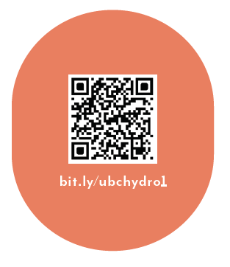
Control (logging decal only)
As part of your participation in this study, we will mail you a decal to put on your washer or dryer, which will look like the following:

Slide 14
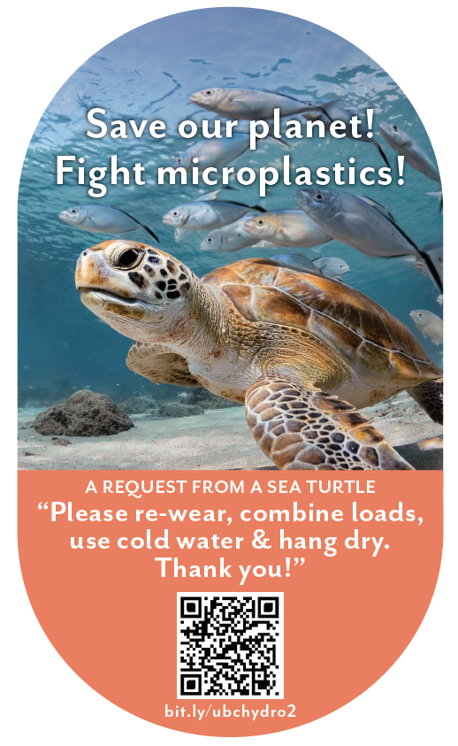
Sea Turtle + Bundled
When you machine wash and dry your clothes with hot water and hot air, “microplastics” come out of your clothes. In fact, experts say that between 700,000 and 12 million microfibres can be shed during one single load of laundry. It is estimated that laundry is responsible for 35% of microplastics in our oceans, seriously harming sea turtles and other marine life.
You can save our planet by:
- Re-wearing clothes more often
- Combining loads to run fewer, larger loads of laundry
- Washing laundry with cold water, rather than hot water or warm water
- Hanging clothes to dry (inside or outside), rather than machine-drying clothes
As part of your participation in this study, we will mail you a decal to put on your washer or dryer, which will look like the following:

Slide 15
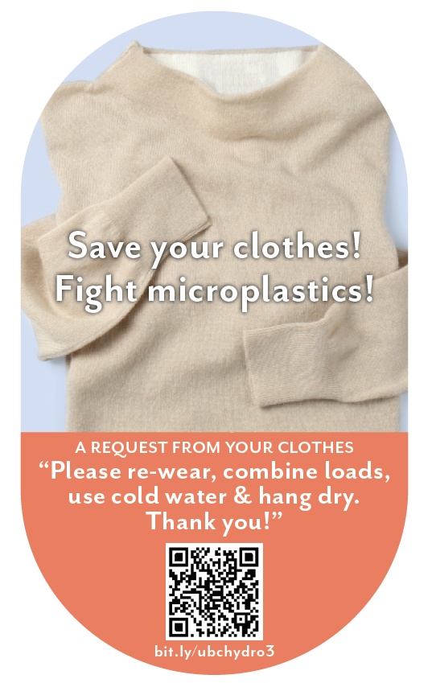
Clothing + Bundled
When you machine wash and dry your clothes with hot water and hot air, “microplastics” come out of your clothes. In fact, experts say that between 700,000 and 12 million microfibres can be shed during one single load of laundry. This breaks down the fabric in your clothes, damaging it and shortening the amount of time you’ll be able to enjoy wearing it.
You can save your clothes by:
- Re-wearing clothes more often
- Combining loads to, run fewer, larger loads of laundry
- Washing laundry with cold water, rather than hot water or warm water
- Hanging clothes to dry (inside or outside), rather than machine-drying clothes
As part of your participation in this study, we will mail you a decal to put on your washer or dryer, which will look like the following:

Slide 16
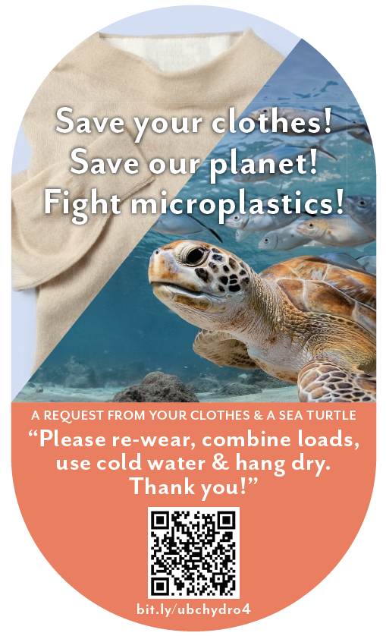
Turtle + Clothing + Bundled
When you machine wash and dry your clothes with hot water and hot air, “microplastics” come out of your clothes. In fact, experts say that between 700,000 and 12 million microfibres can be shed during one single load of laundry. This breaks down the fabric in your clothes, damaging it and shortening the amount of time you’ll be able to enjoy wearing it. It is also estimated that laundry is responsible for 35% of microplastics in our oceans, seriously harming sea turtles and other marine life.
You can save your clothes and save our planet by:
- Re-wearing clothes more often
- Combining loads to, run fewer, larger loads of laundry
- Washing laundry with cold water, rather than hot water or warm water
- Hanging clothes to dry (inside or outside), rather than machine-drying clothes
As part of your participation in this study, we will mail you a decal to put on your washer or dryer, which will look like the following:

Slide 17
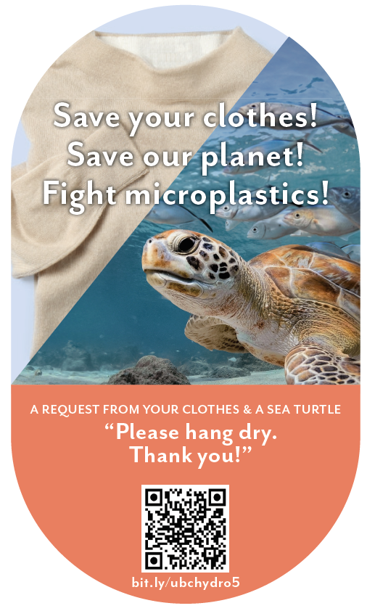
Turtle + Clothing + Hang Dry
When you machine wash and dry your clothes with hot water and hot air, “microplastics” come out of your clothes. In fact, experts say that between 700,000 and 12 million microfibres can be shed during one single load of laundry. This breaks down the fabric in your clothes, damaging it and shortening the amount of time you’ll be able to enjoy wearing it. It is also estimated that laundry is responsible for 35% of microplastics in our oceans, seriously harming sea turtles and other marine life.
You can save your clothes and save our planet by:
- Hanging clothes to dry (inside or outside), rather than machine-drying clothes
As part of your participation in this study, we will mail you a decal to put on your washer or dryer, which will look like the following:

Slide 18
Intentions Results

Slide 19
Intentions to engage in efficient laundry behaviours
Label | Cold Water | Rewear | Combine Load | Hang Dry | Average
QR Scan Only Control (n=185) | 3.25 | 3.10 | 3.19 | 3.44 | 3.25
Sea turtle + bundled msg (n=189) | 3.61* | 3.47* | 3.46* | 3.60 | 3.53*
Fleece + bundled msg (n=200) | 3.58* | 3.52* | 3.48* | 3.61* | 3.55*
Sea turtle + fleece + bundled msg (n=184) | 3.60* | 3.42* | 3.40* | 3.54 | 3.49*
Sea turtle + fleece + hang dry msg (n=189) | 3.56* | 3.42* | 3.38* | 3.77* | 3.53*
Note: Participants answered on a 1-5 scale from 1=“much less often” to 3=“the same” to 5=“much more often”.
* indicates significant difference from control

Slide 20
Summary: Decal Effectiveness vs Control
Condition | Intentions | Self-report | Logged Washing | Logged Drying | Metered Washing | Metered Drying
Turtle + Bundle | ✓
Fleece + Bundle | ✓
Turtle + Fleece + Bundle | ✓
Turtle + Fleece + Hang Dry | ✓

Slide 21
Retrospective Self-report Results

Slide 22
Retrospective Self-report Results
Takeaway:
From S2 to S5, participants were less likely to report engaging in laundry efficient behaviours for the control conditions. “Sea turtle+bundled” message was more effective than control conditions, p<.001

Slide 23
Summary: Decal Effectiveness vs Control
Condition | Intentions | Self-report | Logged Washing | Logged Drying | Metered Washing | Metered Drying
Turtle + Bundle | ✓ | ✓
Fleece + Bundle | ✓
Turtle + Fleece + Bundle | ✓
Turtle + Fleece + Hang Dry | ✓

Slide 24
Behaviour Logging Results

Slide 25
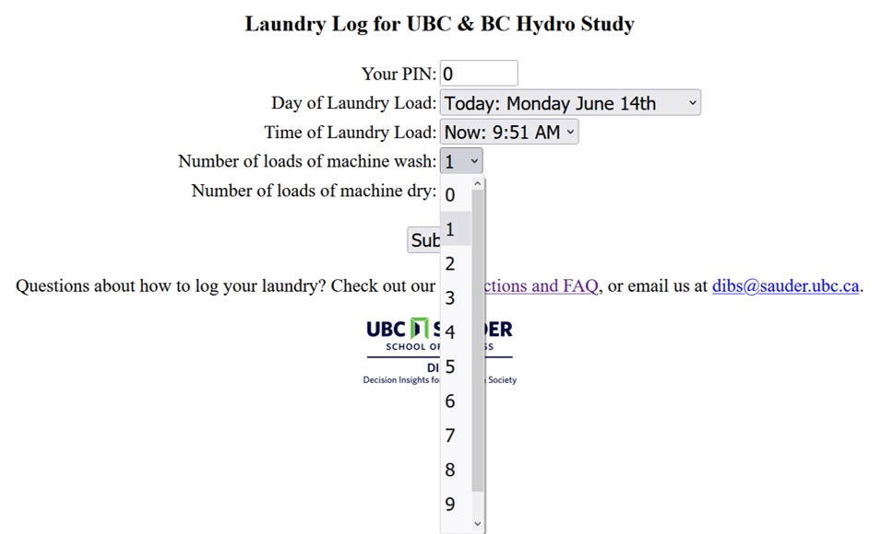
Behaviour Logging Page

Slide 26
Condition: p < .001
Month: p < .001
Condition X Month: p = .72

Slide 27
Condition: p < .001
Month: p = .61
Condition X Month: p = .88

Slide 28
Condition: p < .001
Month: p < .001
Condition X Month: p = .86

Slide 29
Summary: Decal Effectiveness vs Control
Condition | Intentions | Self-report | Logged Washing | Logged Drying | Metered Washing | Metered Drying
Turtle + Bundle | ✓ | ✓ | ✓ | ✓
Fleece + Bundle | ✓ |  | ✓
Turtle + Fleece + Bundle | ✓ |  | ✓
Turtle + Fleece + Hang Dry | ✓ |  |  | ✓

Slide 30
Energy Meter Results

Slide 31
Condition: p = .02
Month: p < .001
Condition X Month: p = .44

Slide 32
kWh During Laundry Log Times
Condition | n | Total Energy | Wash Energy | Dry Energy | Ratio (Dry/Wash)
Control (Decal only) | 94 | 15,168 | 139 | 121 | 0.81
Turtle + Bundle Msg | 91 | 14,704 | 105† | 79* | 0.68**
Fleece + Bundle Msg | 98 | 15,778 | 141 | 121 | 0.8
Turtle + Fleece + Bundle Msg | 72* | 14,240 | 102† | 82* | 0.79
Turtle + Fleece + Hang Dry Msg | 92 | 14,410 | 122 | 86* | 0.69**
Symbols indicate significant differences from control. † p < .1, * p < .05, ** p < .01

Slide 33

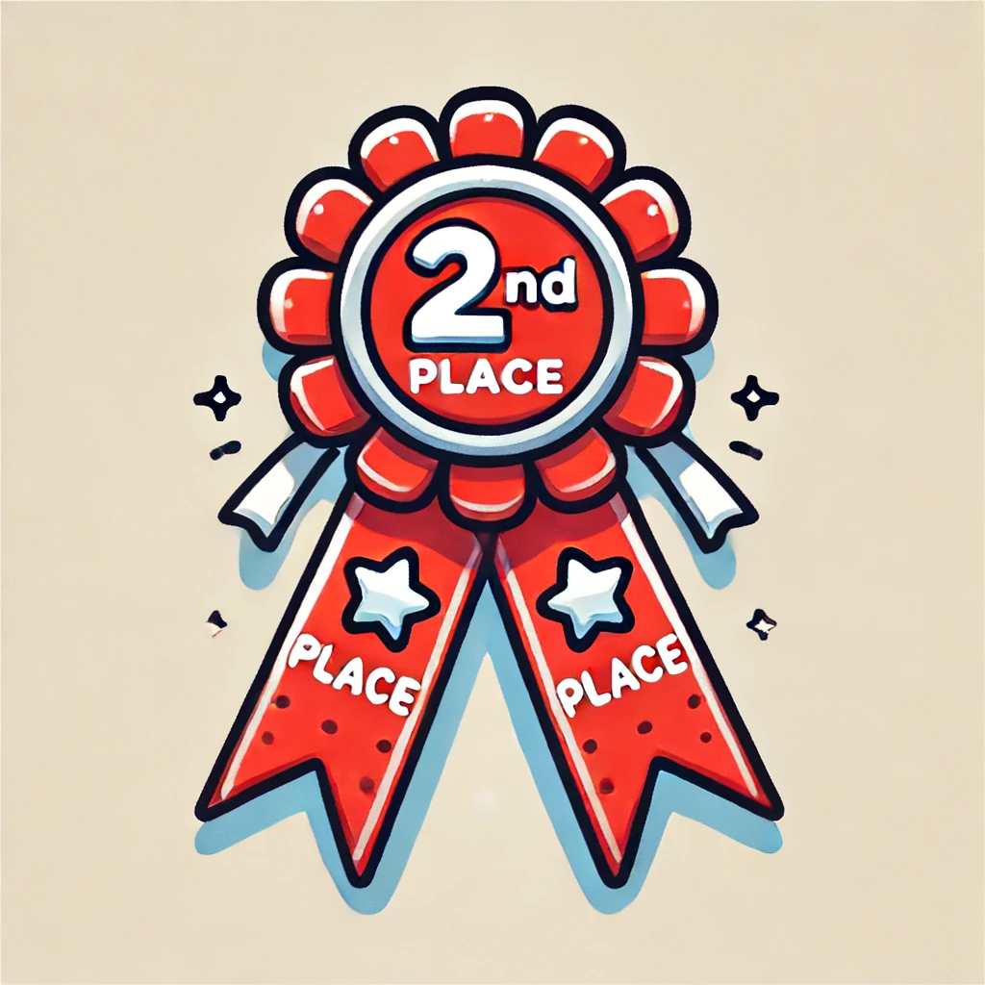
Summary: Decal Effectiveness vs Control
Condition | Intentions | Self-report | Logged Washing | Logged Drying | Metered Washing | Metered Drying
Turtle + Bundle | ✓ | ✓ | ✓ | ✓ | † | ✓
Fleece + Bundle | ✓ |  | ✓
Turtle + Fleece + Bundle | ✓ |  | ✓ |  | †
Turtle + Fleece + Hang Dry | ✓ |  |  | ✓ |  | ✓

Slide 34
Study Summary & Conclusions

Slide 35
Conclusions
In the context of a motivated sample of BC laundry doers, over a period of one year:
Decals can be an effective nudging tool for sustaining efficient laundry behaviour over time
  serves as a constant reminder & motivation
  attractive image is important
Most effective: combining a single, novel motivator (microplastics turtle) with bundle of behaviour change requests
Decal interventions did not significantly affect total household energy usage, perhaps due to noise or negative spillover/licensing

Slide 36
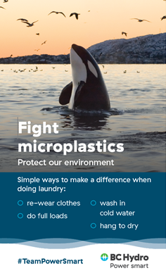
The Implemented Version

Slide 37
Thank You!

Slide 38
Questions?

Slide 39
References
Benartzi, S., & Thaler, R. H. (2013). Behavioral economics and the retirement savings crisis. Science, 339(6124), 1152-1153
Camilleri, A. R., & Larrick, R. P. (2014). Metric and scale design as choice architecture tools. Journal of Public Policy & Marketing, 33(1), 108-125.
Hardisty, D. J., Shim, Y., Sun, D., & Griffin, D. W. (2020). Encouraging energy efficiency: Product labels activate temporal tradeoffs. Available at SSRN 3576266.
Maki, A., Carrico, A. R., Raimi, K. T., Truelove, H. B., Araujo, B., & Yeung, K. L. (2019). Meta-analysis of pro-environmental behaviour spillover. Nature Sustainability, 2(4), 307-315
Schultz, P. W., Nolan, J. M., Cialdini, R. B., Goldstein, N. J., & Griskevicius, V. (2007). The constructive, destructive, and reconstructive power of social norms. Psychological science, 18(5), 429-434.
Steinhorst, J., Klöckner, C. A., & Matthies, E. (2015). Saving electricity–For the money or the environment? Risks of limiting pro-environmental spillover when using monetary framing. Journal of Environmental Psychology, 43, 125-135.
Steinhorst, J., & Klöckner, C. A. (2018). Effects of monetary versus environmental information framing: Implications for long-term pro-environmental behavior and intrinsic motivation. Environment and Behavior, 50(9), 997-1031.
Ungemach, C., Camilleri, A. R., Johnson, E. J., Larrick, R. P., & Weber, E. U. (2018). Translated attributes as choice architecture: Aligning objectives and choices through decision signposts. Management Science, 64(5), 2445-2459.
Wemyss, D., Cellina, F., Lobsiger-Kägi, E., De Luca, V., & Castri, R. (2019). Does it last? Long-term impacts of an app-based behavior change intervention on household electricity savings in Switzerland. Energy Research & Social Science, 47, 16-27.

Slide 40
Extra Slides

