Slide 1

Testing the Digital Frontier: How Research Has Used, and Should Use Online Platform Studies
Johannes Boegershausen, Yann Cornil, Shangwen Yi, & David J. Hardisty
June 1 2024

Slide 2



Co-Authors
Johannes Boegershausen
Yann Cornil
Shangwen Yi
Rotterdam School of Management
University of British Columbia
University of British Columbia

Slide 3

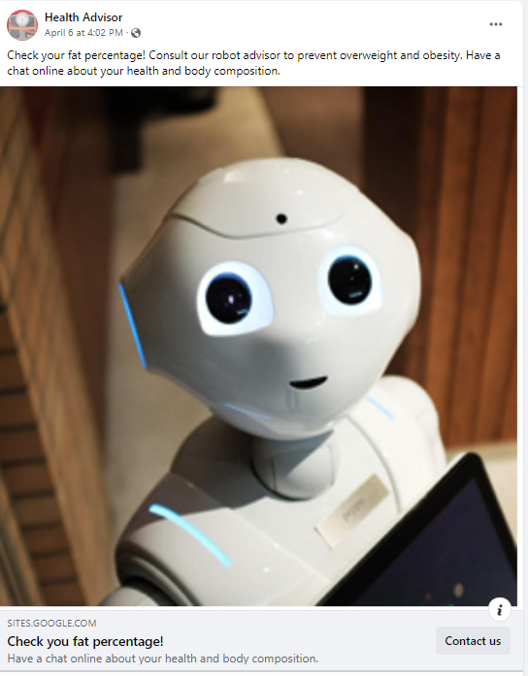
Online Platform Studies Example: Human vs Robot Doctor

Slide 4
Online Platform Studies (OPS)
Often labelled as “AB Tests”, but this is an ambiguous, umbrella category
OPS Definition: studies that are run in a naturalistic online environment and that aim to compare the effect of different stimuli (in particular ads) and the way they are delivered to an online audience, by using the A/B testing functionalities provided by digital platforms, such as Facebook (Meta) or Google Ads
Distinct from:
Holdout (or “lift”) tests – examine effect of advertisement exposure vs no exposure
Fully controlled randomized controlled trials (RCTs) run in partnership with an organization

Slide 6
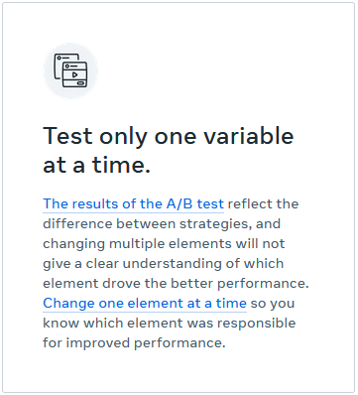
Online Platform Studies: Why use them?
The average person spends 6 hours and 58 minutes looking at their screen each day doing internet-connected activities (We are Social 2022)
Researchers are keen to test their theories in online field studies with large and diverse samples
Online advertising platforms such as Facebook (Meta), Google, and Tiktok offer convenient “AB Testing” tools at a reasonable cost
“A/B Testing helps ensure your audiences will be evenly split and statistically comparable” - Meta
https://www.facebook.com/business/ads/ab-testing#how-it-works

Slide 7
OPS: Internal Validity Issues
“Divergent delivery” compromises internal validity, so we cannot make clean causal inferences
User reactions may change the stimuli
OPS cannot replace a fully-random experiment!
OPS are constantly changing “black boxes”
Meaning of clicks is ambiguous
Often violates independent sampling assumptions of common statistics

Slide 8


OPS: Divergent Delivery Example
Grimace
Grymace

Slide 9

Outline
OPS case example
Review of current practices in all OPS published (through 2023)
Recommendations for researchers & reviewers (I will ask you!)

Slide 10

Case Example

Slide 11


PABT Case Example: Holthöwer & van Doorn (2022)
Research question: are people more interested in robot service providers for embarrassing topics?
Study 2: Facebook AB Test, N (“reach”) = 11,815; United Kingdom ages 18-65+
2x2 Between-Participants Design:
High Embarrassment: Check your fat percentage! Consult our robot (human) advisor to prevent overweight and obesity. Have a chat online about your health and body composition.
Low Embarrassment: Check your fat percentage! Consult our robot (human) advisor to assess your fitness and nutritional diet. Have a chat online about your health and body composition.
Holthöwer, J., & van Doorn, J. (2023). Robots do not judge: service robots can alleviate embarrassment in service encounters. Journal of the Academy of Marketing Science, 51(4), 767-784.
Notes:
Has 76 citations as of May 28, 2024

Slide 12
Holthöwer & van Doorn (2022): Click-Through-Rates
“High Embarrassment” (“prevent overweight and obesity”) | 0.74% | 1.26%
“Low Embarrassment” (“assess your fitness and nutritional diet”) | 0.73% | 0.93%
p = .037
p = .37

Slide 13
How Much Effect Does Optimization Have?
Case Study of Replication and Robustness

Slide 14
Replication and Extension of Holthöwer & van Doorn (2022)
Three distinct A/B tests launched simultaneously on Meta, over a three-day period
Each test compared Robot Ad vs Human Ad (high embarrassment conditions only)
Optimized on “Link Clicks” vs “Impressions” vs “Reach with frequency cap”
Budget of USD 200 per test (i.e., USD 100 per ad)
Total N (impressions) = 267,151, USA, all ages
Pre-registered: https://aspredicted.org/D2B_DT8

Slide 15
Results: Click-Through-Rates
 | Clicks |  | Impression |  | Reach w/ Cap
Ad Version | Human | Robot | Human | Robot | Human | Robot
Impressions | 11,874 | 11,735 | 62,581 | 61,808 | 59,554 | 59,599
Reach | 8,760 | 9,268 | 25,400 | 24,208 | 59,345 | 59,056
Unique Link Clicks | 120 | 152 | 23 | 23 | 22 | 29
CTR1 (Unique Link Clicks/Impression) | 1.01% | 1.30% | 0.04% | 0.04% | 0.04% | 0.05%
CTR2 (Unique Link Clicks/Reach) | 1.37% | 1.64% | 0.09% | 0.10% | 0.04% | 0.05%
p=.04
p=.14

Slide 16
Results: Click-Through-Rates
 | Clicks |  | Impression |  | Reach w/ Cap
Ad Version | Human | Robot | Human | Robot | Human | Robot
Impressions | 11,874 | 11,735 | 62,581 | 61,808 | 59,554 | 59,599
Reach | 8,760 | 9,268 | 25,400 | 24,208 | 59,345 | 59,056
Unique Link Clicks | 120 | 152 | 23 | 23 | 22 | 29
CTR1 (Unique Link Clicks/Impression) | 1.01% | 1.30% | 0.04% | 0.04% | 0.04% | 0.05%
CTR2 (Unique Link Clicks/Reach) | 1.37% | 1.64% | 0.09% | 0.10% | 0.04% | 0.05%

Slide 17
Results: Divergent Delivery
 | Clicks |  | Impression |  | Reach w/ Cap
Ad Version | Human | Robot | Human | Robot | Human | Robot
Frequency (Impression/Reach) | 1.36 | 1.27 | 2.46 | 2.55 | 1 | 1.01
Proportion of Women among exposed | 52.3% | 38.5% | 35.3% | 29.5% | 34.0% | 31.5%
CTR1 among men | 0.98% | 1.34% | 0.04% | 0.04% | 0.03% | 0.04%
CTR1 among women | 1.02% | 1.24% | 0.04% | 0.03% | 0.04% | 0.05%
Average age of exposed users | 62.11 | 62.71 | 54.06 | 53.41 | 53.5 | 53.85

Slide 18
Results: Divergent Delivery
 | Clicks |  | Impression |  | Reach w/ Cap
Ad Version | Human | Robot | Human | Robot | Human | Robot
Frequency (Impression/Reach) | 1.36 | 1.27 | 2.46 | 2.55 | 1 | 1.01
Proportion of Women among exposed | 52.3% | 38.5% | 35.3% | 29.5% | 34.0% | 31.5%
CTR1 among men | 0.98% | 1.34% | 0.04% | 0.04% | 0.03% | 0.04%
CTR1 among women | 1.02% | 1.24% | 0.04% | 0.03% | 0.04% | 0.05%
Average age of exposed users | 62.11 | 62.71 | 54.06 | 53.41 | 53.5 | 53.85

Slide 19
Results: Divergent Delivery
 | Clicks |  | Impression |  | Reach w/ Cap
Ad Version | Human | Robot | Human | Robot | Human | Robot
Frequency (Impression/Reach) | 1.36 | 1.27 | 2.46 | 2.55 | 1 | 1.01
Proportion of Women among exposed | 52.3% | 38.5% | 35.3% | 29.5% | 34.0% | 31.5%
CTR1 among men | 0.98% | 1.34% | 0.04% | 0.04% | 0.03% | 0.04%
CTR1 among women | 1.02% | 1.24% | 0.04% | 0.03% | 0.04% | 0.05%
Average age of exposed users | 62.11 | 62.71 | 54.06 | 53.41 | 53.5 | 53.85

Slide 20
Results: Other User Reactions
 | Clicks |  | Impression |  | Reach w/ Cap
Ad Version | Human | Robot | Human | Robot | Human | Robot
Comments | 2 | 3 | 0 | 0 | 0 | 0
Post Reactions | 11 | 3 | 1 | 0 | 0 | 0

Slide 21
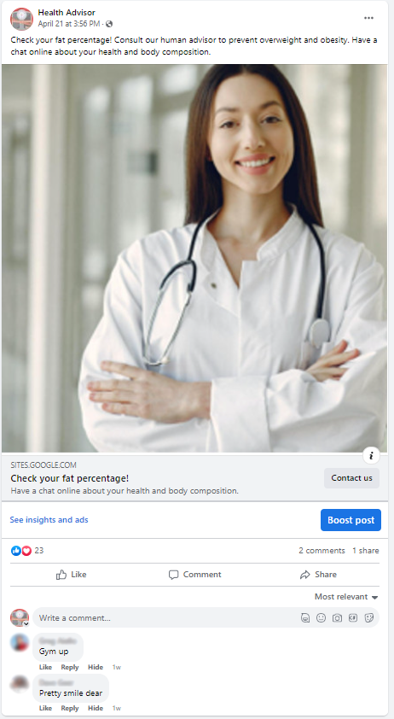
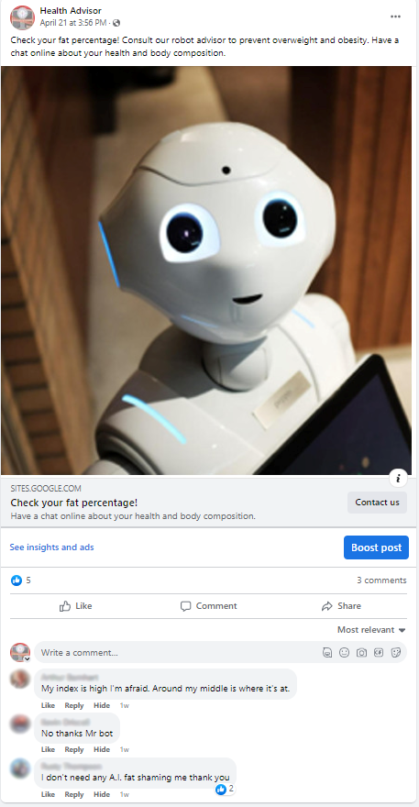

Slide 22
Case Study: Takeaways
When optimizing on clicks:
Replicated previous results
Evidence of divergent delivery
  The robot ad was shown to more men than women
  Men were more likely to click the robot ad
Evidence of divergent reactions
In short, OPS do not test “A” vs “B”. They test “A + optimization A + reactions A” vs “B + optimization B + reactions B”.

Slide 23
Case Study: Takeaways
When optimizing on impressions or capped reach:
Very low click through rates (below industry standards)
Null results
Targeting may be optimized for users unlikely to click
No evidence of divergent delivery (but may still happen on unobservables)

Slide 24
Review of Current Practice

Slide 25
OPS: Review of Current Practice
Review and coding of all 133 OPS published (through 2023)
CTR is a dependent variable in 98% of studies, yet the exact operationalization of CTR varies significantly:
  Numerator: “total clicks” vs “unique clicks”
  Denominator: “reach” vs “impressions”
  64% Not reported
19% preregistered

Slide 26
Review of Current Practice
Generally Desirable Practices | Generally Problematic Practices
18% - Discuss the lack of (true) randomization | 62% - Label the study as an experiment
81% - Stated purpose is to improve external/ecological validity or realism | 53% - Describe the OPS as offering (true) randomization
5% - Stated purpose is to test the combined effect of ad creatives and the algorithms delivering them | 71% - Stated purpose is to test theory
6% - Stated purpose is to learn which ad attributes work best on this platform | 74% - Use explicitly causal language

Slide 29
Recommendations

Slide 30
Recommendations for Researchers and Reviewers?
Evaluate and ensure:
Validity
Transparency
Appropriateness

Slide 31
Validity
Think of it like “DIY” secondary data: requires critical examination of potential confounds and algorithmic interference (Boegershausen et al, 2022)
  Similar to scraped data from Trip Advisor/X/Yelp/Amazon etc.
  Largely avoids validity problems from click farms, LLMs +++
Check for explicit evidence of divergent delivery across conditions, such as:
  Gender, Age, Impression/reach ratio (ie, exposures per person)
Consider the meaning of a click (Purchase intent? Curiosity? Outrage?)
Check for violations of statistical assumptions
  Ex: CTR as clicks/impressions violates independence of observations
  Ideally, funnel to a researcher-controlled website for measurement farther along the customer journey (Dolifka, working paper; Winterich, working paper)

Slide 32
Transparency
Require that the internal validity threats—such as lack randomization–be explicitly stated
The following must be shared:
  “Raw” data (such as PDF prints of campaign results pages)
  Ad campaign settings (such as optimization objective, target audience, etc.) must be shared
  Sample characteristics in each condition
  Alternative DV specifications (clicks/unique-clicks/impressions/reach/engagements)
Pre-registration is helpful, to differentiate confirmatory vs exploratory findings.
(As a reviewer, take a look at the pre-reg)

Slide 33
Appropriateness
A tool in the toolbox: Should not be explicitly “suggested” (ie, required) by reviewers, nor uniformly disallowed
Most useful as a “road test” to show that an intervention can yield real-world impact
OPS should never replace a true RCT
  But can be a nice complement to a lab study (Study 1A/Study 1B)
Appropriateness varies from one project to another, and must be evaluated case-by-case
Personal opinion:
When forced to make tradeoffs, OPS should prioritize ecological validity/realism. They will never be an RCT. Don’t “throw the baby out with the bathwater”.

Slide 34

Summary & Conclusions
OPS offer high ecological validity but low internal validity
OPS should only be used as a complement to, rather than a replacement for, lab-based experiments
With careful design and reporting, OPS can be a useful tool in the modern consumer research toolbox

Slide 35

Thank you!

Slide 36
Thank you!

Slide 37
References
Braun, M., & Schwartz, E. M. (2022). The A-B Test Deception: Divergent Delivery, Response Heterogeneity, and Erroneous Inferences in Online Advertising Field Experiments. working paper, Southern Methodist University.
de Langhe, B., & Puntoni, S. (2021). Are Personalized Ads a Waste of Money? Harvard Business Review Digital Articles.
Eckles, D., Gordon, B. R., & Johnson, G. A. (2018). Field studies of psychologically targeted ads face threats to internal validity. Proceedings of the National Academy of Sciences, 115(23), E5254. doi:10.1073/pnas.1805363115
Holthöwer, J., & van Doorn, J. (2022). Robots do not judge: service robots can alleviate embarrassment in service encounters. Journal of the Academy of Marketing Science, 1-18.
Johnson, G. A. (2023). Inferno: A guide to field experiments in online display advertising. Journal of Economics & Management Strategy, forthcoming. doi:https://doi.org/10.1111/jems.12513
Kohavi, R., & Thomke, S. (2017). The surprising power of online experiments. Harvard Business Review, 95(5), 74-82.
Mosleh, M., Pennycook, G., & Rand, D. G. (2022). Field experiments on social media. Current Directions in Psychological Science, 31(1), 69-75.
Orazi, D. C., & Johnston, A. C. (2020). Running field experiments using Facebook split test. Journal of Business Research, 118, 189-198. doi:https://doi.org/10.1016/j.jbusres.2020.06.053

