Slide 1

When to pay? Consumer decisions about immediate vs future losses
David Hardisty david.hardisty@sauder.ubc.ca Haas Presentation
Notes:
There’s been a lot of research on intertemporal choice, but almost all of it has focused on gains. Meanwhile, many of the real life choices we are interested in involve future losses. For example, credit card debt, obesity, and climate change all involve future losses. Is there a difference between gains and losses? YES THERE IS.

Slide 2
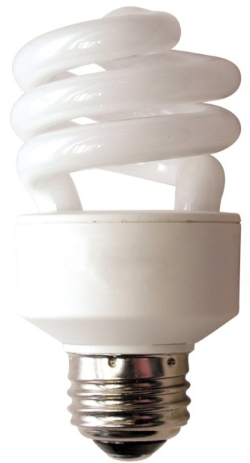
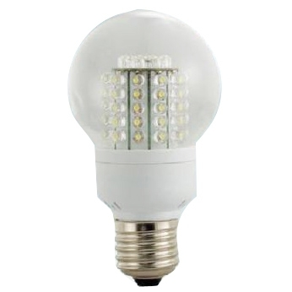
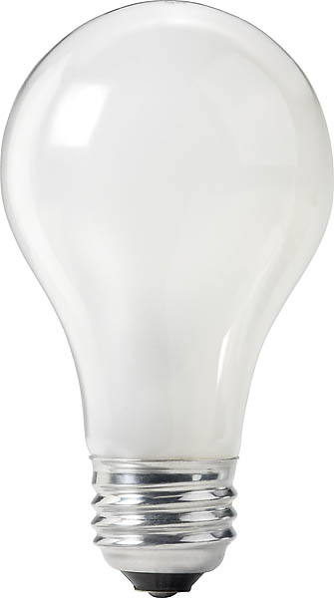
When to pay?
60 watt incandescent
14 watt CFL
9 watt LED
$0.87 now
$3.29 now
$17.50 now
$443 later
$109 later
$61 later
2
(Hardisty, Orlove, Krantz, Small, & Milch, 2012)
Notes:
Consumers are constantly making intertemporal tradeoffs, and they don't always make good choices. Here's one example... In fact, the incandescent bulb is so much worse that it is being outlawed in California and across the country. This is unfortunately heavy handed, and may have unintended consequences…
(be sure to cover uncertainty, resource slack, domain)
Image source (left): https://www.rona.ca/en/product/feit-electric-light-bulb-bright-white-a15-bulb-shape-40-watt-bp40a15-can-31925045
Image source (middle): https://www.bulbconnection.com/product/4909-TCP-80101450-14W-SPRINGLIGHT-50K-14w-Spiral
Image source (right): https://stair-lighting.com/led-e27-c-16_20.html

Slide 3
Some factors affecting time preference
Uncertainty (Bixter & Luhmann, 2013; Takahashi et al, 2007)
Interest on investment (Franklin, 1748; Read, Frederick, & Scholten, 2013)
Resource slack (Zauberman & Lynch, 2005)
Anticipation (Loewenstein 1987)

Slide 4
Discounting: definition
The higher the discount rate, the more consumers want gains now and losses later
Humans, pigeons, and rats all discount hyperbolically (Mazur 1987)
V=A/(1+kD)
Value
Notes:
This model doesn’t distinguish between gains and losses. This is surprising, given that a Nobel Prize was awarded for Prospect Theory, which differentiates gains and losses in intertemporal choice.
Why hasn’t more attention been paid to losses versus gains in intertemporal choice? One possibility is because there hasn’t been a process account or process data to explain the difference.
Today, I am going to show you that the difference between gains and losses is robust across domains, and then demonstrate why this difference happens.

Slide 5
The Discounting Bandwagon
(Hardisty, Thompson, Krantz, & Weber, 2013)
Notes:
Almost all of these are about gains.

Slide 6
The “sign effect”
Losses are discounted less than gains (Mischel et al, 1969; Thaler, 1981)
People want gains now more strongly than they want to postpone losses
Receive $70 now or in a month? 100% choose now.
Pay $70 now or in a month? 47% choose to wait.

Slide 7
Talk Outline
The “sign effect” is quite robust
Trendy non-replication of famous finding
Why are losses discounted less than gains?

Slide 8
The sign effect: quite robust across domains
Notes:
(while controlling for confounding factors)

Slide 9
Experimental Overview
3 Studies
477 US residents, recruited & run online
Hypothetical monetary, environmental & health scenarios
DV: discount rate
(Hardisty & Weber 2009)

Slide 10
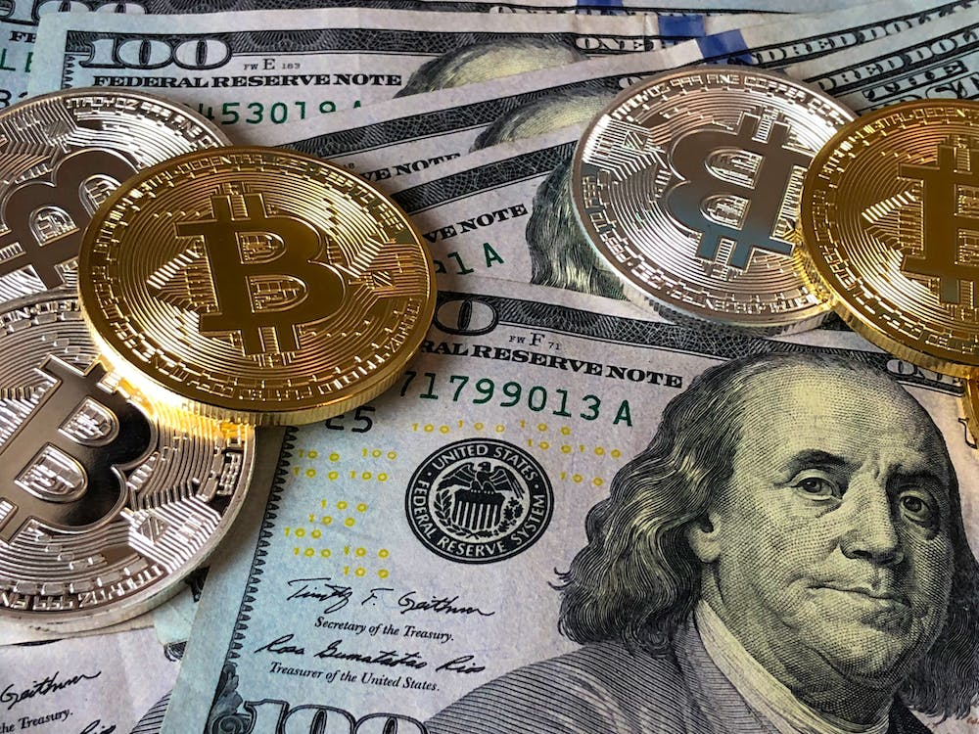
Monetary Gain Scenario
Imagine you just won a lottery, worth $250, which will be paid to you immediately. However, the lottery commission is giving you the option of receiving a different amount, paid to you one year from now.
(Hardisty & Weber 2009)
Notes:
Image credit: https://unsplash.com/

Slide 11
Indifference Point Elicitation
Please choose which option you prefer in each pair:
[ ] Win $250 immediately | [ ] Win $410 one year from now.
[ ] Win $250 immediately | [ ] Win $390 one year from now.
[ ] Win $250 immediately | [ ] Win $370 one year from now.
... | ...
Please fill in the number that would make you indifferent between the following two options: A. Win $250 immediately. B. Win $ one year from now.
(Hardisty & Weber 2009)

Slide 12
Indifference Point Elicitation
Please choose which option you prefer in each pair:
[ ] Win $250 immediately | [x] Win $410 one year from now.
[ ] Win $250 immediately | [x] Win $390 one year from now.
[x] Win $250 immediately | [ ] Win $370 one year from now.
... | ...
Please fill in the number that would make you indifferent between the following two options: A. Win $250 immediately. B. Win $ 380 one year from now.
(Hardisty & Weber 2009)

Slide 13
Discount Rate Computation
[ ] Win $250 immediately | [x] Win $410 one year from now.
[ ] Win $250 immediately | [x] Win $390 one year from now.
[x] Win $250 immediately | [ ] Win $370 one year from now.
... | ...
V = A/(1+kD)
250 = 380/(1+k*1)
k = .52
(Hardisty & Weber 2009)

Slide 14
Monetary Loss Scenario
Imagine you just got a parking fine for $250, which you must pay immediately. However, the city court is giving you the option of paying a different amount instead, one year from now.
(Hardisty & Weber 2009)
Notes:
Image credit: https://unsplash.com/

Slide 15
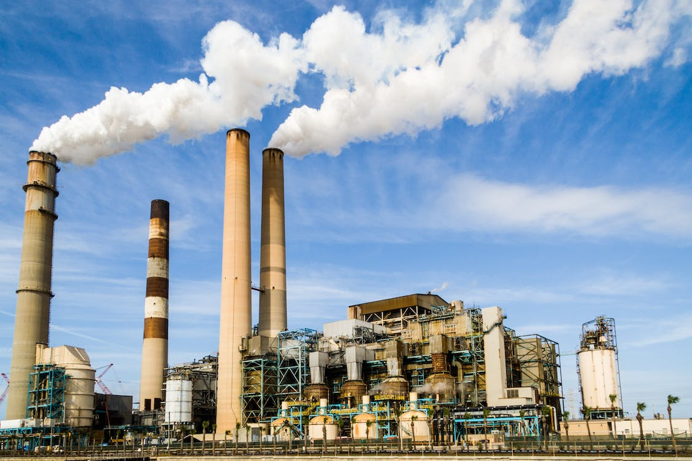
Air Quality Scenarios
Imagine the current air quality in your area is moderate
Temporary emissions regulation test will immediately improve [worsen] air quality for 3 weeks
Alternately, the test may be carried out one year from now, for a different length of time
We are interested in your preference, as someone who will be personally affected by it, between the two options of improved air now or in the future
(Hardisty & Weber 2009)
Notes:
Image credit: https://unsplash.com/

Slide 16
Indifference Point Elicitation
Please choose which option you prefer in each pair:
[ ] Improved air quality immediately, for 21 days. | [ ] Improved air quality one year from now, for 37 days.
[ ] Improved air quality immediately, for 21 days. | [ ] Improved air quality one year from now, for 35 days.
[ ] Improved air quality immediately, for 21 days. | [ ] Improved air quality one year from now, for 33 days.
... | ...
Please fill in the number that would make you indifferent between the following two options: A. Improved air quality immediately, for 21 days. B. Improved air quality one year from now, for ____ days.
(Hardisty & Weber 2009)

Slide 17
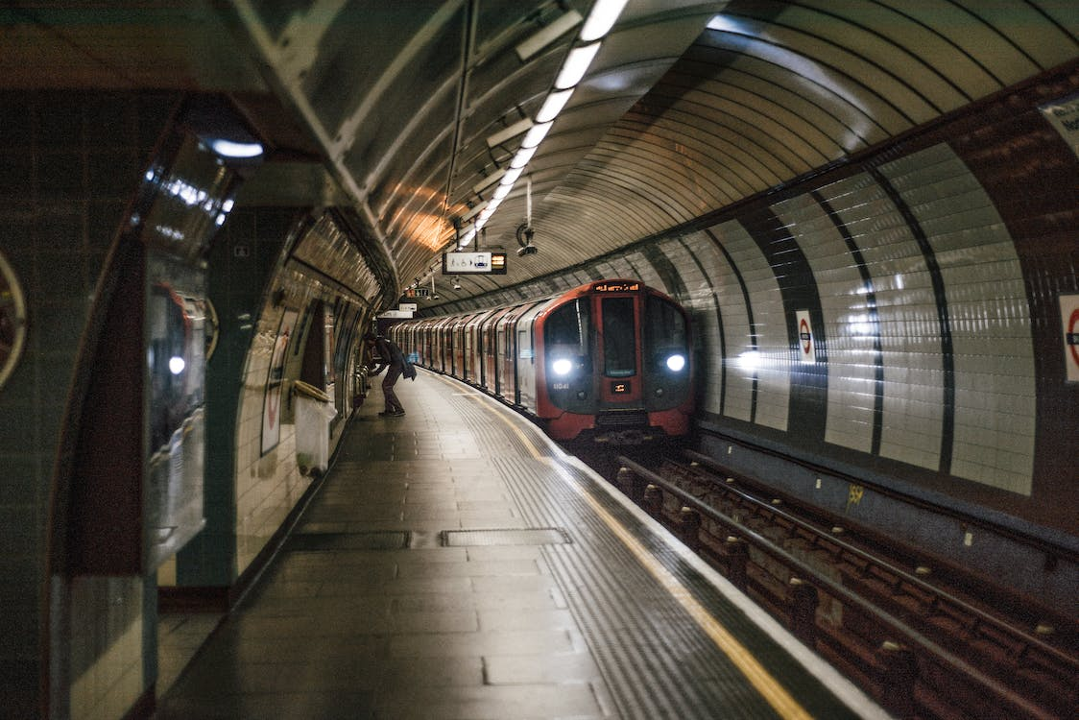
Mass Transit Scenario
(Hardisty & Weber 2009)
Notes:
Image credit: https://unsplash.com/

Slide 18
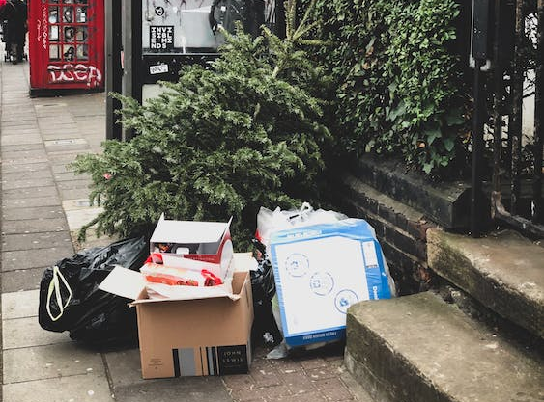
Garbage Scenario
(Hardisty & Weber 2009)
Notes:
Image credit: https://unsplash.com/

Slide 19
Study 1: Discount Rates
(Hardisty & Weber 2009)

Slide 20
Study 2: Objectives
Replicate study 1, using a different measure of air quality & an experienced population
Health outcomes

Slide 21
Monetary Scenarios
Gain and loss, same as study 1
Notes:
Image credit: https://unsplash.com/

Slide 22
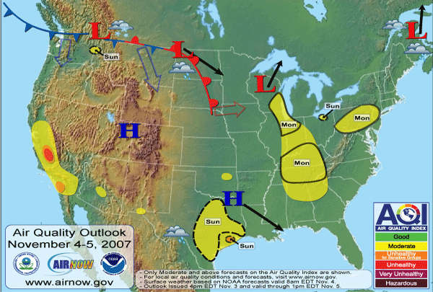
Environmental Scenarios: the AQI
Notes:
Image credit: www.airnow.gov

Slide 23


Understanding the AQI
What is the AQI? The AQI is an index for reporting daily air quality that tells you how clean or polluted your air is... etc
Good
Moderate
Unhealthy for Sensitive Groups
Unhealthy
Very Unhealthy
Hazardous
(Hardisty & Weber 2009)

Slide 24

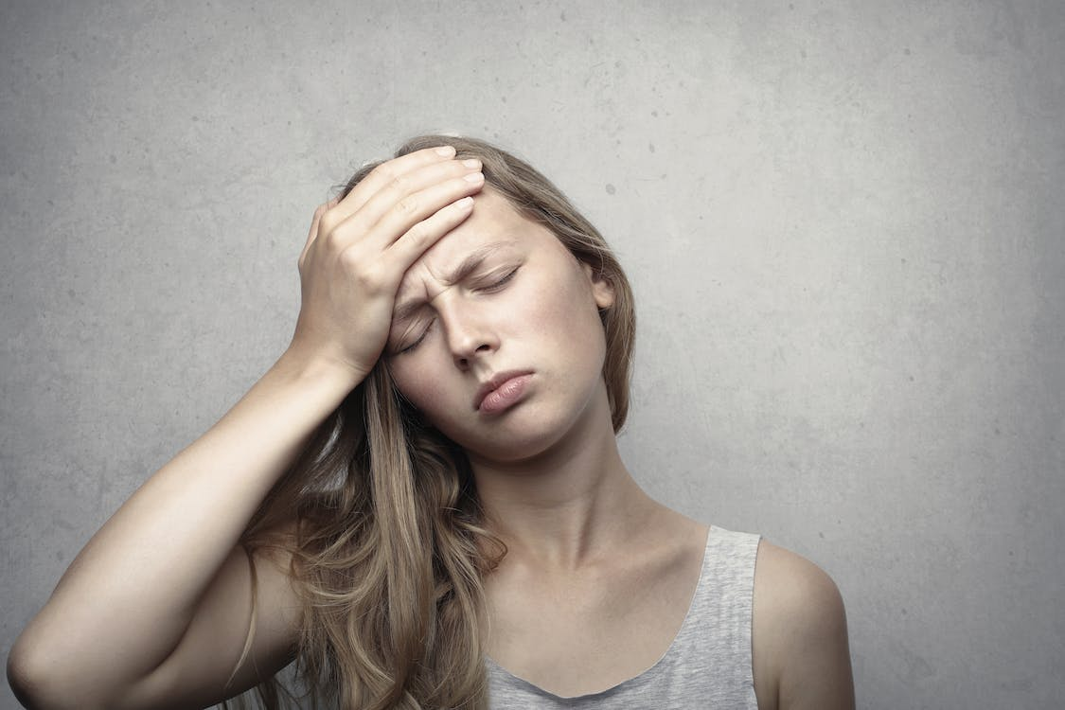
Health Scenarios
Used stimuli developed by Chapman (1996)
Imagine you are currently in poor [good] health
You can choose between two treatments [disorders] which will restore you to [cause you to lose your] full health for a limited amount of time (~12 weeks)
One would take effect immediately, the other one year from now
Notes:
Image credit: https://unsplash.com/

Slide 25
Study 2: Results
(Hardisty & Weber 2009)
Notes:
I’ve run around 20 studies of discounting, and they all show a striking effect: losses are discounted much less than gains. First, let me walk you through the study that got me started on this. This was an online study, with Elke Weber. Participants made a series of choices…. Remarkably, some participants actually showed negative discounting of losses. For example…
Previous studies of environmental discounting screwed this up....
In addition to this behavioral evidence of differences between gains and losses, we also have neural evidence

Slide 26
Study 3: Results
(Hardisty & Weber 2009)

Slide 27
Summary so far
Gains are discounted more than losses, across domains
What about when real money is on the line?

Slide 28
Real Disco
60 Columbia students
2 experimental sessions, 4 weeks apart
Between subjects: real vs hypothetical
Within subjects: - gain vs loss - accelerate vs delay - small vs medium

Slide 29
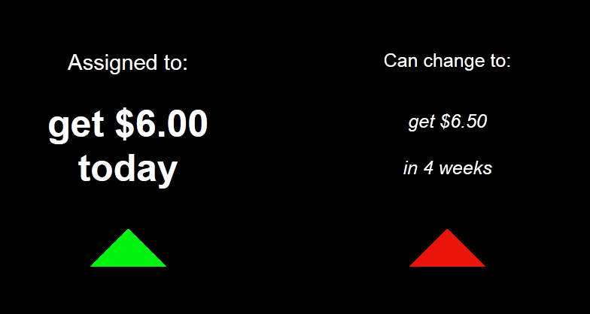
Small Gain Delay

Slide 30
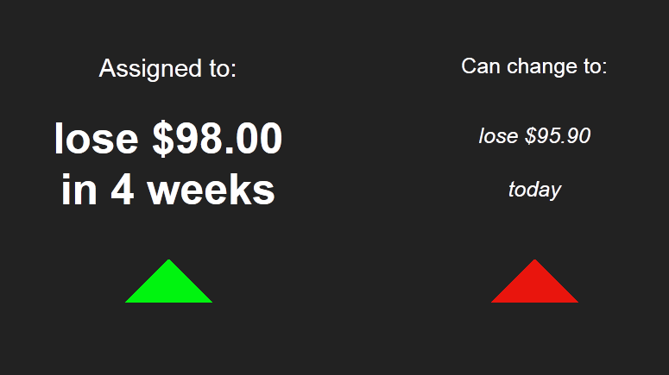
Medium Loss Accelerate

Slide 31
Real vs Hypothetical Gains and Losses

Slide 32
Disco Brain: Gains vs Losses
Gain > Loss
Loss > Gain
(Hardisty, Wimmer, Weber, & Shohamy; in prep)
Notes:
Left: Gain > Loss at p<.01 showing activation in the vmPFC Right: Loss > Gain at p<.05 showing activation in the amygdala and habenula
Why does this happen?
Perhaps, one reason why there are differences in time preference is because there are differences in anticipation value.

Slide 33
Sign X Direction
(Appelt, Hardisty, & Weber, 2012)

Slide 34
Summary so far
Gains are discounted more than losses:
for financial, health, and environmental outcomes
for real and hypothetical outcomes
for accelerate and delay
it’s in the brain

Slide 35
Why?
Anticipation
Loss aversion
Magnitude
Uncertainty

Slide 36
Anticipation

Slide 37
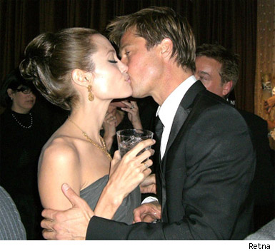
Kiss from a movie star (Loewenstein, 1987)
Discounting
Anticipation
Notes:
Image source: https://people.com/celebrity/angelina-jolie-brad-pitt-married-top-10-pda-moments/

Slide 38
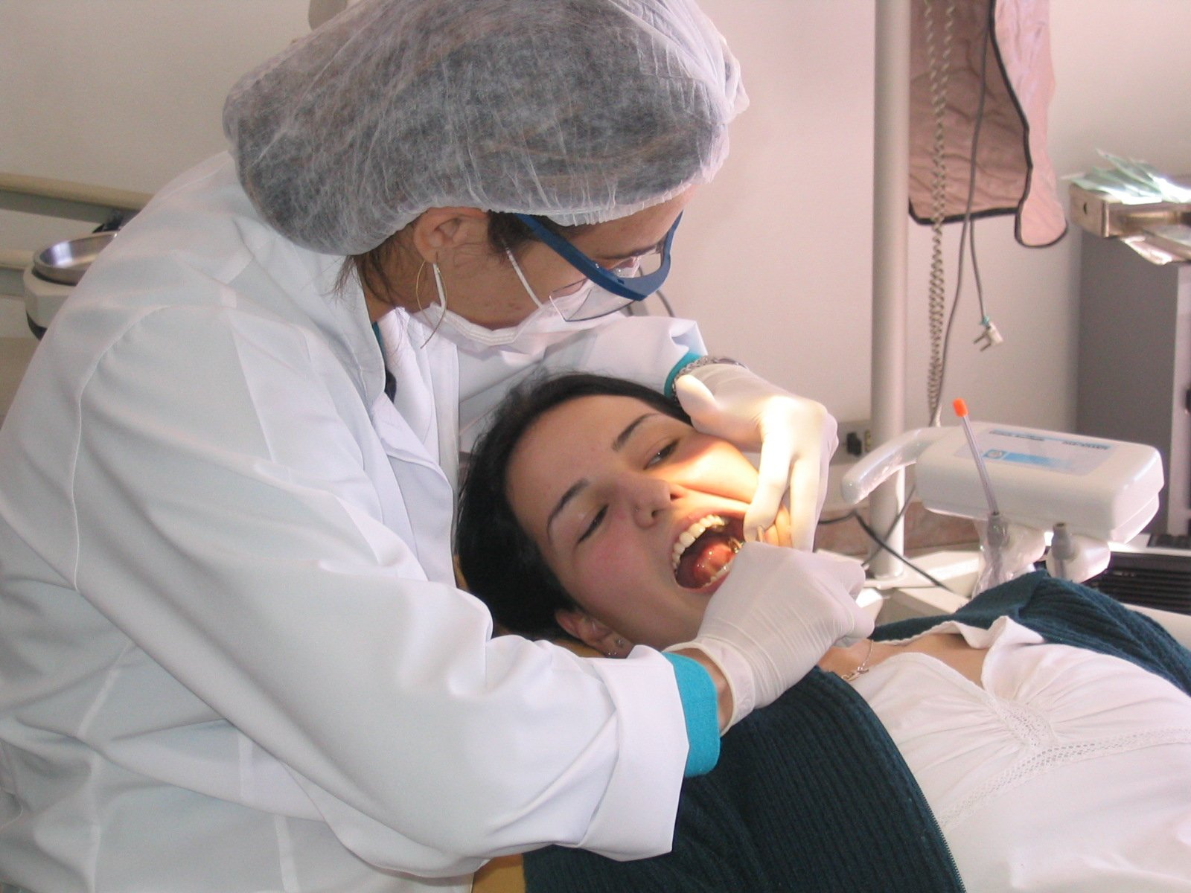
Scheduling a dental procedure
Discounting
Anticipation
Notes:
Image credit: https://unsplash.com/

Slide 39
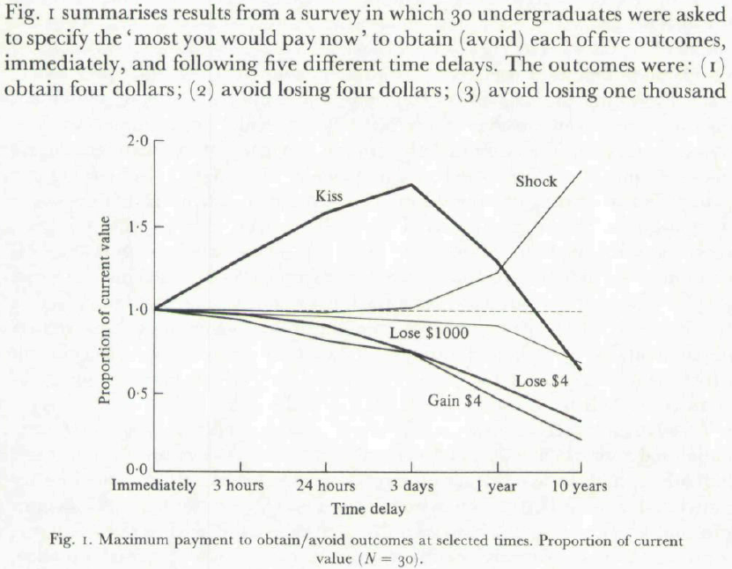
Loewenstein (1987)

Slide 40
Non-replication: Shane’s study
N=103 Harvard students
“What is the most you would be willing to pay for a kiss from your favorite movie star tonight?” Mean = $97; Median = $25
“What is the most you would be willing to pay for a kiss from your favorite movie star three days from tonight?” Mean = $83; Median = $25
“Why?”
Just six participants (out of 103) would pay more for the delayed kiss, and just one mentioned pleasurable anticipation as the reason

Slide 41
Non-replication: Dave’s study methods
N=102 Mturks. Cut 11 for failing an attention check, leaving 91.
“Would you want a kiss from the movie star of your choice?” (Yes/No)
“What is the most you'd pay today for a kiss from the movie star of your choice today?”
“What is the most you'd pay today for a kiss from the movie star of your choice 3 days from today?”
[Counter-balanced order]

Slide 42
Non-replication: Dave’s study results
(36% of participants said they would not like a kiss from the movie star of their choice)
 | Percent showing effect
Anticipation effect (paying more for 3 days from today than for today) | 3%
No effect (no difference between today and 3 days from today) | 75% (median)
Impatience effect (paying more for today than for 3 days from today) | 22%
Total | 100%

Slide 43
Pilot research: savoring?
Savoring: Only 6 out of 103 students would pay more for a kiss next week than one today
Dread: 20 out of 56 students preferred eating 9 worms today rather than 8 next week (see also Harris, 2010; Berns et al 2006)
Does dread loom larger?
Notes:
Students who liked eating worms were screened out. In this sample, at any rate, we failed to replicate Loewenstein’s finding; meal worms isn’t the best control for kissing movie stars

Slide 44
Anticipation: Methods
Imagine receiving [losing] $50.
When would you prefer this to happen?
If this event were one week away, how psychologically pleasurable or unpleasurable would the anticipation be? In other words, how would you feel while waiting for it?
Hardisty, Frederick, & Weber (in revision)
Notes:
We asked this question for 20 different events, 10 positive and 10 negative, including financial, health, and social events, and several “classics” from the literature, such as Loewenstein’s “kiss from a movie star” effect.
Incidentally, we ran two replications of Loewenstein’s kiss from a movie star paradigm, and failed to replicate it both times.
We wanted to see whether anticipation was asymmetric, and whether it predicted time preference.
So, what did we find for time preference?

Slide 45
Anticipation Study: Example Events
Some Positive Events:
receiving a $50 check
spending time with your best friend
kiss from a movie star
Some Negative Events:
paying a $50 fine
a confrontation with your co-worker or family member
painful dental procedure

Slide 46
Results: Time preference
 | Now | Indifferent | Later
Positive Events | 62% | 31% | 7%
Negative Events | 41% | 22% | 37%
Total N=5,420 events (20 events for each of 169 participants)
Notes:
What about anticipation?

Slide 47
Results: Anticipation
Notes:
The distribution for positive events crosses over zero…
Moreover, we found that these ratings of anticipation predicted time preference. This relationship was significant for all 20 events; average standardized beta = -.3. That’s weak, and reinforces the fact that anticipation is just one of many factors that drives time preference.
So, we’ve shown that dread looms larger than savoring, and that anticipation predicts time preferences…
Taken together, this explains the “sign effect”. But is this just loss aversion?

Slide 48
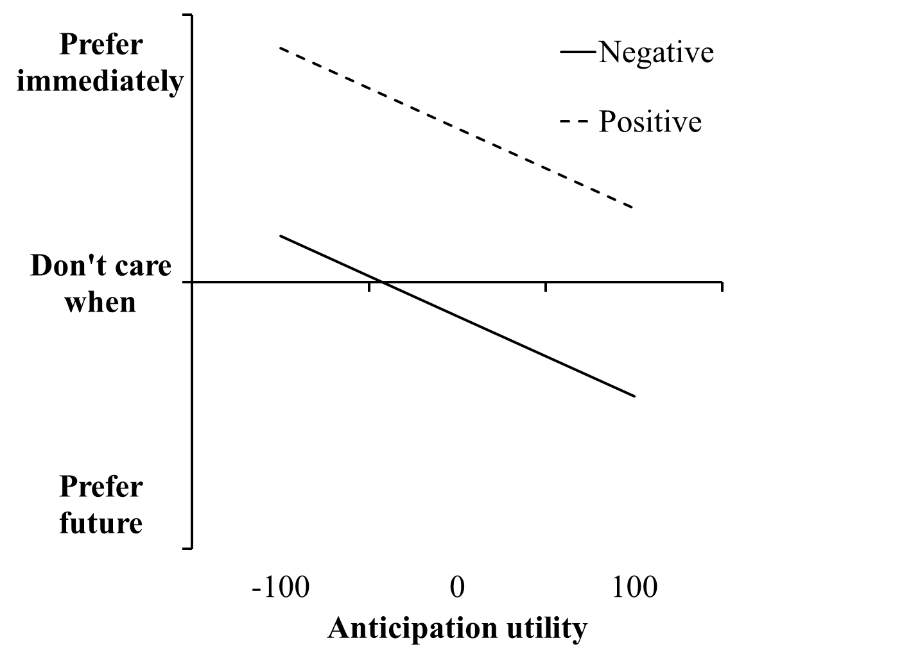
Anticipation predicts time preferences
Notes:
This relationship was significant for all 20 events; average standardized beta = -.3

Slide 49
Why?
Anticipation YES
Loss aversion
Magnitude
Uncertainty

Slide 50
Loss Aversion?

Slide 51
Controlling for loss aversion
Would you accept this pair of events?
50% chance to receive [$25] AND 50% chance to lose $25
Yes Unsure No
Notes:
We also investigated non-monetary outcomes, such as a 50 minute pleasurable massage and being stuck in horrible traffic for 50 minutes.
So, with the outcomes matched, what did we find for time preference?

Slide 52
Results: Time preference
 | Now | Later
Positive Events | 80% | 20%
Negative Events | 57% | 43%
Total N=5,420 events (20 events for each of 169 participants)
Notes:
What did we find for anticipation?

Slide 53
Results: Utility
Notes:
It’s not that losses are stronger, it’s that the anticipation of losses is qualitatively different from the anticipation of gains.

Slide 54
Anticipation: What do we call it?
 | Pleasurable Anticipation | Aversive Anticipation
Positive Event | Savoring | Impatience
Negative Event | ??? | Dread
Notes:
This is just anecdotal evidence, and we wanted to study it more systematically…

Slide 55
Why?
Anticipation YES
Loss aversion NO
Magnitude
Uncertainty

Slide 56
Magnitude?

Slide 57
Sign X Magnitude
(Hardisty, Appelt, & Weber 2012)

Slide 58
Why?
Anticipation YES
Loss aversion NO
Magnitude NO
Uncertainty

Slide 59
Uncertainty?

Slide 60
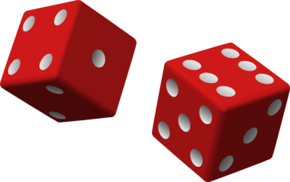
Uncertainty: Methods
Please imagine you face a set of choices about paying a $100 bill immediately, or another amount in one year.
Control: Pay $100 immediately or pay $150 in one year?
Probabilistic: Pay $100 immediately or 50% chance of paying $300 in one year?
Variable: Pay $100 immediately or pay $75 to $225 in one year?
(Hardisty & Pfeffer, under review)

Slide 61
(Hardisty & Pfeffer, under review)

Slide 62
Uncertainty: Discussion
Future uncertainty -> stronger preference for immediate gains and losses -> stronger sign effect
The future is always uncertain, even when experimenters say it’s not (Bixter & Luhmann, 2013; Takahashi et al, 2007)
Therefore, the sign effect is always around

Slide 63
Why?
Anticipation YES
Loss aversion NO
Magnitude NO
Uncertainty YES

Slide 64
Contribution Summary
People choose immediate gains more than they choose to postpone losses
Why? Dread looms larger than savoring, even when controlling for loss aversion. (Also: people avoid future uncertainty.)
Why? Future gains -> savoring and deprivation Future losses -> dread but not “enjoying the moment”
Notes:
Any further questions before I move on to talking about some other projects?

Slide 65
Implications
60 watt incandescent
14 watt CFL
9 watt LED
$0.87 now
$3.29 now
$17.50 now
$443 later
$109 later
$61 later
65
(Hardisty, Orlove, Krantz, Small, & Milch, 2012)
Notes:
Consumers are constantly making intertemporal tradeoffs, and they don't always make good choices. Here's one example... In fact, the incandescent bulb is so much worse that it is being outlawed in California and across the country. This is unfortunately heavy handed, and may have unintended consequences… each bulb gives out about 700 lumens
(be sure to cover uncertainty, resource slack, domain)
Image source (left): https://www.rona.ca/en/product/feit-electric-light-bulb-bright-white-a15-bulb-shape-40-watt-bp40a15-can-31925045
Image source (middle): https://www.bulbconnection.com/product/4909-TCP-80101450-14W-SPRINGLIGHT-50K-14w-Spiral
Image source (right): https://stair-lighting.com/led-e27-c-16_20.html

Slide 66
Thank You!

Slide 67
Additional Slides

Slide 68
A dirty word, or a dirty world?
Hardisty, Johnson, & Weber (2010). A dirty word or a dirty world? Attribute framing, political affiliation, and query theory. Psychological Science, 21, 86-92.
Notes:
I’m also working on an attribute representation project with Christian Wheeler...

Slide 69
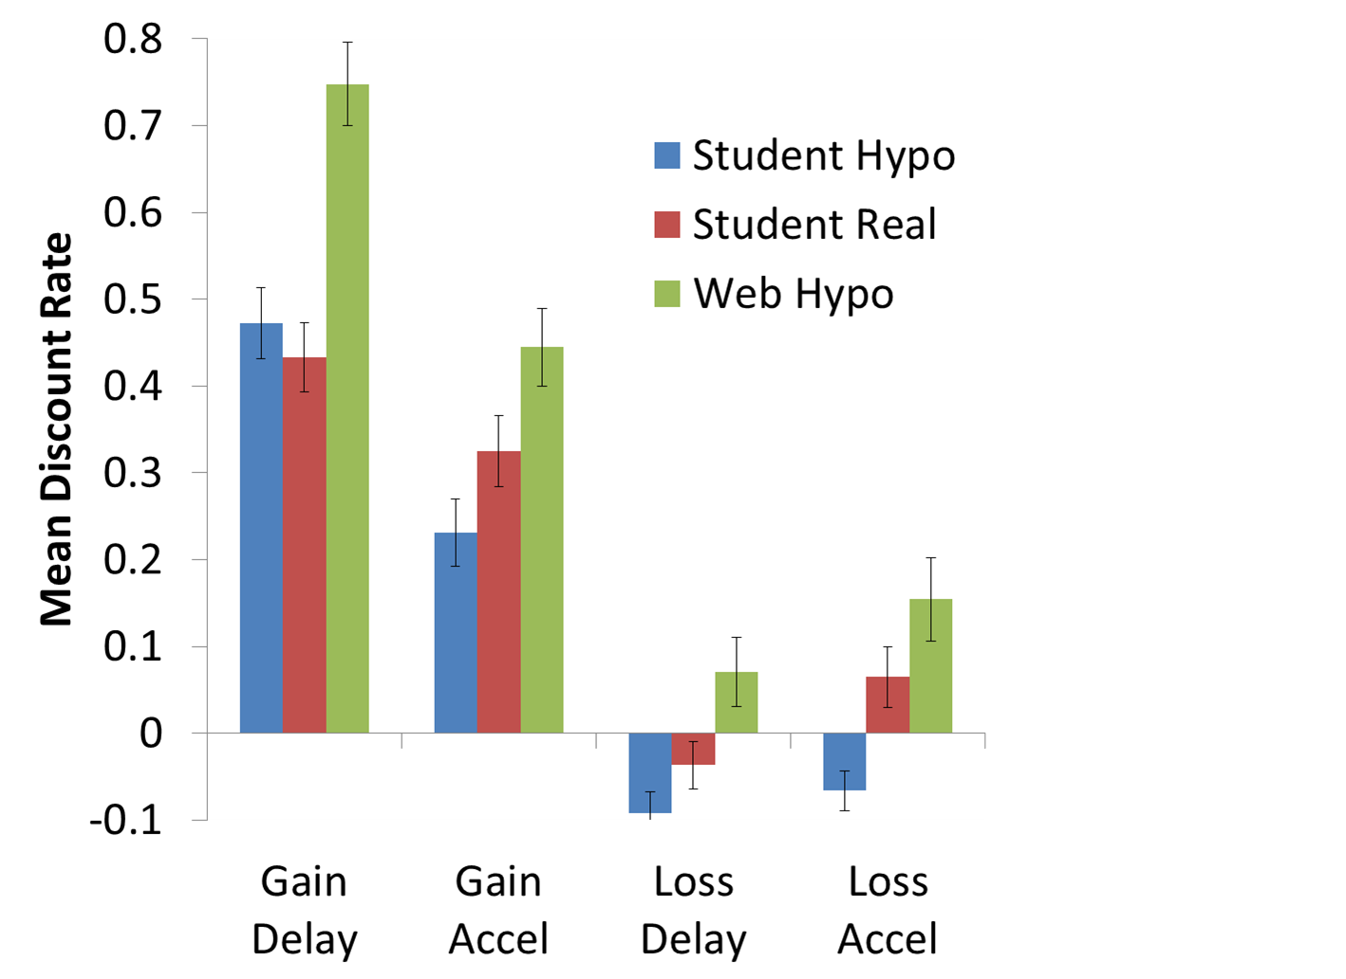
Real vs hypothetical small outcomes

Slide 70
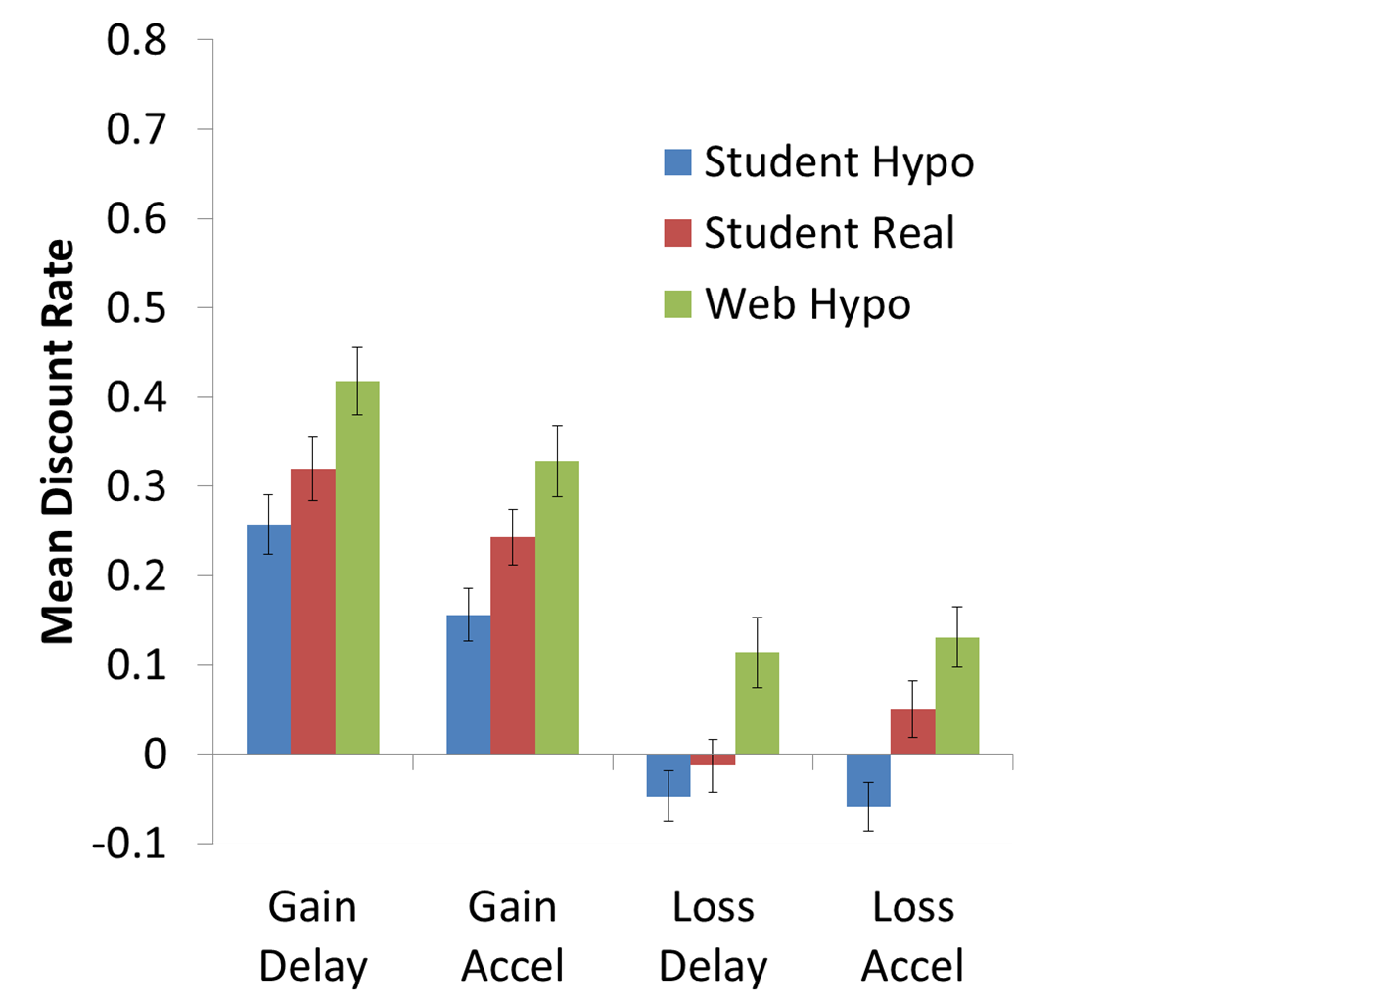
Real vs hypothetical medium outcomes

Slide 71
event | a | e | Corr(a,e) | c | beta (a) | beta (e)
a free 5-day vacation to the destination of your choice | 28 | 75 | .27** | .19 | -.40** | .00
eating a nice meal out at a restaurant | 28 | 59 | .42** | .29 | -.31** | .15
a kiss from the movie star of your choice | 22 | 46 | .38** | .32 | -.17* | .34**
receiving a good grade or performance review | 21 | 68 | .33** | .68 | -.22** | -.01
getting a gift in the mail from a family member | 21 | 64 | .43** | .49 | -.35** | .15
spending time with your best friend | 21 | 67 | .24** | .44 | -.21** | .14
watching your favorite TV show or reading a good book for an hour | 13 | 52 | .39** | .57 | -.27** | .18*
receiving a $50 check | 13 | 66 | .25** | .78 | -.17* | .04
improved energy and health for 10 days | 9 | 67 | .24** | .69 | -.31** | .12
winning the lottery | 6 | 83 | .20* | .79 | -.31** | .15*
doing difficult home cleaning and renovation for 5 days | -19 | -13 | .51** | .02 | -.36** | .32**
filling out paperwork and waiting around for an hour at the local Department of Motor Vehicles (DMV) | -26 | -35 | .43** | .11 | -.30** | .26**
paying a $50 fine | -27 | -39 | .39** | .02 | -.28** | .16
giving a stressful 60 minute improvised speech | -45 | -37 | .45** | -.10 | -.20* | .26**
being sick for 10 days | -47 | -65 | .28** | -.15 | -.32** | .22**
a painful dental procedure | -53 | -63 | .37** | .18 | -.44** | .39**
receiving a bad grade or performance review | -55 | -65 | .43** | .15 | -.38** | .31**
a confrontation with your co-worker or family member | -57 | -60 | .55** | .18 | -.35** | .32**
getting twenty painful (but harmless) electric shocks in a research experiment | -58 | -66 | .41** | .13 | -.36** | .33**
having one of your legs amputated | -63 | -86 | .31** | -.56 | -.24** | .33**

Slide 72
Typical Event Pair
Event | Anticipation | Experience | Choice (1=prefer now) | Regression Beta
receiving a good grade or performance review | 21 | 68 | .68 | -.22**
receiving a bad grade or performance review | -55 | -65 | .15 | -.38**

